Slide 1
RCUK Open Research Data Activities Research Sector Transparency Board May 2014
Mark Thorley
Natural Environment Research Council
mark.thorley@nerc.ac.uk

Slide 2

Open Data Dialogue
Publically funded data should be open, unless not in the public interest;
With private or co-funded data there was a right not to disclose, unless in the public interest;
Researchers should be allowed a short period of exclusive access to data to create value;
Personal data should be confidential, and consent gained for future use;
Anyone reusing public data should acknowledge the source;
Data openness should be governed through an independent group;
Data should be checked for inaccuracies before being made open;
Raw data should include full details explaining what the data relates to, how it was collected, who collected it, and how formatted.
See http://www.rcuk.ac.uk/Publications/policy/OpenData/
Notes:
The public identified 8 key principles that could be used to promote more effective open data policies. Defining the public interest was key in this context.

Slide 3
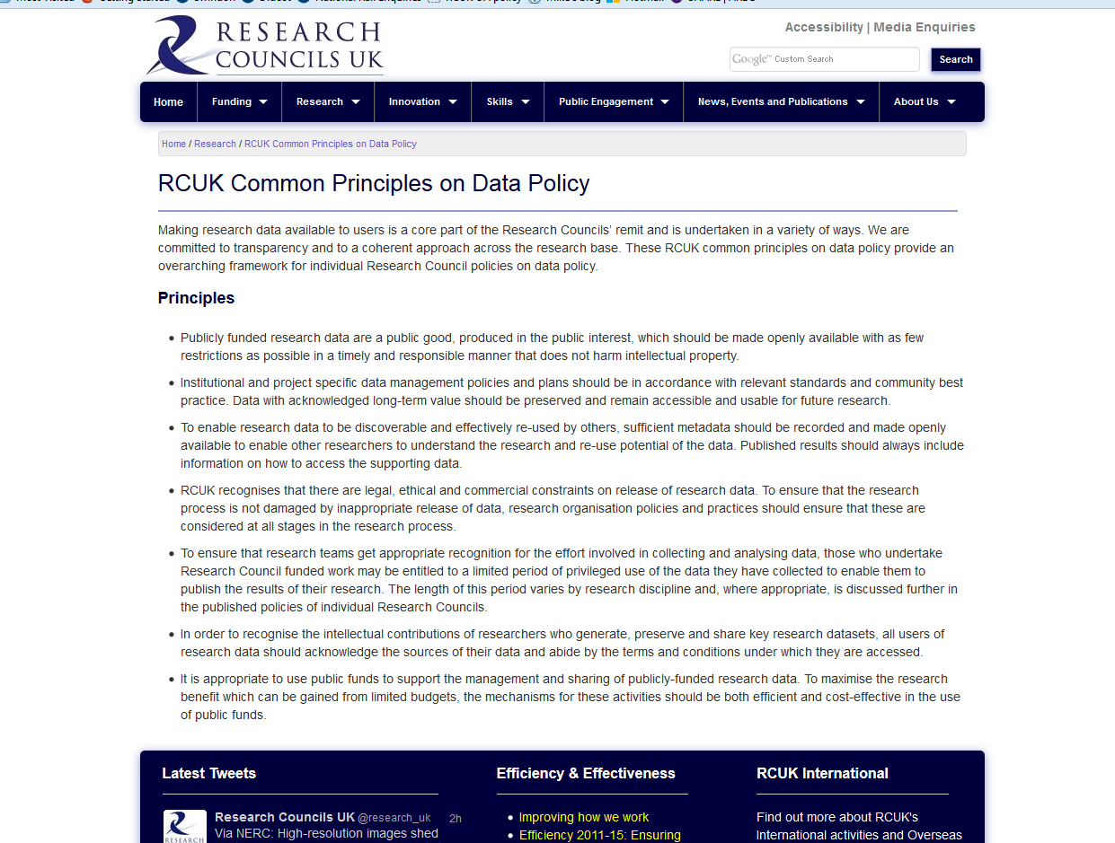
RCUK Common Principles on Data Policy
See http://www.rcuk.ac.uk/research/datapolicy/

Slide 4
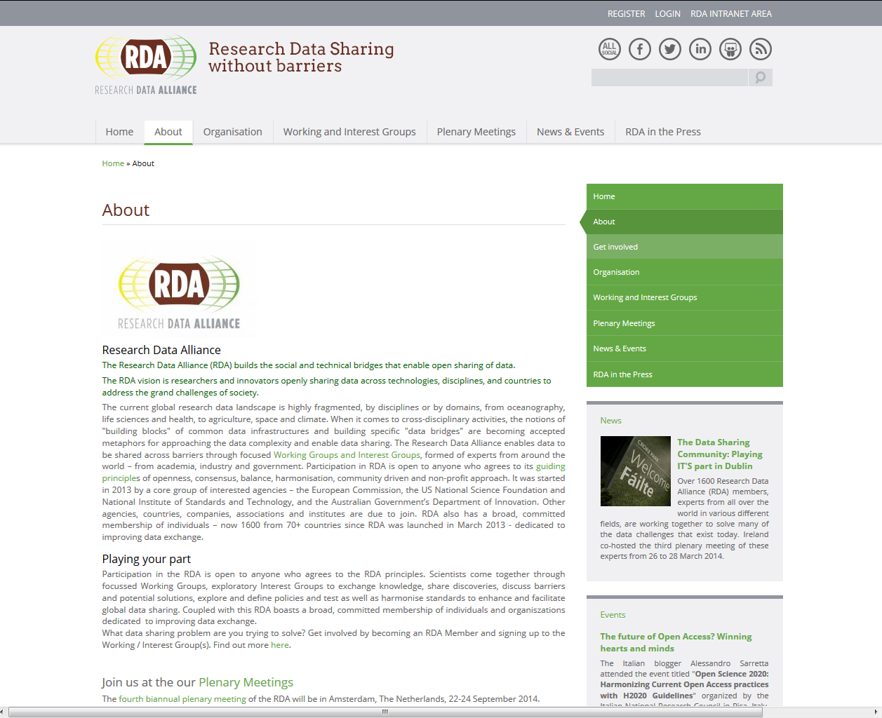
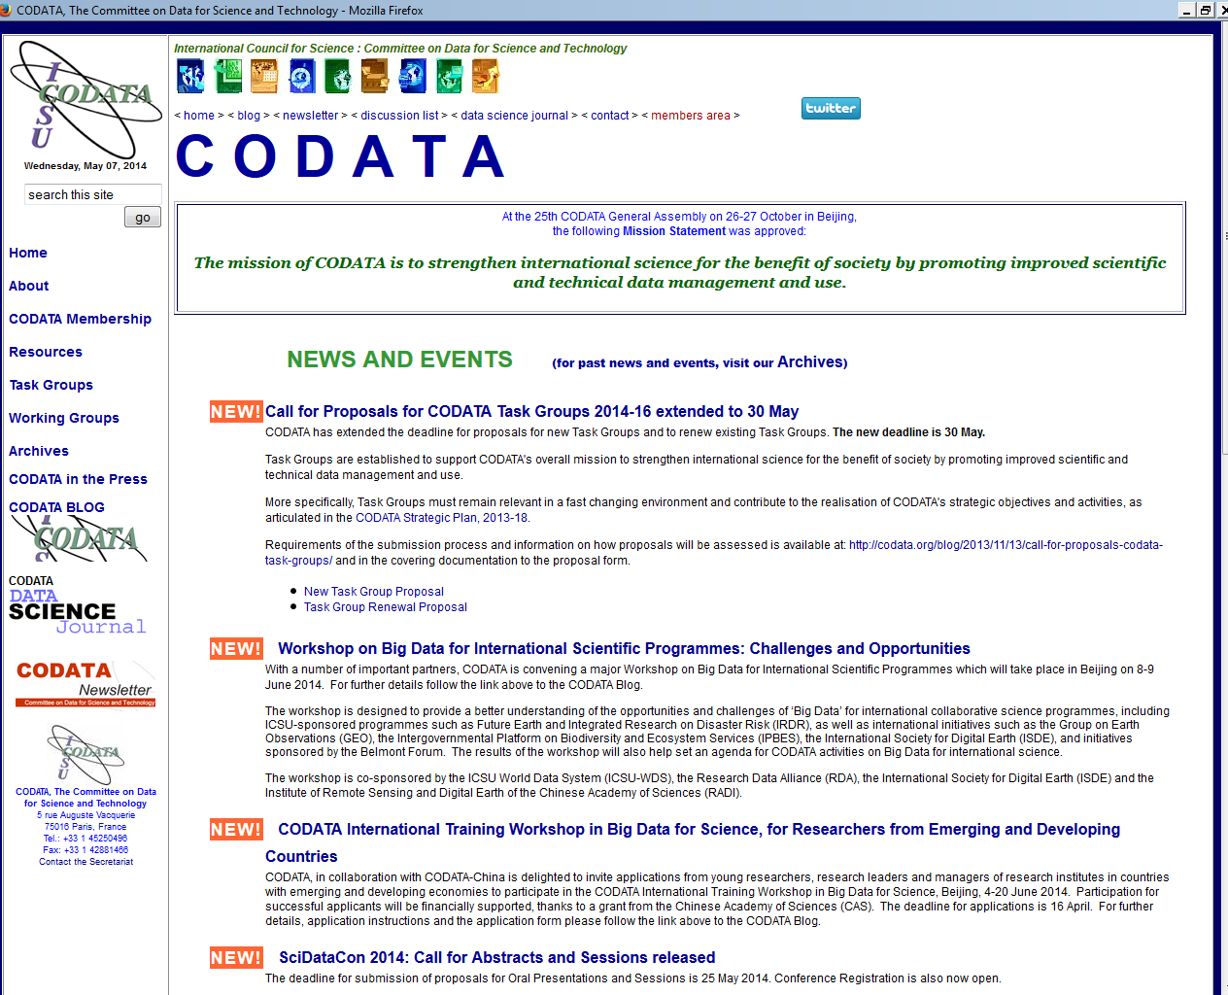
International Data Coordination

Slide 5

Innovation and Growth
Accessibility/outputs/methods and impacts
Big Data – analytics
Modelling
Value from data
Skills
Tools and Methods
Research problem domains
Open Research Data
Data transparency – RCUK policy
Using data across research domains
Data interoperability
Data repositories
Open access to publications and data
Ethics
Big Data Analytics
Multi-use skills and analytics across domains
E-Infrastructure
Multi-use technologies and methods
E-Infrastructure
Storage
Tools and Software
Advanced compute
Access (security/ models of access)

