Slide 1
Tuberculosis in the UK
2014 report
Tables and figures slide set

Slide 2
Tuberculosis case reports and rates, UK, 2004-2013
Source: Enhance Tuberculosis Surveillance (ETS), Enhanced Surveillance of Mycobacterial Infections (ESMI), Office for National Statistics (ONS)
Data as at: May 2014. Prepared by: TB Section, Centre for Infectious Disease Surveillance and Control, Public Health England

Slide 3
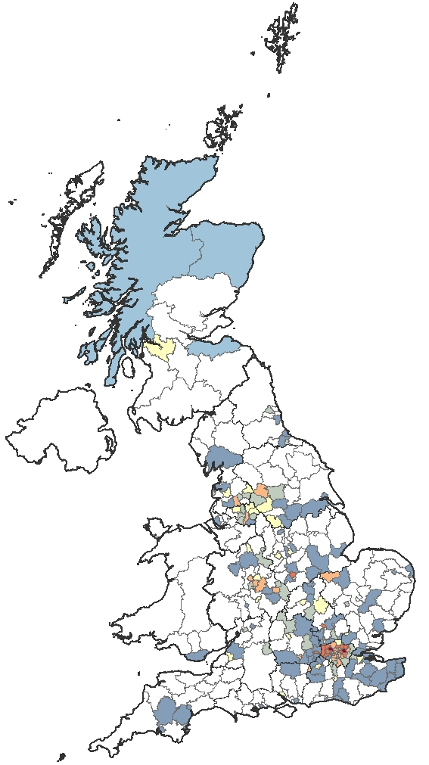
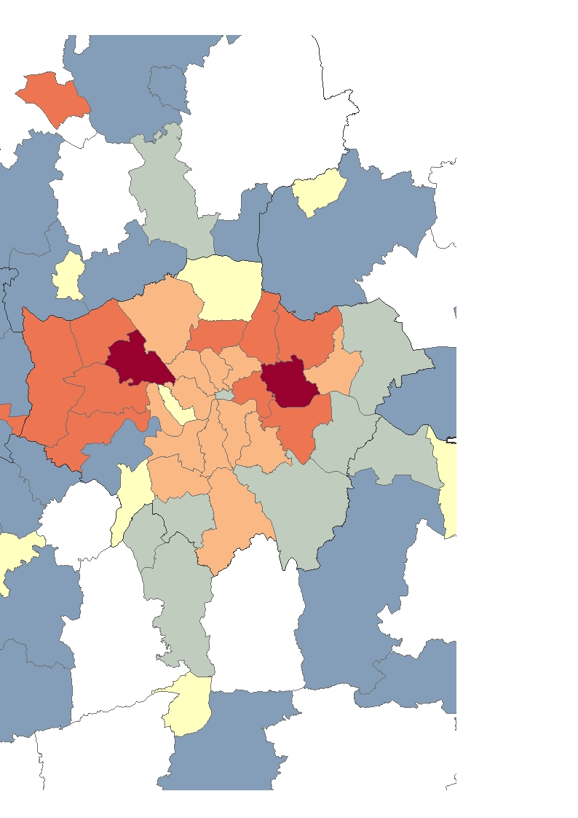
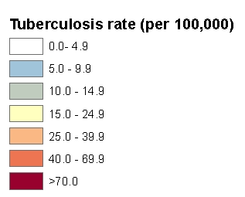
Three-year average tuberculosis case rates by local area*, UK, 2011-2013
*England – Local authorities, Wales and Scotland – Health Boards, NI – Country level
London
Source: Enhance Tuberculosis Surveillance (ETS), Enhanced Surveillance of Mycobacterial Infections (ESMI), Office for National Statistics (ONS)
Data as at: May 2014. Prepared by: TB Section, Centre for Infectious Disease Surveillance and Control, Public Health England
© Crown copyright and database rights 2014 Ordnance Survey 100016969

Slide 4
Tuberculosis case reports and rates by country, UK, 2013
Source: Enhance Tuberculosis Surveillance (ETS), Enhanced Surveillance of Mycobacterial Infections (ESMI), Office for National Statistics (ONS)
Data as at: May 2014. Prepared by: TB Section, Centre for Infectious Disease Surveillance and Control, Public Health England

Slide 5
Tuberculosis case reports and rates by PHE Centre,
England, 2013
Source: Enhance Tuberculosis Surveillance (ETS), Enhanced Surveillance of Mycobacterial Infections (ESMI), Office for National Statistics (ONS)
Data as at: May 2014. Prepared by: TB Section, Centre for Infectious Disease Surveillance and Control, Public Health England

Slide 6
Tuberculosis case reports & rates by age group & place of birth,
UK, 2013
Source: Enhance Tuberculosis Surveillance (ETS), Enhanced Surveillance of Mycobacterial Infections (ESMI),Labour Force Survey (LFS)
Data as at: May 2014. Prepared by: TB Section, Centre for Infectious Disease Surveillance and Control, Public Health England

Slide 7
Tuberculosis rate in UK born children (0-14 years old),
UK, 2004-2013
Source: Enhance Tuberculosis Surveillance (ETS), Enhanced Surveillance of Mycobacterial Infections (ESMI)
Data as at: May 2014. Prepared by: TB Section, Centre for Infectious Disease Surveillance and Control, Public Health England

Slide 8
Tuberculosis case reports & rates by place of birth, UK, 2004-2013
Source: Enhance Tuberculosis Surveillance (ETS), Enhanced Surveillance of Mycobacterial Infections (ESMI), Labour Force Survey (LFS)
Data as at: May 2014. Prepared by: TB Section, Centre for Infectious Disease Surveillance and Control, Public Health England

Slide 9
Most frequent countries of birth for non-UK born TB cases, UK, 2013
* Where country of birth was known; **Years
Source: Enhance Tuberculosis Surveillance (ETS), Enhanced Surveillance of Mycobacterial Infections (ESMI)
Data as at: May 2014. Prepared by: TB Section, Centre for Infectious Disease Surveillance and Control, Public Health England

Slide 10
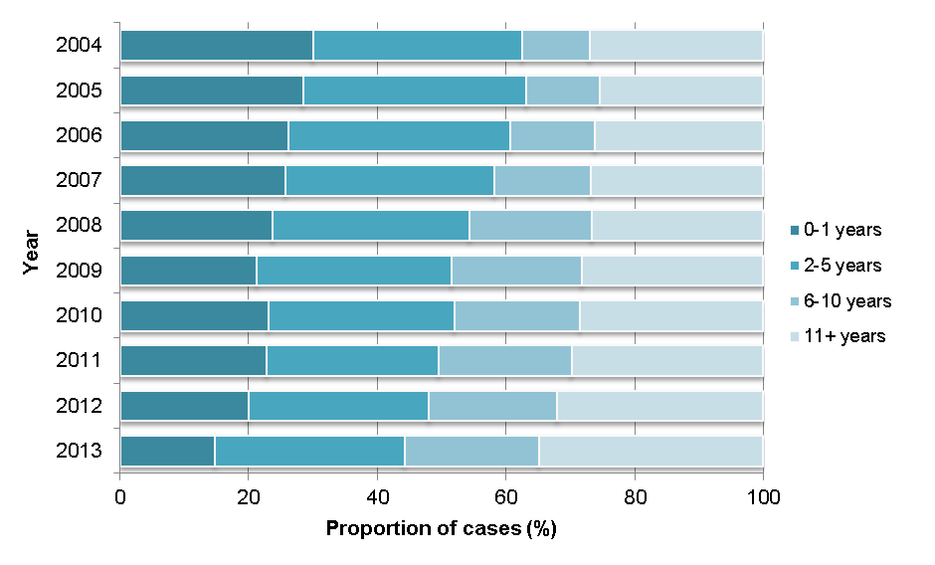
Time between entry to the UK & TB diagnosis for non-UK born TB cases by year, UK, 2013
Source: Enhance Tuberculosis Surveillance (ETS), Enhanced Surveillance of Mycobacterial Infections (ESMI), Office for National Statistics (ONS)
Data as at: May 2014. Prepared by: TB Section, Centre for Infectious Disease Surveillance and Control, Public Health England

Slide 11
Tuberculosis case reports & rates by ethnic group & place of birth, England, Wales and Northern Ireland, 2013
Source: Enhance Tuberculosis Surveillance (ETS), Enhanced Surveillance of Mycobacterial Infections (ESMI), Labour Force Survey (LFS)
Data as at: May 2014. Prepared by: TB Section, Centre for Infectious Disease Surveillance and Control, Public Health England

Slide 12
Proportion of TB cases by deprivation quintile residence, England, 2013
Source: Enhance Tuberculosis Surveillance (ETS), Enhanced Surveillance of Mycobacterial Infections (ESMI), Index of Multiple Deprivation (IMD 2010)
Data as at: May 2014. Prepared by: TB Section, Centre for Infectious Disease Surveillance and Control, Public Health England

Slide 13
Proportion of TB case reports by site of disease, UK, 2004-2013
* With or without extra-pulmonary disease
Source: Enhance Tuberculosis Surveillance (ETS), Enhanced Surveillance of Mycobacterial Infections (ESMI)
Data as at: May 2014. Prepared by: TB Section, Centre for Infectious Disease Surveillance and Control, Public Health England

Slide 14
Tuberculosis case reports by site of disease, UK, 2013
*With or without disease at another site
**Percentage of cases with known site of disease (8751)
±For Scotland cases, this includes both cryptic and miliary site
CNS-Central Nervous System
Total percentage exceeds 100% due to infections at more than one site
Source: Enhance Tuberculosis Surveillance (ETS), Enhanced Surveillance of Mycobacterial Infections (ESMI)
Data as at: May 2014. Prepared by: TB Section, Centre for Infectious Disease Surveillance and Control, Public Health England

Slide 15
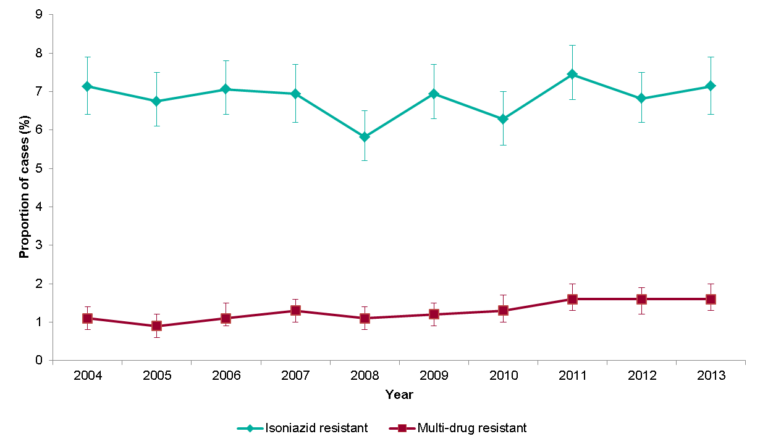
Proportion of TB cases with isoniazid resistance or MDR-TB,
UK, 2004-2013
Source: Enhance Tuberculosis Surveillance (ETS), Enhanced Surveillance of Mycobacterial Infections (ESMI)
Data as at: May 2014. Prepared by: TB Section, Centre for Infectious Disease Surveillance and Control, Public Health England

Slide 16
Number & proportion of TB cases with drug resistance by age group,
UK, 2013
Source: Enhance Tuberculosis Surveillance (ETS), Enhanced Surveillance of Mycobacterial Infections (ESMI)
Data as at: May 2014. Prepared by: TB Section, Centre for Infectious Disease Surveillance and Control, Public Health England

Slide 17
Proportion of TB cases with drug resistance by previous history of TB, UK, 2013
Source: Enhance Tuberculosis Surveillance (ETS), Enhanced Surveillance of Mycobacterial Infections (ESMI)
Data as at: May 2014. Prepared by: TB Section, Centre for Infectious Disease Surveillance and Control, Public Health England

Slide 18
Most frequent countries of birth of non-UK born TB cases with drug resistance, UK, 2013
* The table shows the top ten countries of birth for the number of isoniazid resistant cases and MDR-TB cases in 2013. For these countries, the total number of cases and proportions with resistance are shown.
**Culture confirmed cases with DST results for at least isoniazid and rifampicin
Source: Enhance Tuberculosis Surveillance (ETS), Enhanced Surveillance of Mycobacterial Infections (ESMI)
Data as at: May 2014. Prepared by: TB Section, Centre for Infectious Disease Surveillance and Control, Public Health England

Slide 19
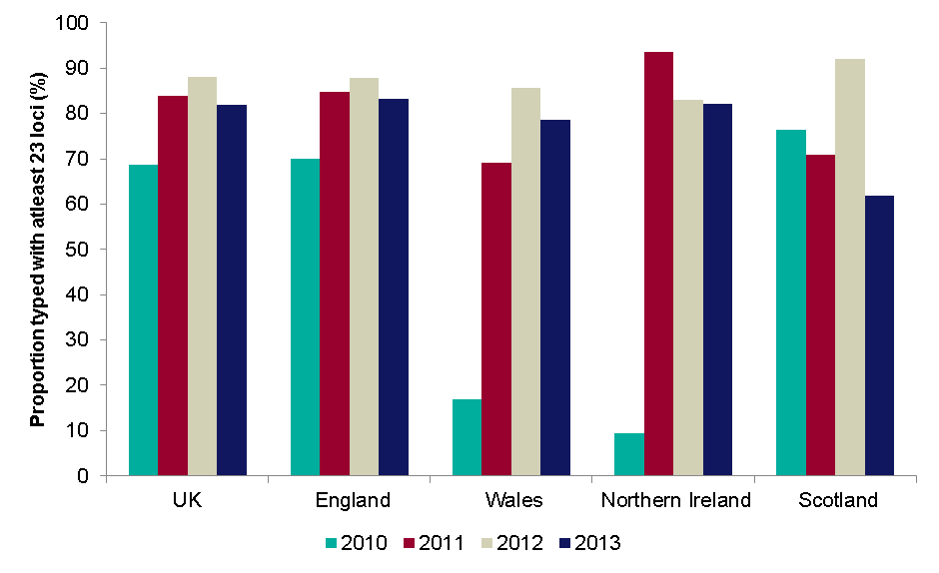
Proportion of culture confirmed TB cases with ≥ 23 loci typed by country, 2010-2013
Source: Enhance Tuberculosis Surveillance (ETS), Enhanced Surveillance of Mycobacterial Infections (ESMI)
Data as at: May 2014. Prepared by: TB Section, Centre for Infectious Disease Surveillance and Control, Public Health England
19 Tuberculosis in the UK: 2013 report

Slide 20
Number of TB clusters and proportion clustered by country,
2010-2013
* Culture confirmed cases with a MIRU-VNTR profile with at least 23 complete loci
** Clustered cases are clustered with each other within the same geographical area
‡ The number of cases clustered in the UK is lower than the sum of all clustered cases in the four countries because it includes clusters that span more than one country. The number of clusters in the UK is higher than the sum of all clusters in the four countries because it includes clusters that span more than one country.
Source: Enhance Tuberculosis Surveillance (ETS), Enhanced Surveillance of Mycobacterial Infections (ESMI)
Data as at: May 2014. Prepared by: TB Section, Centre for Infectious Disease Surveillance and Control, Public Health England

Slide 21
Proportion of TB clusters by size, 2010-2013
Source: Enhance Tuberculosis Surveillance (ETS), Enhanced Surveillance of Mycobacterial Infections (ESMI)
Data as at: May 2014. Prepared by: TB Section, Centre for Infectious Disease Surveillance and Control, Public Health England

Slide 22
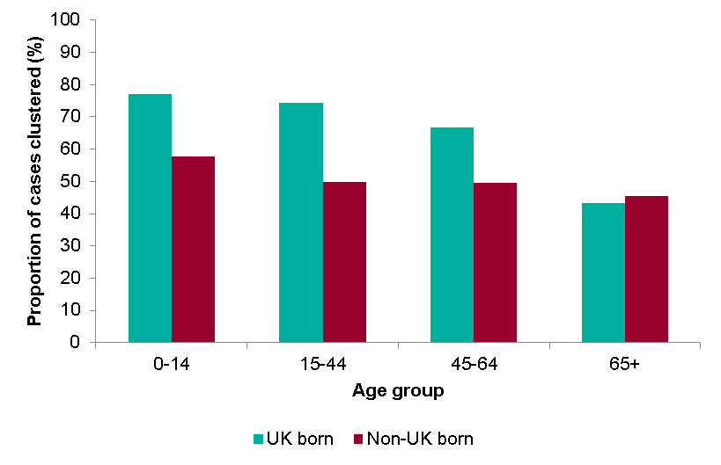
Proportion of TB cases that clustered by age and place of birth, UK, 2010-2013
Source: Enhance Tuberculosis Surveillance (ETS), Enhanced Surveillance of Mycobacterial Infections (ESMI)
Data as at: May 2014. Prepared by: TB Section, Centre for Infectious Disease Surveillance and Control, Public Health England

Slide 23
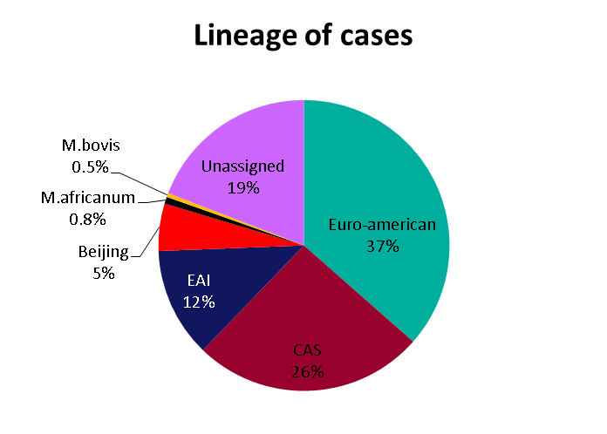
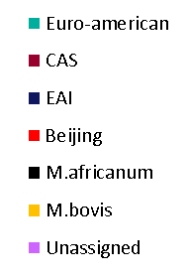
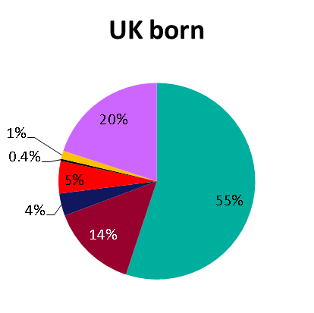
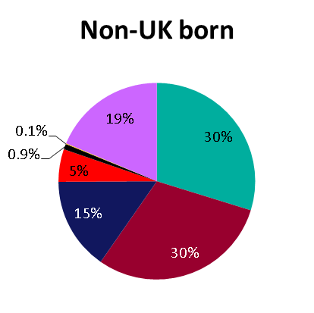
Lineage of TB cases with MIRU-VNTR strain types, 2010-2013*
n=4,088
n=11,909
*as determined by MIRU-VNTR
Source: Enhance Tuberculosis Surveillance (ETS), Enhanced Surveillance of Mycobacterial Infections (ESMI)
Data as at: May 2014. Prepared by: TB Section, Centre for Infectious Disease Surveillance and Control, Public Health England

Slide 24
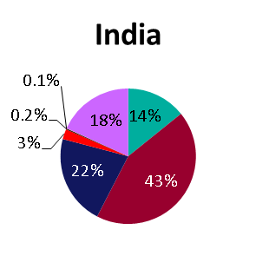
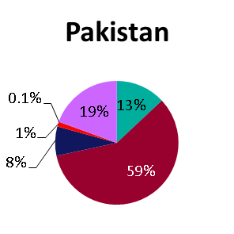
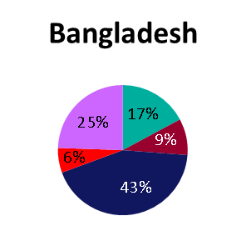
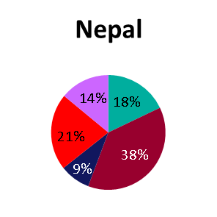
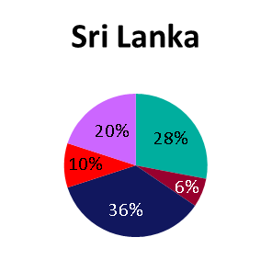
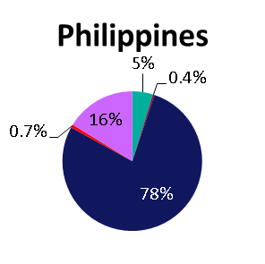
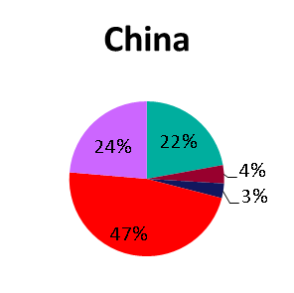
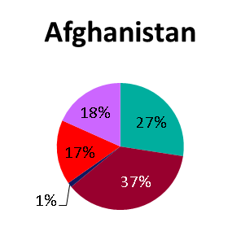
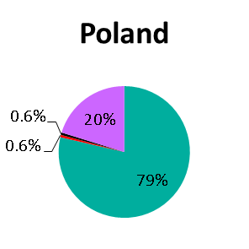
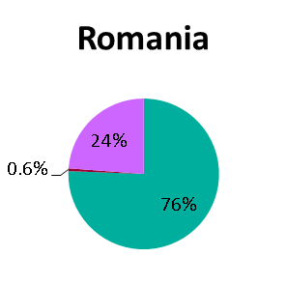
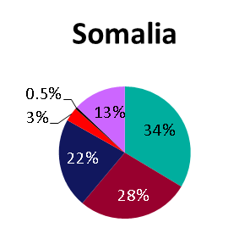
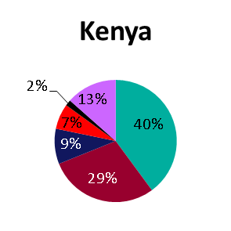
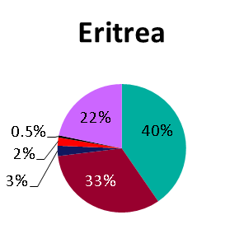
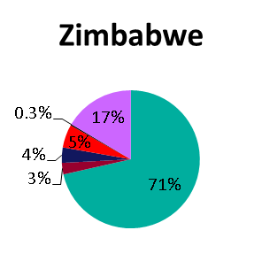
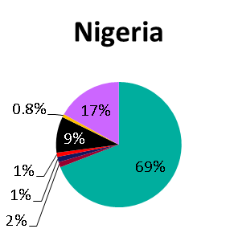
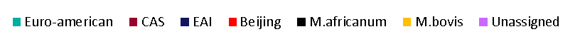
Lineage of TB cases with MIRU-VNTR strain types* by country of birth**, UK, 2010-2013
n=3,397
n=1,910
n=454
n=463
n=200
n=271
n=131
n=164
n=173
n=168
n=795
n=193
n=193
n=333
n=366
*as determined by MIRU-VNTR **top 15 countries of birth by burden of TB in the UK
Source: Enhance Tuberculosis Surveillance (ETS), Enhanced Surveillance of Mycobacterial Infections (ESMI)
Data as at: May 2014. Prepared by: TB Section, Centre for Infectious Disease Surveillance and Control, Public Health England

Slide 25
TB outcome at 12 months for drug sensitive TB cases with expected treatment duration <12 months*, UK, 2012
* Excludes initial and amplified to rifampicin resistant TB and MDR-TB cases and MDR-TB treated cases and those with CNS, spinal, miliary or cryptic disseminated TB
** Not evaluated includes missing, unknown and transferred out
Source: Enhance Tuberculosis Surveillance (ETS), Enhanced Surveillance of Mycobacterial Infections (ESMI)
Data as at: May 2014. Prepared by: TB Section, Centre for Infectious Disease Surveillance and Control, Public Health England

Slide 26
Treatment completion at 12 months for drug sensitive TB cases with expected treatment duration <12 months*, UK, 2003-2012
* Excludes initial and amplified to rifampicin resistant TB and MDR-TB cases and MDR-TB treated cases and those with CNS, spinal, miliary or cryptic disseminated TB
Source: Enhance Tuberculosis Surveillance (ETS), Enhanced Surveillance of Mycobacterial Infections (ESMI)
Data as at: May 2014. Prepared by: TB Section, Centre for Infectious Disease Surveillance and Control, Public Health England

Slide 27
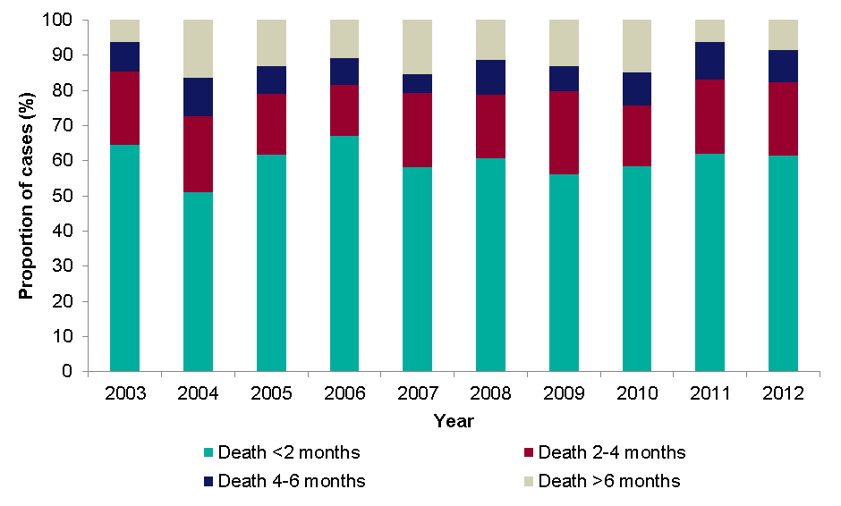
Time between start of treatment & death for drug sensitive TB cohort*, UK, 2003-2012
* Excludes initial and amplified to rifampicin resistant TB and MDR-TB cases and MDR-TB treated cases
Source: Enhance Tuberculosis Surveillance (ETS), Enhanced Surveillance of Mycobacterial Infections (ESMI)
Data as at: May 2014. Prepared by: TB Section, Centre for Infectious Disease Surveillance and Control, Public Health England

Slide 28
TB outcome at 24 months for drug resistant cohort, UK, 2011*
*Excludes initial and amplified to rifampicin resistant TB and MDR-TB cases and MDR-TB treatment cases
** Not evaluated includes missing, unknown and transferred out

Slide 29
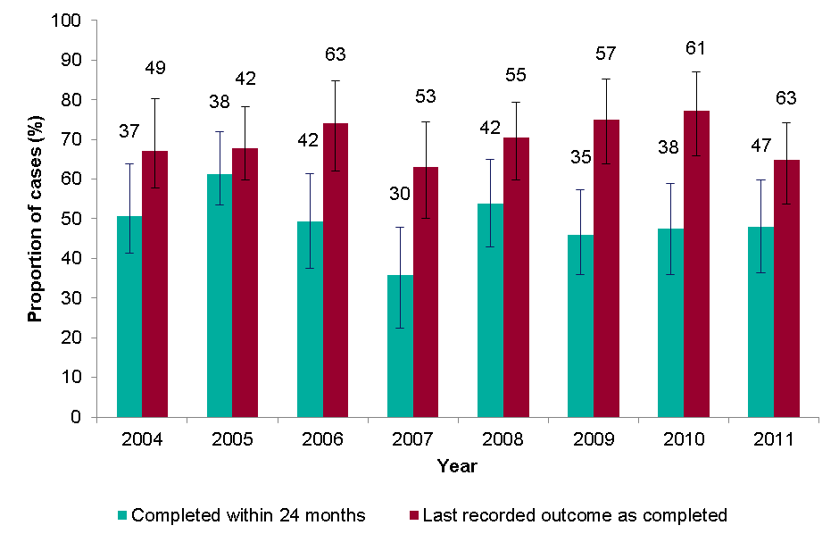
Treatment completion for drug resistant TB cases, UK, 2004-2011*
* Includes initial and amplified to rifampicin resistant TB and MDR-TB cases and MDR-TB treatment cases only
Data labels display the number of cases completing treatment

