Slide 1
Efficiency and Reform Half Year: 2013/14
Thursday 7 November 2013

Slide 2
Agenda
08:30 Welcome
Katharine Davidson, Director of Strategy, Efficiency and Reform Group
08:35 H1 Savings
Rt Hon. Francis Maude MP, Minister for the Cabinet Office and Paymaster General
08:45 UK Growth
Sajid Javid MP, Financial Secretary to the Treasury
08:55 Financials and Forward Look
Stephen Kelly, Chief Operating Officer, UK Government
09:10 Q&A Panel
Rt Hon. Francis Maude MP, Minister for the Cabinet Office and Paymaster General
Stephen Kelly, Chief Operating Officer, UK Government
Bill Crothers, Chief Procurement Officer, UK Government
Katharine Davidson, Director of Strategy, Efficiency and Reform Group
Mike Bracken, Director, Government Digital Service
2
2
Efficiency and Reform H1 Progress Report 7 November 2013
Efficiency and Reform H1 Progress Report 7 November 2013
Efficiency and Reform H1 Progress Report 7 November 2013
Efficiency and Reform H1 Progress Report 7 November 2013
Follow us on twitter #GovSavings
Follow us on twitter #GovSavings
#GovSavings

Slide 3
Rt. Hon. Francis Maude MP Minister for the Cabinet Office and Paymaster General

Slide 4
Fiscal consolidation is underway but we must do more to balance the books
% of GDP
Source: Office for Budget Responsibility: Economic and Fiscal Outlook March 2013
4
4
4
Efficiency and Reform H1 Progress Report 7 November 2013
Efficiency and Reform H1 Progress Report 7 November 2013
Efficiency and Reform H1 Progress Report 7 November 2013
Efficiency and Reform H1 Progress Report 7 November 2013
Follow us on twitter #GovSavings
Follow us on twitter #GovSavings
#GovSavings
Notes:
Growth at 0.8%

Slide 5
Our initiatives focus on the £93bn spent on pay, pensions and procurement in central Government. We also work to reduce benefit fraud and error
Financial Payments Accounting and Adjustments
Pay and Pensions
£ Billions
(Including central Government, & military pay & pensions administrated by central Government)
73
54
Procurement
39
(Within central Government administration control)
209
300
Welfare and State Pension Payments
Payment to Other Bodies
100% = £673bn
Note: Figures may not sum due to rounding
Source: QDS 2012/13 Full Year Expenditure, 2012 Budget Data, 2012/3 Full Year OSCAR Mgt Accounts, OBR Economic and Fiscal Outlook 2013
5
5
5
Efficiency and Reform H1 Progress Report 7 November 2013
Efficiency and Reform H1 Progress Report 7 November 2013
Efficiency and Reform H1 Progress Report 7 November 2013
Follow us on twitter #GovSavings
Follow us on twitter #GovSavings
Follow us on twitter #GovSavings
#GovSavings

Slide 6
In 2012/13 we saved £10 billion and prevented £6.5 billion in losses through our Fraud, Error and Debt programme
1.7
6.5
1.1
1.7
16.5
3.4
10
10
5.5
3.75
Note: Saving figures compared to 2009/10 baseline
Source: ERG Performance and Planning Team
6
6
Efficiency and Reform H1 Progress Report 7 November 2013
Efficiency and Reform H1 Progress Report 7 November 2013
Efficiency and Reform H1 Progress Report 7 November 2013
Follow us on twitter #GovSavings
Follow us on twitter #GovSavings
#GovSavings

Slide 7
Today, we are announcing first half savings of £5.4bn – a year on year increase of 73%
Stretch Target
£15bn+
(incl FED)
12.5
Forecast Savings
(excl FED)
Note: Saving figures compared to 2009/10 baseline. Figure at H1 2013/14 is unaudited. Stretch target includes savings arising from reductions in Fraud, Error and Debt (FED) Source: ERG Performance and Planning Team
7
7
Efficiency and Reform H1 Progress Report 7 November 2013
Efficiency and Reform H1 Progress Report 7 November 2013
Efficiency and Reform H1 Progress Report 7 November 2013
Follow us on twitter #GovSavings
Follow us on twitter #GovSavings
#GovSavings

Slide 8
We are transforming public services, making them easier to use and cheaper to operate...
8
8
Efficiency and Reform H1 Progress Report 7 November 2013
Efficiency and Reform H1 Progress Report 7 November 2013
Efficiency and Reform H1 Progress Report 7 November 2013
Follow us on twitter #GovSavings
Follow us on twitter #GovSavings
#GovSavings

Slide 9
...and creating joint ventures with our suppliers
Shared Services Connected Limited
75% Share
25% Share
9
9
9
Efficiency and Reform H1 Progress Report 7 November 2013
Efficiency and Reform H1 Progress Report 7 November 2013
Efficiency and Reform H1 Progress Report 7 November 2013
Follow us on twitter #GovSavings
Follow us on twitter #GovSavings
#GovSavings

Slide 10
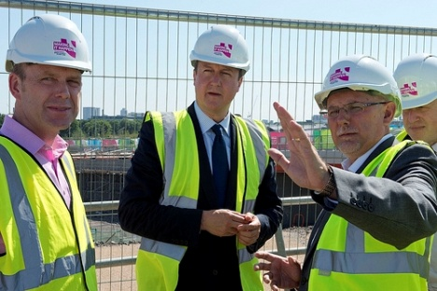
To achieve £20bn in efficiency savings by the end of 2014/15 we are reforming public services
Crown Commercial Service
Digital
Major Projects
Restructure Civil Service
10
10
10
10
Efficiency and Reform H1 Progress Report 7 November 2013
Efficiency and Reform H1 Progress Report 7 November 2013
Efficiency and Reform H1 Progress Report 7 November 2013
Follow us on twitter #GovSavings
Follow us on twitter #GovSavings
#GovSavings

Slide 11
Sajid Javid MP Financial Secretary to the Treasury

Slide 12
We have published contract pipelines of £169 billion to make it easier for suppliers to work with public bodies
Construction
£109bn
Energy and utilities
£9bn
Property and facilities management
£4.5bn
Welfare to Work
£4.8bn
Probation and Offenders Services
£2.6bn
Professional Services
£5bn
Office solutions
£2.6bn
Financial Services
£12.1bn
Clinical and medical life sciences
£7.9bn
Information
and Communication Technologies
£5.7bn
Vehicles
£2.1bn
12
12
Efficiency and Reform H1 Progress Report 7 November 2013
Efficiency and Reform H1 Progress Report 7 November 2013
Follow us on twitter #GovSavings
#GovSavings

Slide 13
We are supporting UK innovation by working with SMEs
13
13
Efficiency and Reform H1 Progress Report 7 November 2013
Efficiency and Reform H1 Progress Report 7 November 2013
Follow us on twitter #GovSavings
#GovSavings

Slide 14
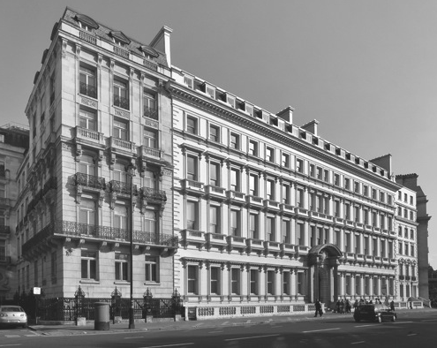
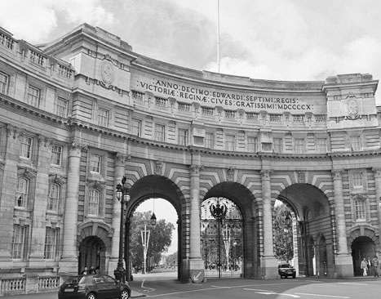
Rationalising our property holdings will save money, support the construction industry, and create jobs
14
14
Efficiency and Reform H1 Progress Report 7 November 2013
Efficiency and Reform H1 Progress Report 7 November 2013
Follow us on twitter #GovSavings
#GovSavings

Slide 15
Stephen Kelly Chief Operating Officer, UK Government

Slide 16
Savings have been achieved by exercising spending controls, buying more efficiently and reducing the Civil Service workforce
Source: ERG Performance and Planning Team
Note: Saving figures compared to 2009/10 baseline . Totals are not directly comparable to 2012/13 figures because of changes to savings categories
16
16
Efficiency and Reform H1 Progress Report 7 November 2013
Efficiency and Reform H1 Progress Report 7 November 2013
Follow us on twitter #GovSavings
#GovSavings

Slide 17
By the end of 2013/14 we will have launched another joint venture for shared services...
Transformation
H1 2013/14 Savings
By the end of 2013/14 we will have...
1 | A live Independent Shared Service Centre 2
2 | Launched an Identity Assurance service with HMRC and DVLA
3 | Exited 260,000 SqM of Government property
0.6
100% = £5.4bn
17
17
Efficiency and Reform H1 Progress Report 7 November 2013
Efficiency and Reform H1 Progress Report 7 November 2013
Follow us on twitter #GovSavings
#GovSavings

Slide 18
...have worked with departments to assure projects with a total whole life cost of over £350bn...
Projects
H1 2013/14 Savings
By the end of 2013/14 we will have...
1 | Undertaken 180 assurance activities on major projects
2 | Delivered at least £700m of savings by reducing construction costs
3 | 50 graduates from the Major Projects Leadership Academy
0.7
100% = £5.4bn
18
18
Efficiency and Reform H1 Progress Report 7 November 2013
Efficiency and Reform H1 Progress Report 7 November 2013
Follow us on twitter #GovSavings
#GovSavings

Slide 19
...established a Crown Commercial Service...
Commercial
H1 2013/14 Savings
By the end of 2013/14 we will have...
1 | DfT and DWP spend transitioned into the new CCS
2 | Saved at least £1bn through better commercial practices
1.8
100% = £5.4bn
19
19
Efficiency and Reform H1 Progress Report 7 November 2013
Efficiency and Reform H1 Progress Report 7 November 2013
Follow us on twitter #GovSavings
#GovSavings

Slide 20
...and reduced the size of the Civil Service by 84,000 FTE
Workforce and Pensions
H1 2013/14 Savings
By the end of 2013/14 we will have...
1 | Saved £2.3bn by increasing employee pension contributions
2 | Reduced the Civil Service by 84,000 people since 2010
2.3
100% = £5.4bn
20
20
Efficiency and Reform H1 Progress Report 7 November 2013
Efficiency and Reform H1 Progress Report 7 November 2013
Follow us on twitter #GovSavings
#GovSavings

Slide 21
You are invited to attend three follow up ‘Deep Dive’ sessions:
Date | Session
4th December | Business Models
8th January | Crown Commercial Service
5th February | Fraud, Error and Debt
21
21
21
Efficiency and Reform H1 Progress Report 7 November 2013
Efficiency and Reform H1 Progress Report 7 November 2013
Efficiency and Reform H1 Progress Report 7 November 2013
Follow us on twitter #GovSavings
#GovSavings

Slide 22
Our mission is to....
Deliver better public services at lower costs
Save £20bn a year by March 2015
Support UK business and growth
1
2
3
22
22
22
Efficiency and Reform H1 Progress Report 7 November 2013
Efficiency and Reform H1 Progress Report 7 November 2013
Follow us on twitter #GovSavings
#GovSavings

Slide 23
Q&A Panel Members
Rt Hon. Francis Maude MP
Minister for the Cabinet Office and Paymaster General
Stephen Kelly
Chief Operating Officer, UK Government
Bill Crothers
Chief Procurement Officer, UK Government
Katharine Davidson
Director of Strategy, Efficiency and Reform Group
Mike Bracken
Director, Efficiency and Reform Group
23
23
23
Efficiency and Reform H1 Progress Report 7 November 2013
Efficiency and Reform H1 Progress Report 7 November 2013
Follow us on twitter #GovSavings
#GovSavings

