Slide 1
Offtaker of Last Resort Consultation Event
3 March 2014

Slide 2
Session One: Offtaker of Last Resort Rationale, aims and objectives

Slide 3
The current market situation
Lenders usually require generators to have a PPA with a credit-worthy counterparty before they will provide debt finance, as it provides them with a secure price for power.
If independent generators cannot secure PPAs, they struggle to finance and develop projects, reducing competition and increasing costs to consumers.
Independent renewable developers currently face difficulties in securing bankable long-term PPAs because:
Offtakers are reluctant to offer price floors within long-term PPAs;
The closure of the Renewables Obligation to new entrants from 2017 appears to me making large utilities more cautious when contracting for ROCs
Views of the future costs and risks of managing a PPA (such as balancing costs), are making offtakers relatively reluctant to offer PPAs, and are resulting in higher PPA discounts where they are offered.

Slide 4
Contracts for Difference will help…
Many of the issues that have been identified in the market at present will be addressed through the Contract for Difference (CfD):
CfD pays a variable ‘top-up’ to developers, which combined with the variable power price provides a stable price
It therefore removes long-term price risk from the generator and thus the requirement for price floors or fixed prices in PPAs in order to satisfy financiers that there will be a minimum wholesale price received for electricity generated.
PPA providers also no longer need to value and market ROCs through PPAs

Slide 5
…but some risks remain
There were three issues raised in responses to our Call for Evidence last year, which may present challenges for independent generators under the CfD:
Lack of competition within the Long-term PPA market. If lenders continue to require generators to have long term PPAs with well-capitalised creditworthy offtakers, who have a strategic interest and long term presence in the GB electricity market.
Long-term route-to-market risks (including imbalance costs) which are difficult to price accurately. The combination of increasing intermittency, higher likelihood of system imbalance and regulatory uncertainty means that lenders are pricing a higher risk premium in the PPAs being offered.
The switch to the CfD creates transitional uncertainty and caution for lenders and offtakers. We have been working with generators and offtakers as part of a Market Readiness Group to address this, developing a sample PPA structure compatible with the CfD, as well as best practise guidelines for securing a PPA.

Slide 6
The Aims of the Offtaker of Last Resort
In order to address the long-term route to market risks and the lack of competition within the long-term PPA market, we are proposing to introduce the Offtaker of Last Resort.
The Offtaker of Last Resort will provide renewable CfD generators with a guaranteed, 'backstop' route-to-market for their power: a Backstop PPA.
The Offtaker of Last Resort aims to:
Open up route to market opportunities for independent generators;
Reduce the cost of investment in renewable electricity generation; and
Boost competition and thereby lower costs to consumers.

Slide 7
The Aims of Today
Present our proposed design for the Offtaker of Last Resort
Provide an opportunity for you to ask questions
Gather your initial views on our design proposals
Please note that this event is no substitute for submitting your views in written form through our consultation.

Slide 8
A Word on Competition Law
This event should be conducted in full accordance with competition regulations. Participants should not share commercially sensitive information, such as:
The value to a company of any particular OLR design detail;
Any specific financial or other data, inputs or assumptions used in any model, investment appraisal, forecast or analysis;
Individual output, capacity and production plans;
Prices, pricing strategy, profits, profit margins, cost information, and market trends, market shares and marketing policy;
Supplier details, contracting strategies, contract terms or contract tenders;
Credit terms and credit limits;
Individual investment or technical development; or
Individual business plans or strategies.
If you feel at any point that discussions might be in danger of restraining or distorting competition, please alert the chair and seek to terminate the discussion.

Slide 9
Session Two: Generator Eligibility, Offtaker Identity, Access and Allocation

Slide 10
Offtaker of last resort – outline design
Generators have a right to a ‘Backstop PPA’
Eligible generators have a right to a ‘backstop PPA’ enshrined in regulations and supply licence conditions. Terms grandfathered from the point of CfD signature
Provides a guaranteed route to market at a fixed discount to the market price; when combined with CfD top up, it creates a fixed price per MWh
Fixed discount set to be larger than discounts expected to be available in the market, to ensure it is a genuine ‘last resort’ – so fixed price, but significantly below the strike price
Effectively ‘caps’ generators’ long term route to market costs (eg imbalance/basis risk)
Gives greater flexibility to developers to choose the contracting structure and counterparty which best suits their appetite for risk
Backstop PPAs are 1yr in length, with a minimum tenor of 6 months
Obligation on suppliers to bid for backstop PPAs
Offtakers are competitively allocated backstop generators, by bidding a management fee
Certain suppliers mandated to bid; other suppliers can do so voluntarily
Credit-worthiness: ensured by credit rating or letter of credit requirements?
Management fees levelised across suppliers
Management fees bid by backstop offtaker are levelised across all suppliers through a levelisation process

Slide 11
Eligibility and Offtaker Identity
Eligibility
All Renewable CfD holders including IC holders
Considering splitting output from generators with capacity above 100MW across multiple offtakers
Offtaker Identity
Largest suppliers (those that supply more than [X]% of GB electricity) are mandated to submit bids to manage each Backstop PPA.
Duty on SoS to review the threshold if it appears that no supplier would exceed it.
Other licenced suppliers are able to voluntarily submit bids, subject to any credit requirements

Slide 12
Access
Access
Few fetters on access. Generators’ eligibility for further Backstop PPAs is lost if:
a Backstop PPA is terminated by offtaker for ‘material breach’, or
if they terminate a Backstop PPA early without the required notice
Generators are able to enter into a Backstop PPA at any point during their CfD (once payments have started)
However, initial delay to enable Ofgem to get their systems in place: earliest access to a Backstop PPA is in early 2016
Considering requirement for information provision

Slide 13
Allocation
Allocation
Backstop PPA is allocated to an offtaker competitively – they bid a management fee £/MWh. Contract allocated to the lowest bidder.
Mandatory offtakers are required to submit bids for each Backstop PPA.
Ofgem to allocate within five weeks of generator expressing an interest in a Backstop PPA. Contract comes into force a week later: six weeks after notifying Ofgem.
Allocation initially via sealed bid, could move to monthly auction if Ofgem judged this would be in consumers’ interest.
Potential to use mutualisation provisions to compensate generator in the event that Ofgem fails to allocate within five weeks.

Slide 14
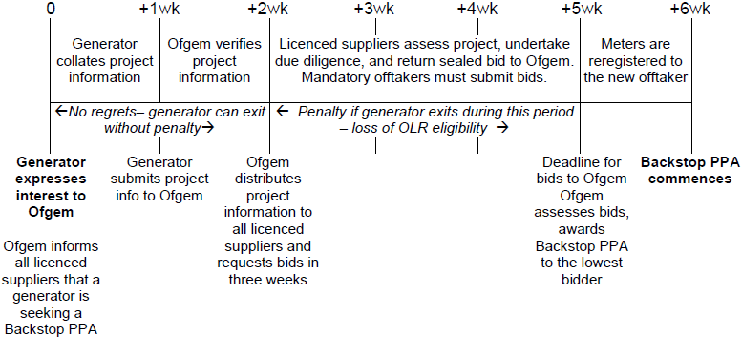
Allocation
Allocation

Slide 15
Table Discussion Questions
Offtaker Identity
How do generators and lenders get comfort over OLR payment flows?
Minimum offtaker credit rating of, or letter of credit from, a BBB- entity?
No need for credit support as the right to swift (6-week) re-allocation should be sufficient?
Compensate generators in the event of offtaker insolvency via the mutualisation provisions?
Allocation
Does the high-level allocation timeline for Backstop PPAs look appropriate for generators and suppliers?
What information should Generators be asked to provide when applying to access the OLR, to help inform Offtakers’ bids?

Slide 16
Session Three: Levelisation and Pricing

Slide 17
Levelisation
Levelisation
The sum of the management fees bid by offtakers will be levelised across all licensed suppliers.
Costs split by market share (domestic and non-domestic)
Quarterly levelisation
Mutualisation provisions
Subject to review: manner and frequency of levelisation may change under large volume of BPPAs

Slide 18
Pricing
Pricing
Absolute (£/MWh) discount
Fixed over time
Indexed to CPI
Modelled £20-£30/MWh discount, £25/MWh favoured option
Single discount for all technologies

Slide 19
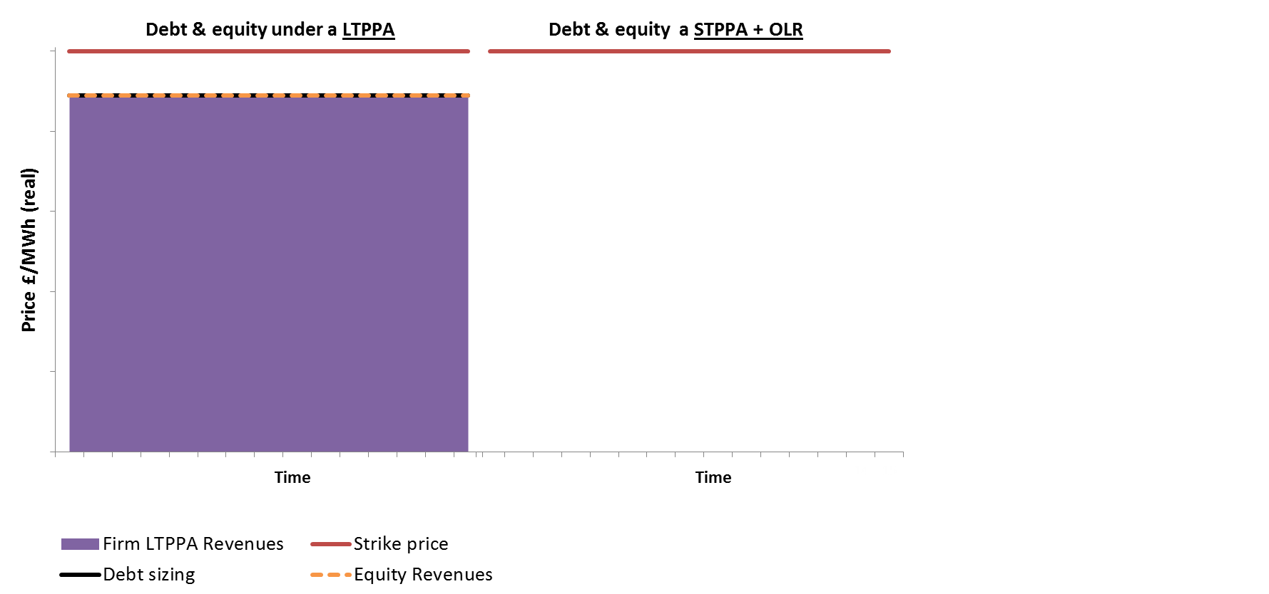
Pricing
Pricing

Slide 20
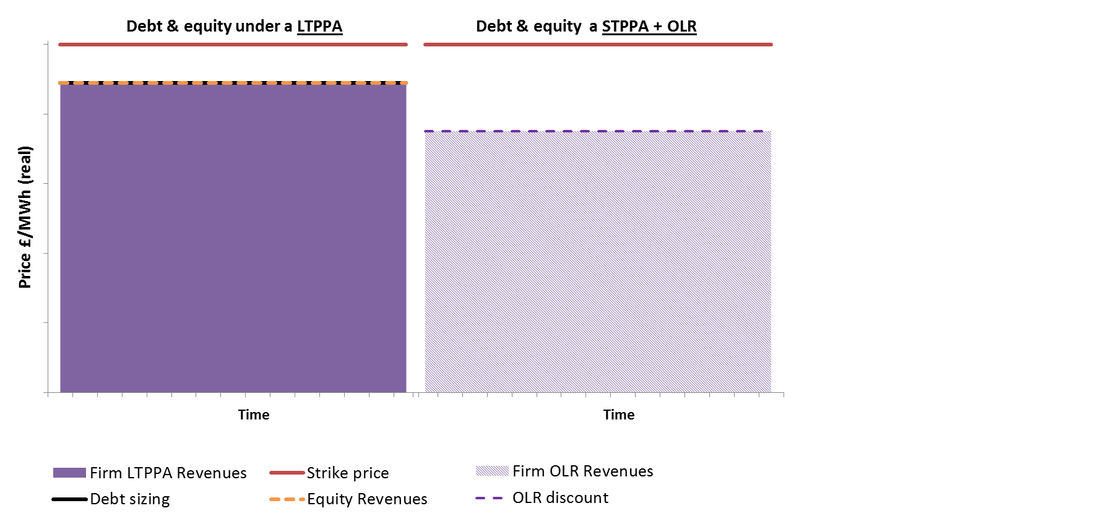
Pricing
Pricing

Slide 21
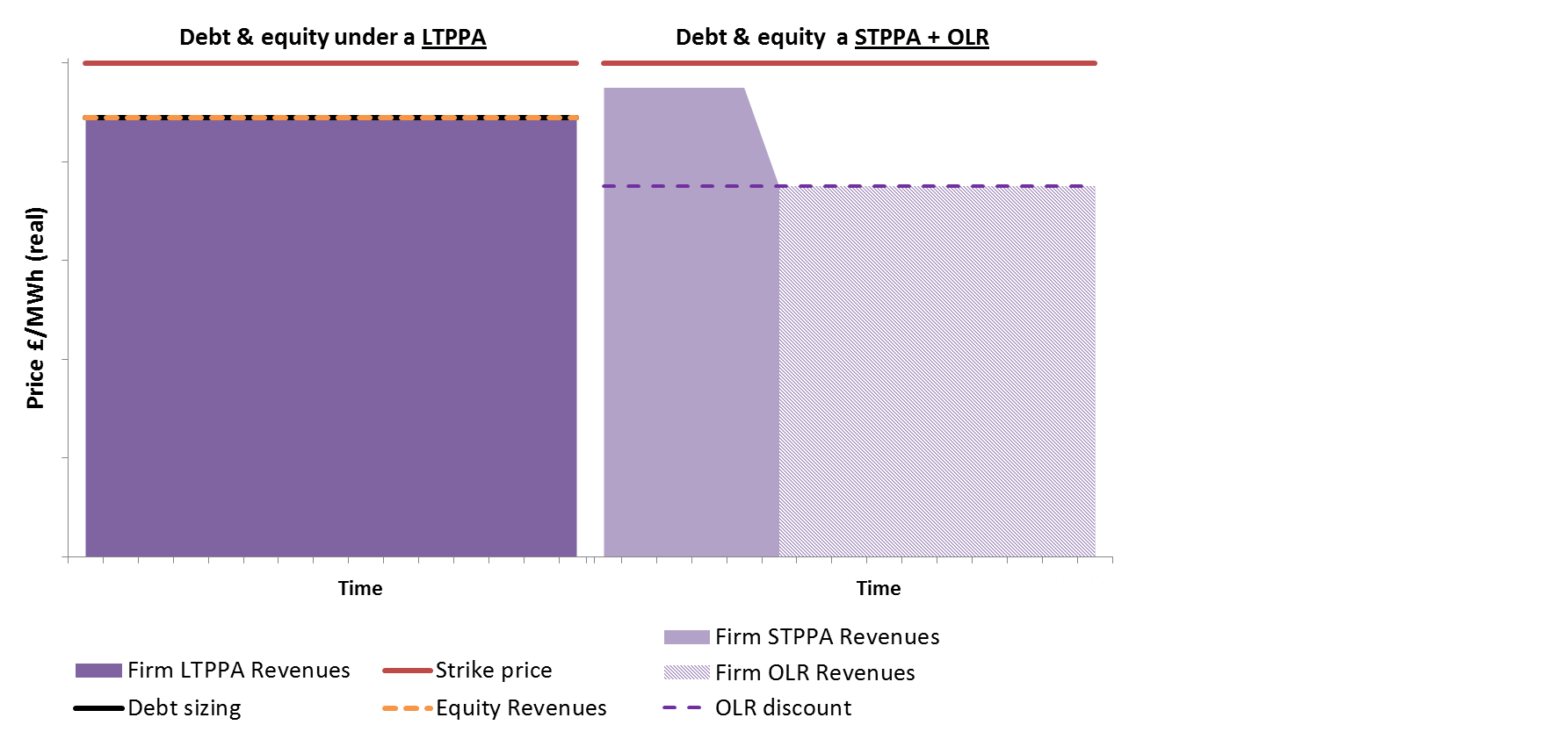
Pricing
Pricing

Slide 22

Pricing
Pricing

Slide 23
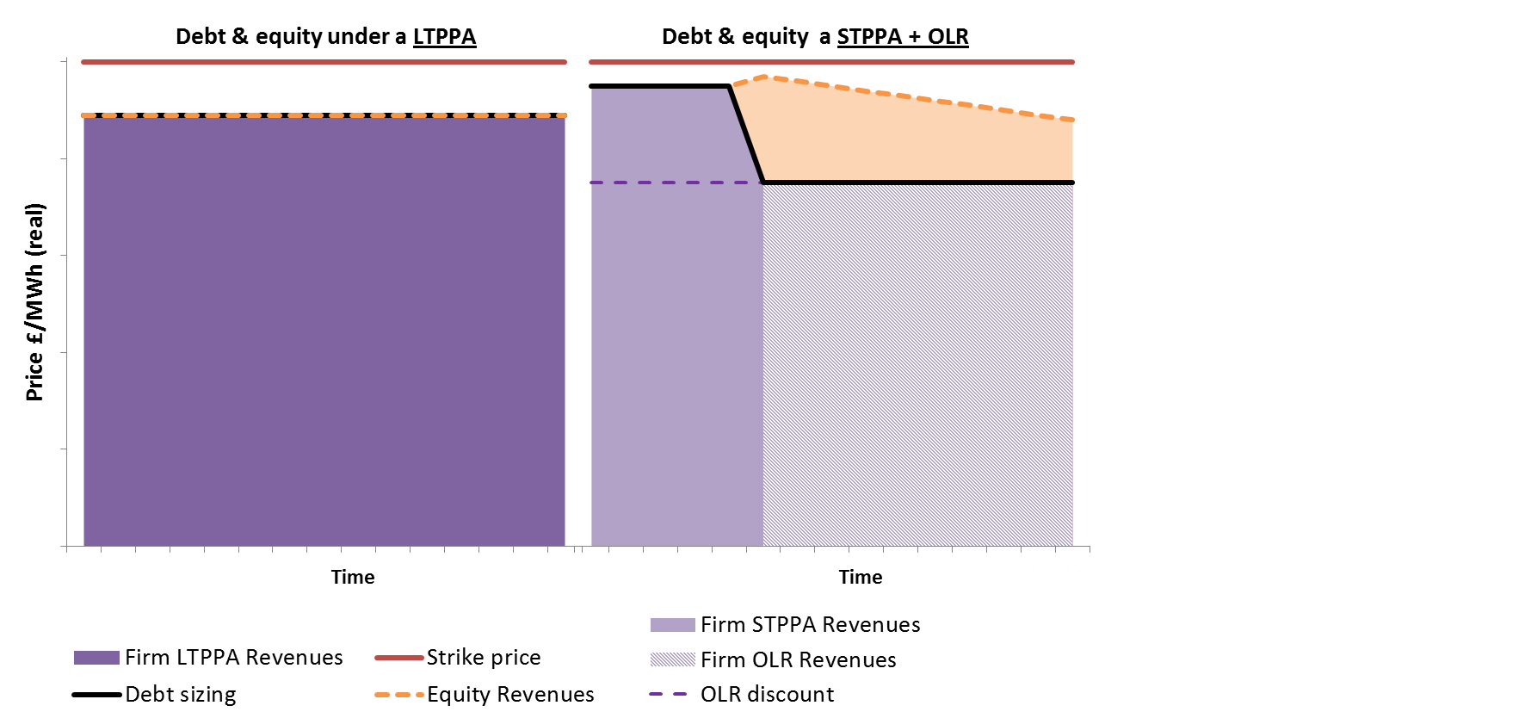
Pricing
Pricing

Slide 24
Pricing
What OLR discount gives a similar project returns across both scenarios?
Pricing
☺ Higher gearing
☹ Bigger discounts
☺ Smaller discounts
☹ Less gearing

Slide 25
Pricing
Pricing
 | Reference case (15-year PPA) |  | Short term contracting strategy, with debt sized on the following OLR discounts:
 |  |  | £20/MWh |  | £25/MWh |  | £30/MWh
Technology | Gearing | Equity IRR | Gearing | Equity IRR | Gearing | Equity IRR | Gearing | Equity IRR
Onshore wind | 70.6% | 13.1% | 67.6% | 13.3% | 65.1% | 13.0% | 62.7% | 12.7%
Offshore wind | 75.5% | 15.2% | 73.8% | 15.5% | 71.9% | 15.2% | 69.8% | 15.0%
Solar PV | 63.9% | 10.3% | 60.3% | 10.3% | 58.7% | 10.2% | 57.1% | 10.1%

Slide 26
Questions?

Slide 27
Session Four: Backstop PPA – contract terms

Slide 28
Principles of the bPPA
Help ensure bankability
Facilitate easy comparison for competitive allocation
Provide an appropriate balance of risks for the Parties
Ensure normal operational incentives are maintained.
Should be as close as possible to a ‘typical’ commercial PPA
Have based the initial shape heavily on the emerging output of the CfD Market Readiness Working Group.
Contract terms should be standard without areas of negotiation between the Parties.
As far as possible, contract terms should be universal across technology types.
If variation is necessary to the contract over time, should (to the extent possible) leave the generator in an equivalent position.

Slide 29
Structure
Strong preference for single set of terms and conditions that would apply to all projects and technology types.
Intention (subject to drafting) is that any differences required would be reflected in the schedule to the contract which would provide project specific details and make clear the overall shape of the contract.
The information in the schedule would need to be available to offtakers prior to the allocation process to allow them to factor in to their bidding strategies.
The index price will be the relevant CfD Market Reference Price for that particular project. This will be detailed in the schedule.
Contract will include an operational period (during which the offtaker will take power and provide payment to the generator) of up to 12 months. Likely to be preceded by a short ‘start-up’ period to get systems connected and make appropriate metering arrangements.

Slide 30
Metering and meter registration
Backstop PPA will need to come into force very quickly therefore will need to get meters registered very quickly.
We are working with Elexon to ensure that new offtaker can either be registered within 5 working days, or at least has access to the metering data.
Transmission connected
Relatively easy to transfer BMU to new offtaker
Distribution connected
Not possible to transfer A.BMU, and setting up a new one takes time
We are working with Elexon on new approach whereby A.BMUs are kept open for all potential new offtakers

Slide 31
Forecasts & Data Provision
Generator will need to provide
SCADA access
Forecasts of availability.
Baseload/despatchable generators will also need to provide regular estimated output profile
Generator would need to provide notice to the offtaker if availability is significantly different from forecast (unplanned outage).
There may be a need to include additional incentives to ensure that information is provided in a timely manner:
Failure to provide notice of outages within the specified timeframes will result in the generator paying the offtaker the system sell price for the forecast generation during the unnotified period of the outage.
Is SCADA appropriate for all types of generators?
Can minimum requirements be specified?
What timescale is appropriate for notification of unplanned outages?
Are the penalties appropriate?
Notes:
Offtaker should have the ability to require the installation of any additional equipment to assist in forecasting – the costs of which should be met by the offtaker.

Slide 32
Negative price protection
Not proposing to provide protection for reduced revenue as a result of negative prices, just providing protection for negative revenue at times of extreme negative prices.
Negative prices are passed through to generator (i.e. generator pays offtaker)
Generator would specify a point below which it would not want to generate.
Below this point offtaker would not sell their output on the exchanges.
Offtaker would notify generator who would be obliged to curtail for the relevant period (OR offtaker automatically curtails generator, if connection allows)
Do these provide the appropriate protection for generators?
Does the automatic curtailment option introduce new risks for the offtaker?
Will generators have the capability to be curtailed remotely?

Slide 33
Intra-day Curtailment
As generator is paid on the basis of the Day-Ahead price or the Baseload reference price, they would not respond if intra-day prices fall.
To facilitate efficient generation at times of over supply it would be useful to retain the incentive to curtail output if prices fall between day-ahead and gate closure.
Would also allow offtaker to bid the facility in to the Balancing Mechanism.
Considering that where functionality allows, offtaker has ability to curtail generator at any time, and provide full compensation for lost revenue
Would offtakers find this a useful provision?
Would generators have concerns?
How could the curtailed output of the facility be estimated?
Notes:
= ((index price) + (top-up generator would have received) – (short-run marginal costs) – (bPPA discount)) x (volume)

Slide 34
Termination & consequences of termination
Contract will need to include clear definition of ‘event of default’. This will include either party being declared insolvent, liquidated or under administration, as well as either Party providing false information or failing to perform an obligation (including payment) and not remedying this.
Termination following default would lead to compensation for losses incurred by the non-defaulting party.
If caused by generator default the generator would lose eligibility for the OLR in the future.
If caused by offtaker default then Ofgem could pursue for breach of licence obligations.
Non-Default termination. In addition, after the first 6 months of the contract, the generator will be able to terminate the contract without liability by providing 6 weeks' notice to the offtaker.

Slide 35
Scheme Review
Terms of the OLR will be grandfathered from the point of CfD signature. Any changes to the terms or discount would be subject to consultation and only apply to new generators.
But OLR intended to be a transitional measure and available until a competitive market for bankable PPAs develops and lenders, offtakers and generators are more comfortable with the scheme.
Therefore may be appropriate to amend or withdraw for new entrants as the market develops.
Propose a combination of annual reporting & evaluation, with a comprehensive review after a few years.

Slide 36
Annual reporting and evaluation
Evaluate the scheme against a number of market parameters to ascertain whether there have been any significant shifts in the market:
Volume of CfD generation coming forward (and proportion from independents)
Number of offtakers and terms available in the market
Number of generators accessing OLR (and their capacity)
Will require data from PPA market to inform review. Considering requiring that generators provide information on their initial route-to-market at the point at which their CfD payments commence. The information would likely cover:
The PPA tenor;
The discount to the reference price (or other price metric); and
Any substantive clauses that might need reflecting in future Backstop PPAs.
Is it appropriate to require generators to provide information about their initial PPA arrangements at point of CfD signature?

Slide 37
Comprehensive review
Most likely to take place in 2018/19, to consider whether the scheme should remain open to new CfD signatories after the end of the first EMR delivery plan.
The review would also consider whether any aspects of the design need to be changed.
In addition to the sources of data identified for the annual updates, the comprehensive review would likely include a Call for Evidence.

Slide 38
Table Discussion Questions
Is SCADA an appropriate requirement for all Generators? Can minimum requirements be set?
Are the timings for Meter Registration appropriate? Is it necessary to include these steps in the contract or rely on ‘as soon as reasonably practicable’?
Are tolerance limits appropriate for unplanned outages? If so, at what level?
Is the risk of exposure to cash-out the best incentive to ensure the generator provides good information on outages?
What do you see as the best way to protect generators from very negative prices?
Do offtakers see value in being able to curtail the generator (and provide compensation)?
Would Offtakers find intra-day curtailment useful? Would Generations have concerns?
Is it appropriate for Government to ask generators for details of their initial PPA?

