Slide 1
Solution Design Advisory Group (SDAG)
Smart Metering Implementation Programme
UNCLASSIFIED
BIS Conference Centre
28 May 2013

Slide 2
Agenda: SDAG #7 BIS Conference Centre 10:00 Tuesday 28 May 2013
No | Time | Subject | Lead
1 | 10.00 – 10.15 | Actions from previous meeting | Colin Sawyer
2 | 10.15 – 10.45 | Consolidated Issues Log - update | Colin Sawyer
3 | 10.45 – 11.30 | Role Based Access Control | Andy Armstrong
4 | 11.30 – 12.00 | Historical Data on IHD | Andy Armstrong
5 | 12.00 - 12.45 | HAN Options | Colin Sawyer/Julian Hughes
6 | 13.15 – 14.00 | CAD update | Tim Bailey
7 | 14.00 - 14.30 | SMETS2 (1st iteration) Open Issues | Peter Morgan/ Robin Niblock
8 | 14:45 – 15:00 | AOB

Slide 3
1. Actions From Previous meeting
Colin Sawyer

Slide 4
Actions

Slide 5
Actions

Slide 6
Actions

Slide 7
2. Consolidated Issue Log (raid) - update
Colin Sawyer

Slide 8
Open Issues

Slide 9
3. Role based Access Control
Andy Armstrong

Slide 10
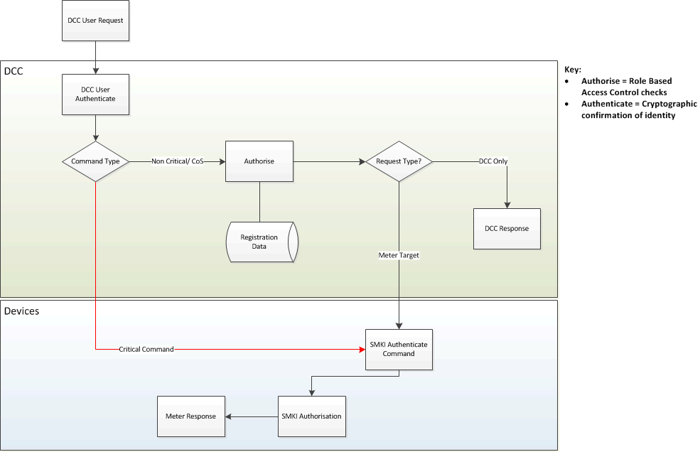
RBAC Flow diagram

Slide 11
Role Base Access Control - Architecture
Components/Entities Performing Role Based Access
DCC RBAC (DSP)
Determines valid DCC Users for any service requests
Determines valid DCC Users that can request consumer data, i.e. meter readings
Provides access control for pairing of devices including remote service for type 2 pairing requests
Provides access control for valid DCC user requests for type 2 pairing and type 1 whitelisting (i.e. at Install & Commission)
Provides access control at Change of Supply against registration data to validate pending/active registration
Provides data level access control for transformation of non critical DUGC service requests into ‘HAN Ready’ commands, e.g. import or export profile data
Meter RBAC (defined with GB Companion Specification)
Applies access control on every critical command received based upon known roles; Supplier, Network Operator, DSP, Recovery, Root
This is built into the firmware and is based upon security credentials and cryptographic signature
DUGC – present user roles and functionality but the actual access control is applied at the meter for critical commands.

Slide 12
4. Historical data on ihd
Andy Armstrong

Slide 14
5. HAN options
Colin Sawyer

Slide 16
6. CAD update
Tim Bailey

Slide 17
Objectives of the session
Remote Pairing
To update on current position and further work;
To explain the current position regarding what the end-to-end system will provide
To set-out the additional services required to allow a Third Party to use the system to provide a pairing service;
To explain further work which will consider whether additional regulatory intervention is required to ensure that Third Parties are able to provide pairing services.

Slide 18
Objectives of the session
Locally-initiated Pairing
To explore the potential benefits from providing a local option in addition to remote option to initiate pairing;
To update on the two options for locally-initiated pairing

Slide 19
Remotely-initiated Pairing

Slide 20
What will the E2E system provide? Current proposals.
No changes required to SMETS as remote pairing does not rely on functions of the equipment;
GB Companion Specification will support pairing/unpairing of a CAD following receipt of a valid pairing/unpairing request via the WAN interface;
SEC schedule of core communication services will offer a service to any DCC user to send pairing and unpairing commands to equipment;
DCC user will be subject to Privacy requirements (tbc but e.g. to verify the identity of the energy consumer from whom they have obtained permission to provide a CAD pairing/unpairing service)

Slide 21
What additional services are required to provide a CAD pairing service?
Consumer verification;
Means to allow consumer to provide information to identify themselves, their Comms Hub and their CAD (e.g. portal)
Issue of pairing command via DCC (for remote pairing);
Management of CADs and unpairing;
Support to help consumer navigate Portal;
Support for issues with CADs.

Slide 22
Locally-initiated Pairing

Slide 23
Benefits of a locally-initiated option
What will be the attractions of a local option:
At different stages in the rollout
Prior / post DCC go-live;
Prior / post availability of a remote pairing service.
To different types of stakeholder:
Consumers;
CAD providers;
Suppliers.

Slide 24
Locally-initiated options
Option 1: Selection of CAD ID from a list on the meter
If Electricity Meter is in a shared space consumer enters Privacy PIN to access restricted menu functions;
Consumer switches on CAD and selects ‘pair CAD’ function/button on Electricity Meter menu.
Menu lists ‘IDs’ all unpaired CADs within range (usually will only be 1)
Consumer selects the ID printed on CAD and selects pair;
Pairing occurs;

Slide 25
Locally-initiated options
Option 2: – Short-code entry on Electricity Meter initiates bootstrapping
If Electricity Meter is in a shared space consumer enters Privacy PIN to access restricted menu functions;
Consumer switches on CAD and selects ‘pair CAD’ function/button on Electricity Meter menu;
Customer enters CAD ID via meter interface (4/8 digits depending on level of security required);
Pairing occurs.

Slide 26
7. SMETS2 (1st iteration) Open Issues
Peter Morgan/Robin Niblock

Slide 27
Background 1 of 2
When SMETS 2, first iteration, was notified to the EC there were 115 SSAG Comments that were not fully addressed. At the time, these comments were categorised as follows:
Category | No of Comments
GB HAN Companion Specification | 65
Future SMETS version | 28
Combination of Documents (SMETS, GBHCS, etc.) | 9
Other Document (e.g. CHTS, CPA) | 9
Uncategorised | 4
Total: | 115

Slide 28
Background 2 of 2
The breakdown of outstanding comments was issued to SSAG in January, and DECC undertook to track these and report back to SDAG (Action 5.04).
In addition, a SDAG member carried out some further work following a previous SDAG meeting:
Performing a review of the outstanding comments log for SMETS2 (1st iteration) and commenting on this.
Co-ordinating comments from other SDAG members on 11 potential “gaps” in SMETS2 coverage, to be addressed in the 2nd iteration.
The over-arching concern was a lack of clarity about where specific issues would be “landed”; and that important functionality might be missed.

Slide 29
DECC’s response
We are updating the SMETS2 issues log to reflect the current position in light of the progress that has been made since January, for example in:
GBH Companion Specification development.
CHTS development and issue.
ISFT Material.
Workshops held with SDAG.
At today’s meeting we will:
Summarise the work to date on progressing the outstanding comments.
Give an initial response to the perceived 11 “gaps” in coverage.

Slide 30
Current Snapshot of Comments
Latest analysis of the comments indicate they will be resolved as follows:
Category | No of Comments
GB HAN Companion Specification | 44
No Further Action following review | 28
Comms Hub Technical Specification | 6
Next Version of SMETS 2 | 3
Later Version of SMETS | 1
Technical Architecture | 1
Commercial Product Assurance | 1
A number of Documents (details in log) | 6
Still being worked on [no showstoppers] | 25
Total: | 115

Slide 31
Potential Gaps identified by SDAG Member 1 of 4
PPMID: Ongoing considerations around capabilities in relation to re-enabling gas and electricity meters. DECC Response: PPMID will form part of the next iteration of SMETS. ICH: Further consideration / justification for a hardwired communication link or PLC connectivity through the ICH port. This will impact upon future interoperability. Potential to reduce HAN traffic supports a case for a hard wired data link, which takes communication between electricity and meter out of the HAN. DECC Response: PLC connectivity excluded from the current version of SMETS2, and is unlikely to be in the next iteration. HHT: Concern that there still are no detailed rules as to what operatives will be allowed to do on site with an HHT. The industry also needs to come to a consensus view as to whether a HHT will support the meter installation process or whether engineering menus will be provisioned. DECC Response: The Programme’s view is that the HHT is not a Smart Metering device; it is a mechanism for transferring signed DSP commands direct to a meter. As such, the functionality of HHTs is down to industry to define.
Notes:
1 PPMID
The PPMID functionality is a key part of SMETS2, and SDAG has already commented on the Detailed Design Specification, (DDS), which will form part of the next iteration of SMETS. On the specific issue of enablement the Programme’s view is that, as there was significant opposition for gas enablement in the consultation responses, PPMID is not mandated to enable gas supply over the HAN. The position will be covered in the Condoc Response. The PPMID specification only mandates enablement of electricity supply over the HAN.
2 ICH
Provision of a hardwired communication link or PLC connectivity has been excluded from the current version of SMETS2, and is unlikely to be in the next iteration. The Programme’s concern is that no industry agreed protocol for hardwired communications exists. We are evaluating different options for PLC connectivity as part of the “HAN Strategy”.
3 HHT
The Programme’s view is that the HHT is not a Smart Metering device; it is a mechanism for transferring signed DSP commands direct to a meter. As such, the functionality of HHTs is down to industry to define; we do not see a need to add to SMETS2. The details of HHT pairing will be covered by a combination of the existing protocol, and the GBCS. The position will be covered in the Condoc Response.

Slide 32
Potential Gaps identified by SDAG Member 2 of 4
CAP: The concept appears to have been removed from the E2E architecture and SM HAN designs with the suggestion that RBAC will achieve this function. It is accepted that information can be extracted by means of RBAC commands but there is a concern that a CAD requires a CAP as its data gateway leading to concern as to exactly how a CAD will pair and exchange data across the HAN? RBAC has only recently been introduced and requires a clear definition. DECC Response: The concept of a CAP has been removed from the Technical Architecture because it has been replaced with Type 1 and Type 2 devices.
CAD: Further to the CAP concerns the high level design of the CAD has yet to be defined. DECC Response: A CAD is a Type 2 device and the mechanism for pairing such devices will be included in the GBCS.
ALCS: Acknowledged that ongoing work is making good progress but is yet to be completed. DECC Response: The (HAN Connected) ALCS functionality will form part of the next iteration of SMETS.
Notes:
4 CAP
The concept of a CAP has been removed from the Technical Architecture because it has been replaced with Type 1 and Type 2 devices, as defined in SMETS2.
5 CAD
A CAD is a Type 2 device as defined by SMETS. The mechanism for pairing Type 2 devices will be included in the GBCS. RBAC is described in more detail in the Security Architecture, the Technical architecture and the DUGC. Beyond this, there is no known functional requirement which needs to be added to SMETS2. The programme is still evaluating local CAD pairing; depending upon the outcome of this work further change may be required to CHTS or SMETS2. The position will be covered in the Condoc Response.
6 ALCS
The (HAN Connected) ALCS functionality is a key part of SMETS2. A draft Detailed Design Specification, (DDS), which will form part of the next iteration of SMETS, is currently with SSWG. It will be released to SDAG for comments as soon as this is complete.

Slide 33
Potential Gaps identified by SDAG Member 3 of 4
CoT: Still concern that the requirement to log daily register reads is set to 14 days. This may give rise to a significant amount of final bills on CoT to be based on estimates (some estimates suggest 25%). DECC Response: The daily total consumption log allows access to the last 731 days of data, or we could consider changing the daily register reads to something other than 14 days. The latter would need a proposal for a different figure with a cost/benefit analysis; ideally this should be proposed via Energy UK.
Firmware Management / Upgrades: Is recognised as a complex area which may require further definition in SMETS or the GB Companion Specification. Clarity is required on how IHD firmware is to be managed. DECC Response: Proposed workshop on Firmware Management should clarify the intended solution. Export: Ensuring that this is documented to enable export MPANs to be input and associated with registers and processes developed to support the requirements of the Export Supplier when not the Import Supplier. DECC Response: The section on MPAN appears to cover this requirement.
Notes:
7 CoT
The daily total consumption log (4.5.4.7) allows access to the last 731 days of data, and may provide an effective workaround to this issue. Failing this, we’d consider changing the daily register reads to something other than 14 days. To progress this, we would need a proposal for a different figure, with a cost/benefit analysis. Ideally, this should be proposed via Energy UK.
8 Firmware management
The proposed workshop on Firmware Management should clarify the intended solution. We anticipate that there will be Use Case(s) covering this in the GBCS, but do not anticipate any changes to SMETS2; commands already exist to cover this.
9 Export Section 6.6.3.24 MPAN appears to cover this requirement; the MPAN is a configurable data item which can be written. The business processes around this would be outside the scope of SMETS2, but there will be a “write MPAN” use case in the GBCS.

Slide 34
Potential Gaps identified by SDAG Member 4 of 4
Security Access Control: This is required at data level. Do we have enough detail of how access control will work to confirm that this can all be undertaken by DCC and there is no specific requirement within the meters? DECC Response: The GBCS will provide a detailed definition of access control at a data level. Additional use of Load Limiting functionality: To date three Suppliers have responded and each support the proposal for Load Limiting as an additional function linked to prepayment services. It is therefore proposed that the requirements should be progressed. This could be undertaken via a small working group within SDAG or by other means as you consider appropriate. There isn't general support for taking forward load management aspects at this point in time. DECC Response: This would be a new addition to SMETS2 functionality. To progress it we would need a clear definition of the requirements and a cost benefit analysis, ideally proposed via Energy UK.
Notes:
10 Security Access Control
The GBCS will provide a detailed definition of access control at a data level. It is likely that this will place significant requirements upon meters – as described in the Security Architecture.
11 Load Limiting functionality
This is a new – and potentially significant – addition to SMETS2 functionality. To progress this we would need a clear definition of the requirements and a cost benefit analysis. Ideally, this should be proposed via Energy UK.

Slide 35
8. AOB

Slide 36
Date for Next Meeting
Next Meeting
Meeting #8 – 2 July 2013
BIS Conference Centre, 10am–3pm,

