Slide 1
Reducing energy demand from new and existing urban habitat - problems and issues in UK and India a UK perspective of the research challenge
Martin Mayfield
Professor of Engineering Design
Royal Academy of Engineering Centre of Excellence for Sustainable Building Design
The Urban Institute
University of Sheffield

Slide 2
The purpose of this presentation is to cover a range of problems and issues in order to inform the exploration of common research challenges.
STEEP
Societal
Technical
Economic
Environmental
Political

Slide 3
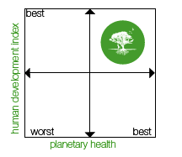
A wide variety of possible future scenarios
The two main factors in long term development is human development and planetary health. Four possible broad behavioural paradigms can be expected from these factors.

Slide 4
Existing/Retrofit
New Build
Common Issues

Slide 5
Existing/Retrofit
New Build
Common Issues

Slide 6
Existing/retrofit
Societal
Lack of understanding that energy costs are expected to increase. UK National Audit Office recently reported that energy costs would rise above the level of inflation until 2030.
Societal
Disconnect between cost and benefit in rented buildings.
Economic & Political
Lack of policy stability for refurbishment standards means that investment confidence is low irrespective of the strength of the financial model
21 million homes in the UK – 27% of UK carbon emissions
1.8 million non-domestic buildings – 18% of UK carbon emissions
86% of existing homes will exist in 2050
Upgrading existing building stock is a huge challenge

Slide 7
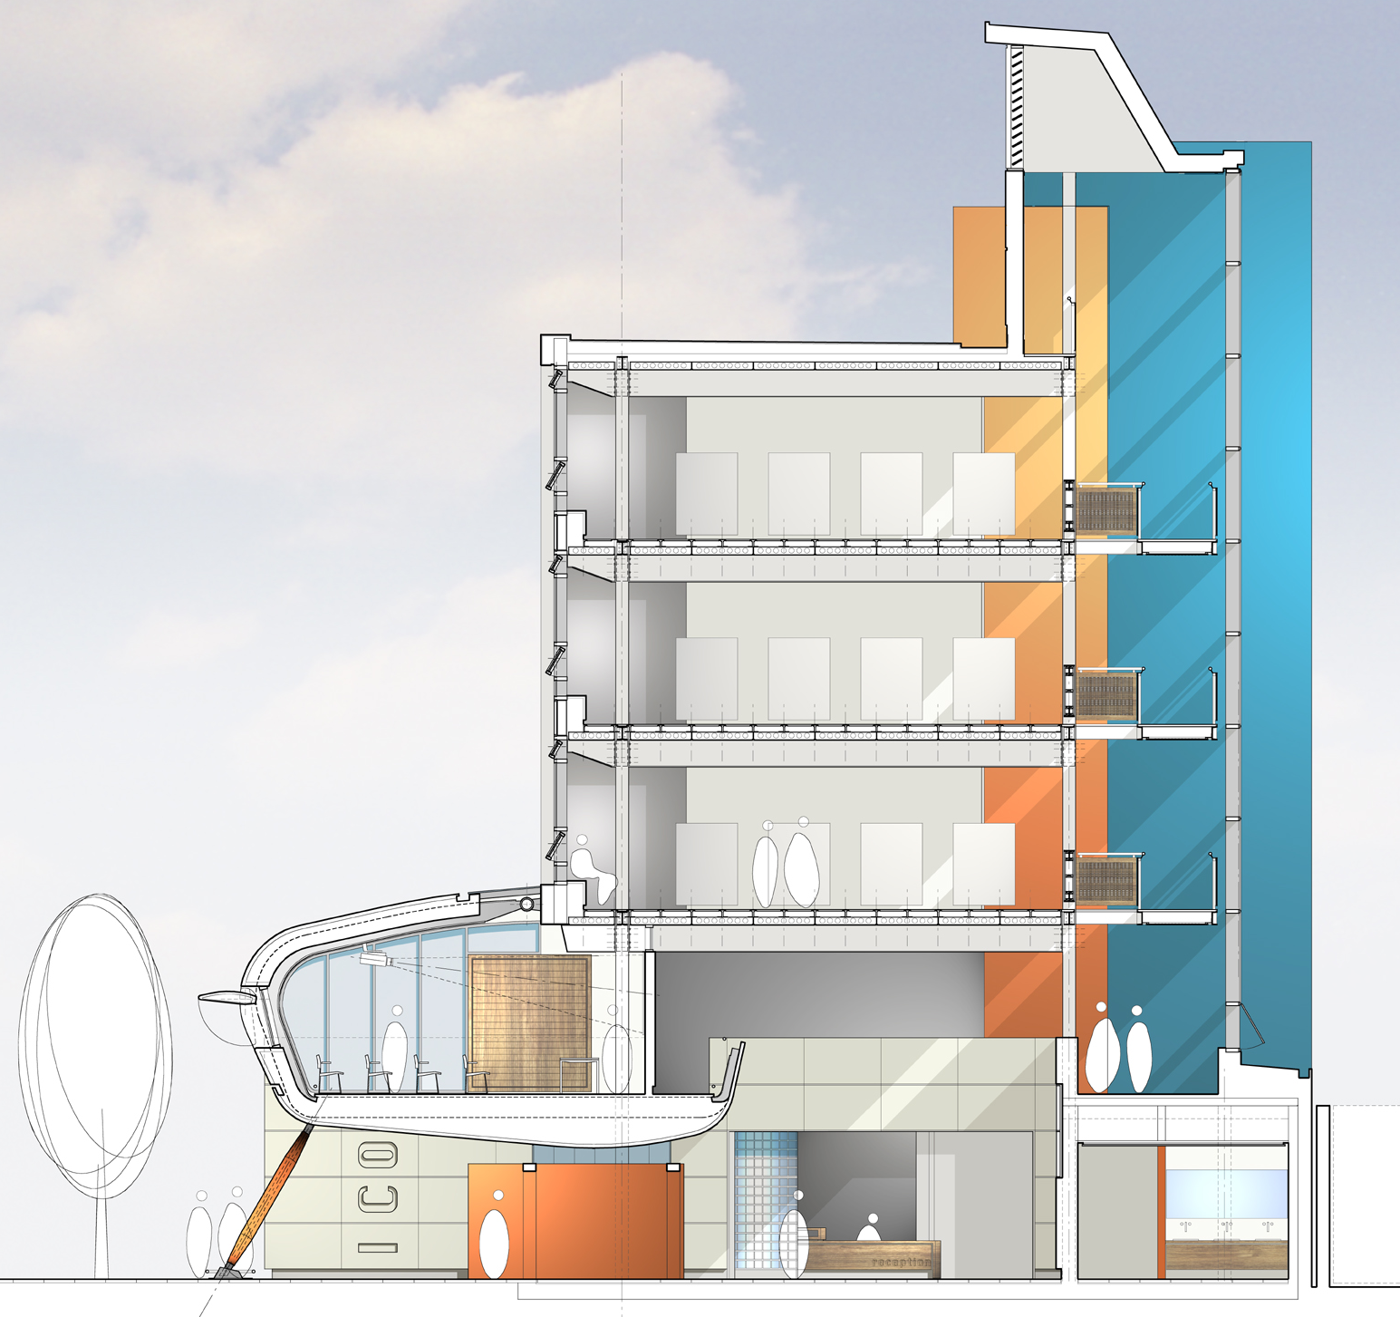
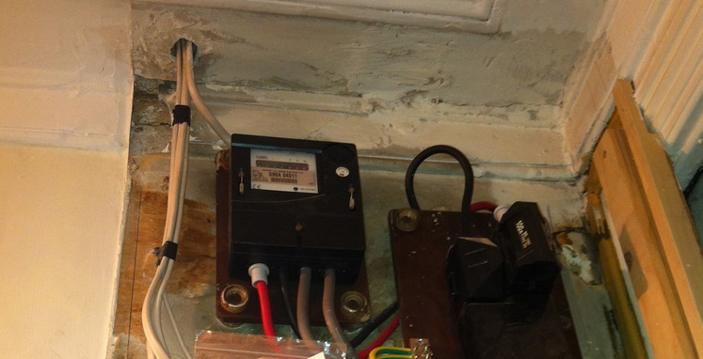

Existing/retrofit
Technical
Quality and granularity of feedback loops - the more people understand about their energy use the more they are able to manage it. Research suggests that this includes onsite generation as it’s presence helps people develop their understanding about energy which they translate to consumption thus reducing energy usage.
Building
Floor
Room
Node

Slide 8
Existing/Retrofit
New Build
Common Issues

Slide 9
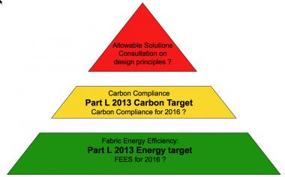
New Build
Political & Economic
Lack of policy stability makes it difficult for companies to invest.
Code for Sustainable Homes
Standards for all new homes
Introduced 2007
Set path to Net zero carbon by 2016
Might be scrapped?
Likely to be scaled back?
Part L for Non-domestic buildings (approximate reductions aggregated by sector)
2006 – 25% reduction
2010 – 25% reduction
Planned 2013 – 22% reduction
Standards delayed
Actual 2014 – 9% (approx.)

Slide 10


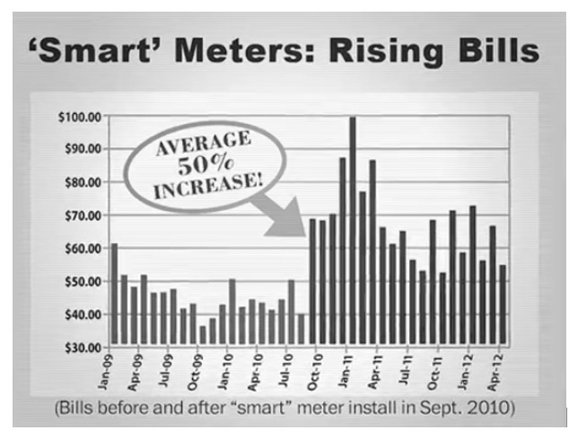
New Build
Political & Technical
No requirement for “Smart” readiness to be incorporated in the design of new buildings for:
Load management?
Storage integration?
Renewable energy readiness?
Smart Meters not particularly smart..
Lack of understanding
Promotes negative
Perspective in media.

Slide 11
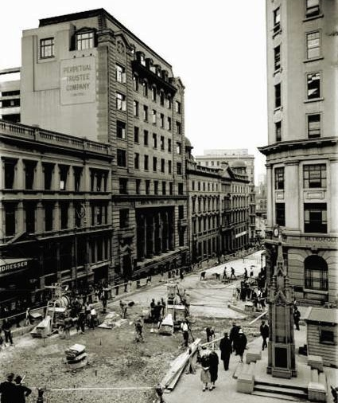
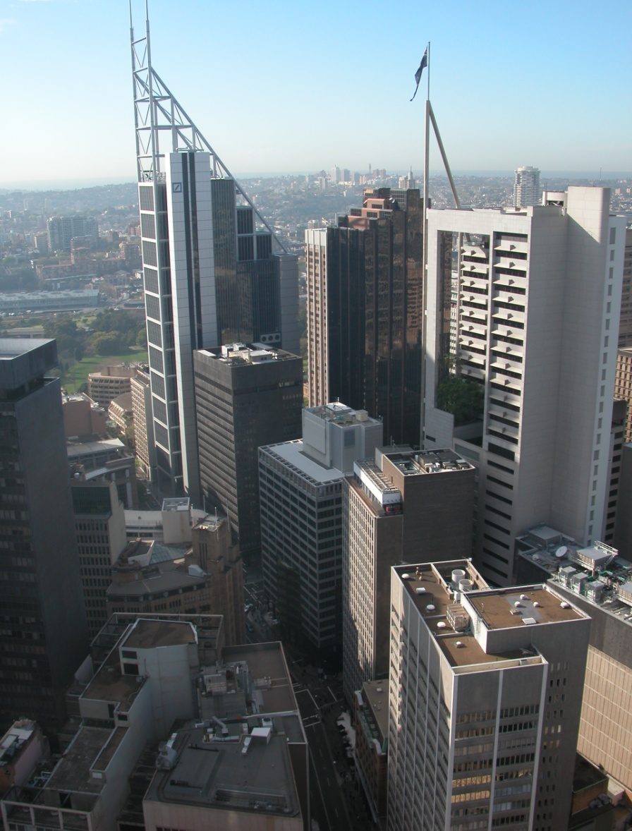
New Build
Political and Technical
The challenges of building low energy buildings in a rapidly changing urban environment
  1916

Slide 12
Existing/Retrofit
New Build
Common Issues

Slide 13
Common Issues
Societal
Little demand for low energy buildings. EUED reduction is focused in Industrial sector (partly due to green tariffs which add approx. 20% to energy costs).
Little understanding of issues faced by global increases in demand.
Societal issues exposed by taxing consumption rather than wealth.

Slide 14
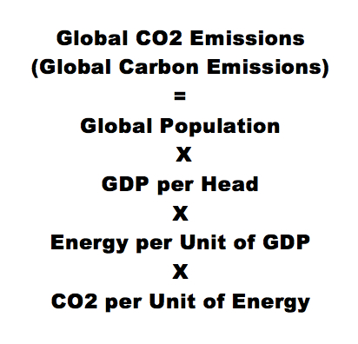
Common Issues
Societal & Technical
Built Environment measures performance per m². Goals are measured with metrics. Do we have metric misalignment?
One planet infrastructure?
20% infrastructure?
Factor 10 buildings?
Energy Proportional buildings?
2N Energy Systems
N+1 Healthcare models
Why do we measure building performance, cost and value on a per m² basis? What if we use a per person metric?
5
CO2
4
3
GDP/per person
2
Population
1
CO2/energy
Energy/GDP
1950
2010
Kaya equation
Kaya Identity

Slide 15
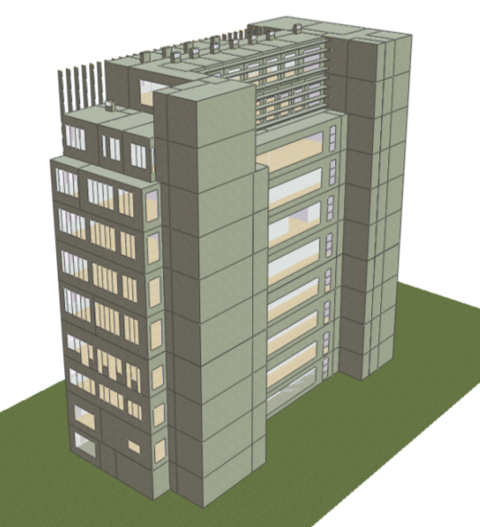
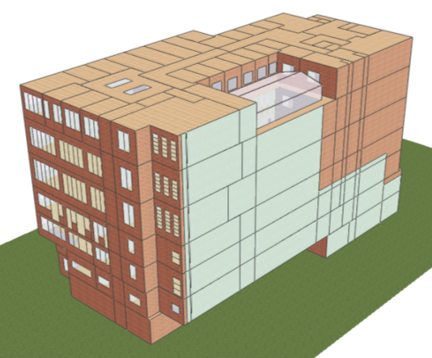
Common Issues
Political & Technical
No requirement for Climate Change adaptation to be built in to design.
No requirement for adaptive capacity (such as incremental adaptation) to be incorporated in the design of new buildings.
Designed for 2013
Designed for 2050

Slide 16
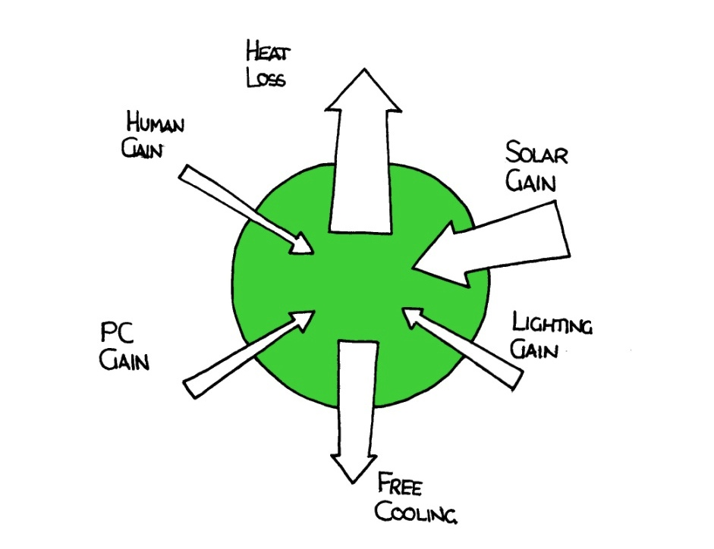
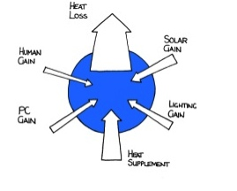
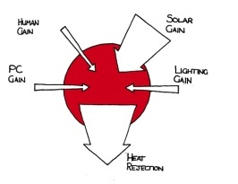
Common Issues
Political & Technical
Even in a country as small as the UK, the climatic difference between the middle of London and the rural North can be considerable (and compounded by UHIE). This is not considered in building standards and design guides.
Building Standards call for the same minimum standards across the UK rather than climatically optimised standards. What we want are buildings that are in balance (use no energy other than plug loads) for as much of the year as possible.
.
Winter - heating
Summer - cooling
Mid season – in balance

Slide 17
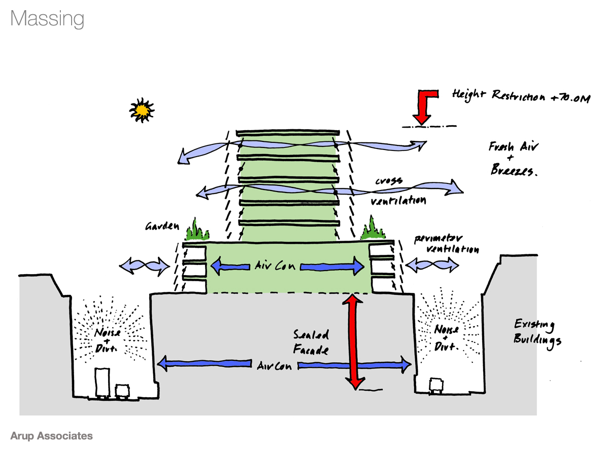
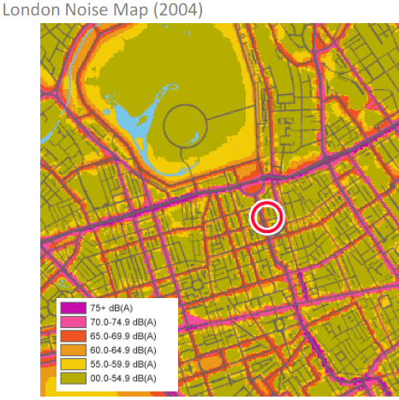
Common Issues
Political & Technical
Naturally ventilated building’s consume around ½ the energy of comfort cooled buildings. Deployment is a systemic issue - we do not employ the necessary multi scalar thinking of linking building design to city design that drives re-enforcing loops of better acoustics, less pollution, more natural ventilation.

Slide 18
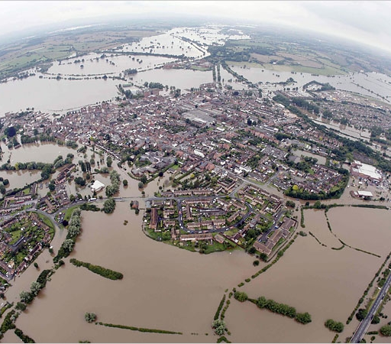
Common Issues
Environmental & Politics
Politics tends to respond to events rather than systemic drivers. The flooding will bring a particular focus on a single issue. It is likely to be addressed by the adoption of more sophisticated models (that define risks). However, the issue is a balance of risks and uncertainty there requiring a balanced approach of complexity and design.
The Armitt review proposes a 30 year infrastructure plan for the UK

Slide 19
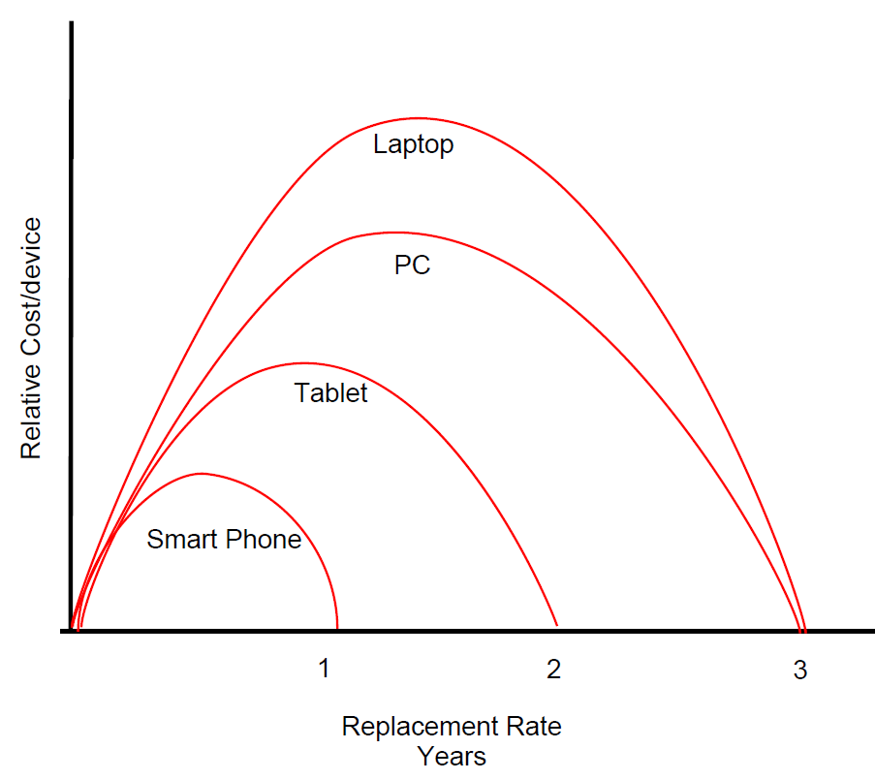
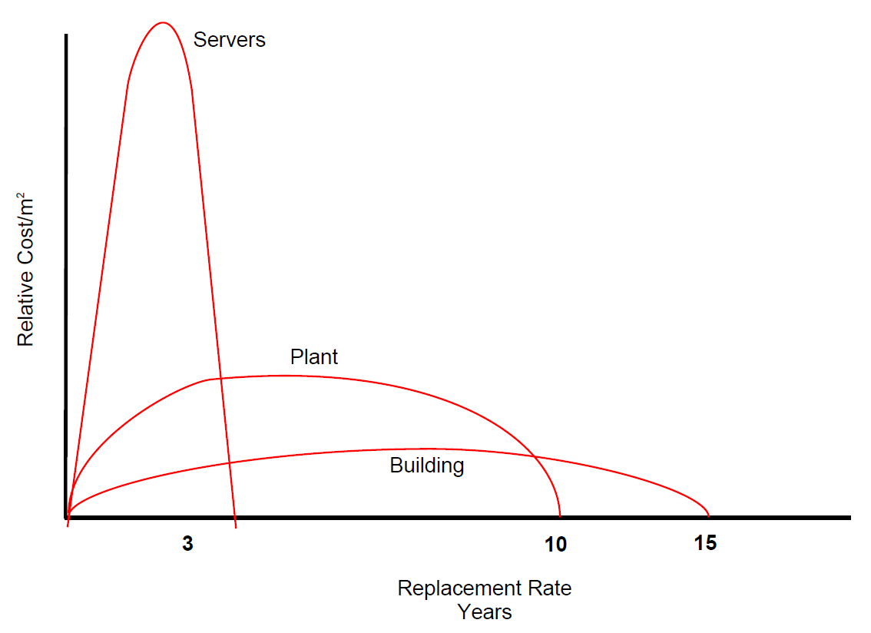
Common Issue
Technical
Impact of Disruptive Technology on Built Environment?
Demand Drivers
Hardware refresh rates for typical large organisations is a primary driver behind energy demand. Workload trends are increasing the amount of data being produced and consumed. Increased "large data" computations and "batch" computations
Supply Drivers
Server refresh highly variable, but broadly comparable to PC/Laptop refresh rate. However, the HVAC Plant and Building refresh frequencies are much lower leaving Buildings vulnerable to disruptive technology changes.

Slide 20
Optimisation of Urban Infrastructure?
This will require a systems approach and a greater understanding of system characteristics and how these inter-relate.
Systems tend to optimise at different scales.
System capacity often limited by peak flows.
Peak lopping through temporal or system load shifting.
Urban Integrated Infrastructure

Slide 21
Significant Issue
Urban System Solutions require us to blend hard and soft systems thinking.
If we apply a systems approach to in Cities, what might this offer?
Places to interact with Systems (in increasing order of effectiveness)
Adapted from Systems Principles. Meadows (2008)
Numbers – Constants and parameters relating to system operation
Buffers – size of stabilising elements relative to their flow
Stock and flow Structures – physical systems and their nodes of intersection
Delays – lengths of time relative to the rates of system changes (particularly where systems interact)
Balancing Feedback loops
Reinforcing Feedback loops
Information Flows – the structure and extent of information flow (sensors and how their systems are inter-connected)
Rules (market forces, legislation, technological constraints)
Self-Organisation – changing or evolving a system
Goals – these drive system behaviour and they are never clear and always contradictory…..?
Paradigms – the mind-set out of which the system arises (usually fragmented and evolving)
Transcending Paradigms - doing it entirely differently
Thinking is stuck here
Some DE work here
Smart Grid focus is here
The Smart City focus is here
Lack of policy inhibiting here
This are the really interesting levels

Slide 22
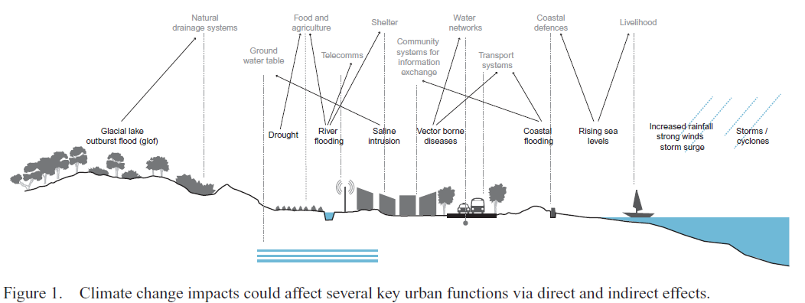
Infrastructure vulnerability to urban systemic risks?
Urban shocks why we fail to predict the problems:
Poor understanding of vulnerabilities to individual systems
Poor understanding of how those systems interact
Consequence:
Systems fail in a manner not predicted
Systems take much longer to repair or replace leading to significant financial and human cost
Three pillars of resilience Anticipation (expectation of an urban shock)
Preparedness (preparing to respond to that urban shock)
Recovery (effectively and quickly responding to disturbances)
(Mayena 2006)

Slide 23
Thank you
Martin Mayfield
Professor of Engineering Design
Royal Academy of Engineering Centre of Excellence for Sustainable Building Design
The Urban Institute
University of Sheffield

