Slide 1
S.P.R.I.N.T v2.0 User Guide
Infrastructure Access Feedback Survey

Slide 2
SPRINT v2.0
Change log
Changes from previous version:
Added title screen
Added additional details boxes for some questions
Added free text comments form
Changed some combo boxes to list boxes
Outlook no longer needs to be open – the application can take care of that for you
Added reset buttons
Added help screen
Added validation visual cue icons
Added additional navigation controls

Slide 3
Welcome
Introduction
Feedback The Infrastructure Access Survey is designed to be an easy way for users running MS Office to inform DECC of how discussions on third-party access to infrastructure were carried out.
→

Slide 4
User Guide
Opening the file
Enable Macros For the survey form to work, macros must be enabled.
To do this, click the “Options” button and select “Enable this content” →

Slide 5
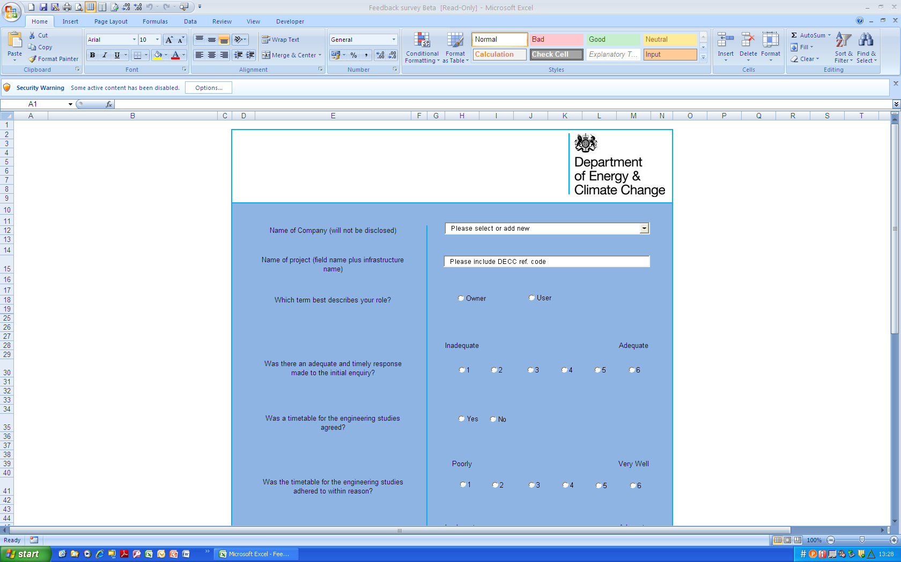
User Guide

Slide 6
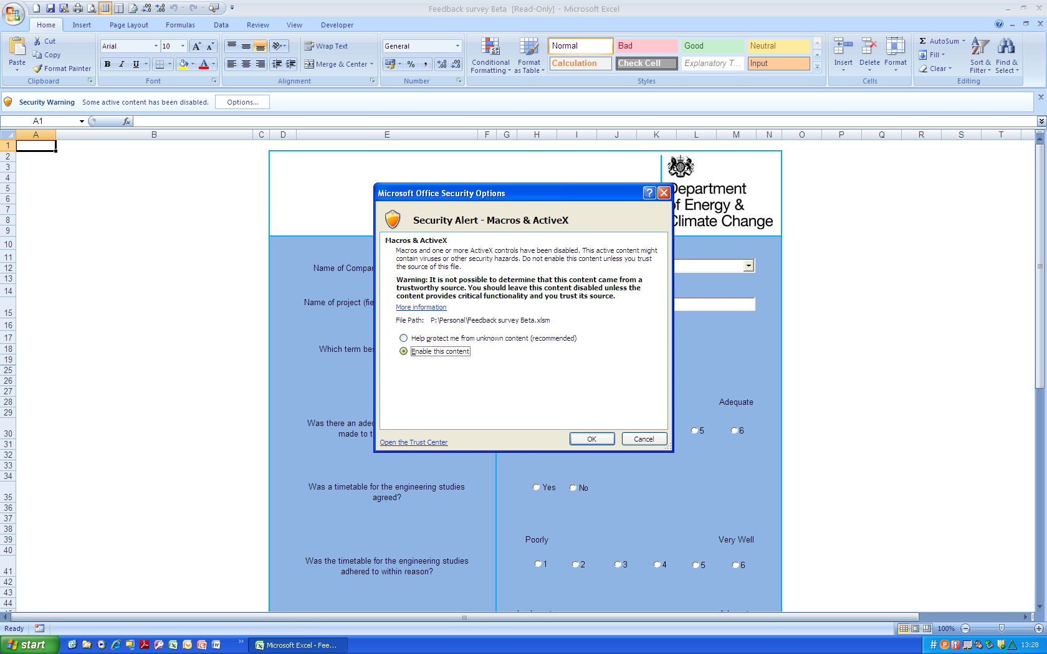
User Guide

Slide 7
User Guide
Opening the file
Enable Macros Some versions of Excel may not ask you to enable macros due to default security settings. If this is the case and the system does not appear to work check macro handling under: File/Office icon > Options > Trust Center > Trust Center Settings

Slide 8
User Guide
Using the Form
Restrictions Once macros are enabled, you will lose access to the menus (Ribbon) and tab browser (worksheets). Please navigate using only the buttons on the form. This includes Saving and exiting
→

Slide 9
User Guide

Slide 10
User Guide
Identifying Information
Name and Reference Code Select your company’s name from the list, or add new (this info is for DECC internal use only).
The reference code will have been emailed to you when you informed DECC of the initial enquiry →

Slide 11
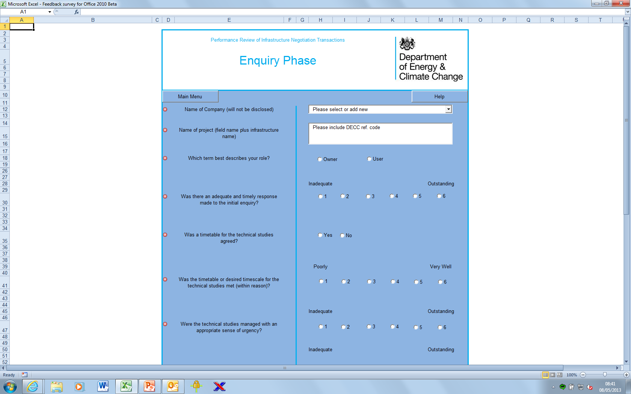
User Guide

Slide 12
User Guide
Define Role
Owner or User? Selecting either “Owner” or “User” will change the question set displayed.
→

Slide 13
User Guide

Slide 14
User Guide
Save & Exit
Come back later You may save the form for completion at a later date by clicking “Save & Exit” at any time. This will allow you to save a copy of the form to a location of your choice →

Slide 15
User Guide

Slide 16
User Guide
Negotiation
Navigation If the third-party access enquiry did not proceed to a negotiation, then you will not be able to use the “Proceed to Negotiation Phase” button
→

Slide 17
User Guide

Slide 18
User Guide
Blockers
Declaring Blockers If the access enquiry did not proceed to negotiation then you will be asked to declare if there were blockers, and if so, describe them
→

Slide 19
User Guide

Slide 20
User Guide
Submitting the Form
Submit Form to DECC If the access enquiry did not proceed to a negotiation and all questions have been completed, the “Finish and submit form to DECC” button will become active. Only click if you are sure you want to submit the form →

Slide 21
User Guide

Slide 22
User Guide
Outlook Email
Permissions You must allow the form to access Outlook and send email. Clicking “Deny” will cause the program to crash and you will lose your progress
→

Slide 23
User Guide

Slide 24
User Guide
Negotiation Phase
The Negotiation Phase The page for the negotiation phase behaves in a similar way to the enquiry phase. You can navigate between the two using the buttons
→

Slide 25
User Guide
Negotiation Phase

Slide 26
User Guide
Submitting the Negotiation Form
Submit Form to DECC If the negotiation questions have all been completed, the “Finish and submit for to DECC” button will become active. Only click if you are sure you want to submit the form →

Slide 27
User Guide
Troubleshooting
Known Issues
The “Finish and submit form to DECC” button isn’t active despite all questions being answered
- Click in a blank cell to activate the button
→

Slide 28
User Guide
Feedback
Let Us Know
Please let DECC know how you found using the form:
Richard.Thyer@decc.gsi.gov.uk Robert.A.White@decc.gsi.gov.uk

