Slide 1
Data Pack Improving permanence for looked after children
September 2013

Slide 2
Improving permanence for looked after children
Improving Permanence
About the data
Placement Stability
Placement stability by age, reason for entering care, region and local authority
Placement stability by length of time in care and placement type
Placement stability and educational attainment
Return Home from Care
Return Home for Care by age, legal status, duration of latest period in care and local authority
Return home and re-entry to care – 2006/7 - 2012

Slide 3
Improving Permanence
The Department for Education is committed to improving for permanence for all looked after children
Reviewing aspects of the statutory framework to ensure that it supports all permanence options and timely decision making for all children
Identifying and supporting evidence based interventions which drive improved practice and a better quality of care
Strengthening the framework for children to move into permanence arrangements such as adoption, special guardianship, returning home and long term foster care where this is appropriate

Slide 4
This data pack is intended to:
provide greater detail about placements for looked after children and those who return home
illustrate key factors that contribute to placement stability for looked after children and those children returning home from care
inform the strategic and operational decisions taken by Directors of Children’s Services and Lead Members, commissioners, managers, social workers and independent reviewing officers

Slide 5
About this data pack
The data in this pack has been provided to assist local authorities and regions to think about what their data tells them about the local care population and how and why this may differ within and across regions
There are key questions throughout the data pack that local authorities can use to think about the range of factors that may impact on success in achieving placement stability and successful return home, how to interpret their local data and how to use this to inform service development and commissioning

Slide 6
How the data is presented
All figures are based on data from the SSDA 903 return collected each spring from all local authorities in England and published in September 2012.
Numbers are rounded to the nearest ten and percentages are rounded to the nearest whole number. Numbers of five or fewer and percentages based on a numerator of five or fewer or a denominator of ten or fewer have been suppressed and replaced by an ‘x’. Figures not applicable are indicated in the data pack by a dot.
Looked after children who go missing from their placement for a period of 24 hours have their missing period included as a placement move in relevant analysis. If a child is missing from care and then returns, this will be included as three separate placements as the placements before and after the missing period are included separately.
The Government is consulting with local authorities about the way they record missing or absent from care. Under these proposals, each episode of a child being missing or absent from care would be recorded in a separate module, and the Department will be able to exclude information on missing children from change of placement analysis accordingly. All episodes, including those lasting less than 24 hours, would be included in the new module.

Slide 7
The pack includes data on two specific areas:
Placement stability
Children returning home
numbers of placements
length of time in placement
placement types and age groups
impact of high numbers of placements on educational attainment
children who returned home after ceasing to be looked after in 2012
children who returned home during 2006-7 and had re-entered care by 31 March 2012

Slide 8
Placement stability
Data is published in the Statistical First Release – Children looked after in England (including adoption and care leavers) on numbers of children who experience 1, 2 and 3+ placements in a year (to 31 March)
Through considering additional factors it may be possible to establish patterns which will enable local authorities to review their practice and use of support services to reduce placement instability for particular groups of children and young people

Slide 9
Placement stability
Two thirds (67%) of all looked after children had one placement in the year ending 31 March 2012
89% of all looked after children had up to two placements in the year ending 31 March 2012
11% - a small but substantial number of children - experienced three or more placements in the year ending 31 March 2012
Such small numbers should make it possible for local authorities to look at individual cases and address specific issues

Slide 10
10 year olds were most likely to have a single placement – 77 % had 1 placement in the year ending 31 March 2012. This is the peak of the group of 7 to 13 year olds who were the most likely age range to have one placement during the year
*Further breakdowns are not available due to small numbers

Slide 11
Those children who were 13, 14, 15 and 16yr olds when they became looked after were the groups most likely to have 3 placements or more (13yrs – 21%, 14yrs – 22%, 15yrs – 24 % and 16yrs – 21%)
*Further breakdowns are not available due to small numbers

Slide 12
Children who started to be looked after due to socially unacceptable behaviour were the most likely to have had three or more placements during the year. 23% of children had at least three placements. Children who entered due to disability were the least likely to have had three or more placements (5%)
*Further breakdowns are not available due to small numbers

Slide 13
Although a large majority of local authorities (133) had children with more than five placements in the year ending 31 March 2012, less than half (67) had children with at least 10 placements during the year
*Further breakdowns are not available due to small numbers
City of London and Rutland have been excluded from this chart due to small numbers

Slide 14
Questions for local authorities
General
What proportion of our looked after population experienced more than 10 placements last year? How does this compare to the previous five years? What do we know about the needs profile of these children and their families?
What proportion of our looked after population experienced three or more placements last year? How does this compare to the previous five years?
What are our services for looked after children and their families?
How has our service provision changed over the last five years? What informed the change?
What action are we currently taking to improve placement stability?
Age
Do we understand the age profile of our looked after population in terms of the average age of children entering care and the split across age groups (e.g. under 2yrs, 3 – 6yr olds, 7 -12yr olds and 13yrs-15yrs and 16yrs+) within the current care population? How does this compare to the previous five years?
Do we have services and/or interventions that target specific age groups – e.g. specialist foster care provision for very young children such as the Multidimensional Treatment Foster Care – Prevention Programme for 3 – 6 year olds? If yes, what informed the decision to commission these services/interventions?
Does our local data about the age and needs profile suggest that we consider exploring the need for age specific services/interventions to improve placement stability?
Are there children in particular age groups who are difficult to place? Is this due to complex needs and no appropriate local placements/services? What are our current arrangements for out of area placements and spot purchasing?

Slide 15
Questions for local authorities
Reason for entering care
Do we understand the profile of our looked after population in terms of the reason for entering care? How does this compare to the previous five years?
Do we have usual services and/or interventions that target children with particular experiences and needs – e.g. specialist services that address parental difficulties which impact on their capacity to parent such as Multisystemic Therapy? If yes, what informed the decision to commission these services/interventions?
Local area
What local factors might impact on placement stability? These could include areas of deprivation or local housing stock and impact on foster carer recruitment?
How do we compare to our statistical neighbours in terms of size of care population, age profile of looked after children and reasons for entering care?
How are local looked after children’s services organised and made available across the local authority area? How might this impact on placement stability?
How is the goal of achieving placement stability reflected in local policy and practice? How is this monitored?

Slide 16
Placement stability – length of time in care and length of time in placement
This section explores placement stability in the context of length of time in care and placement type. The purpose is to consider how a child’s age, legal status and placement type might impact on placement stability over a longer period and what this might indicate to local authorities about how their data could be used to inform system and service development

Slide 17
The factors considered in this analysis include:
Length of time in care with length of time in placement – under and over five years
Child’s age
Child’s legal status
Placement type – foster placements including a sub section on foster placements with a relative or friend (also known as family and friends foster care) and residential care home placement (also referred to as children’s homes)

Slide 18
Data demonstrates that long term foster care provides stability for a significant minority of fostered children (6,290 children – 17% of all fostered children - between 5 and 18yrs had been in the same foster placement for more than five years. 1% were accommodated under s20)

Slide 19
20% (1,500) of children with their friends or family had been in that placement for more than five years compared to 11% (4,790) for those with other foster carers

Slide 20
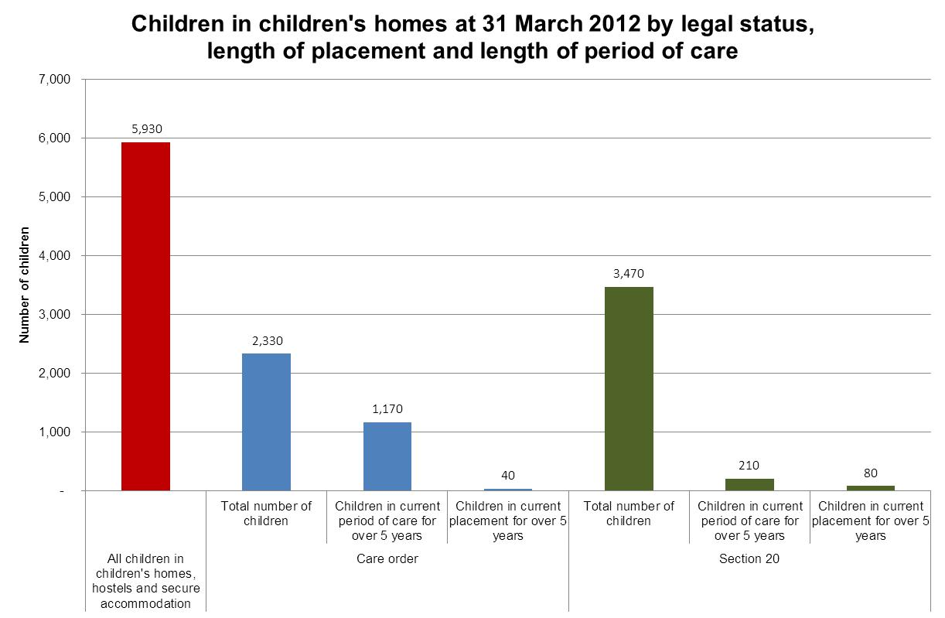
Children are more likely to be placed in children’s home under S20 than a care order. Children placed in children’s homes under a care order are more likely to remain in care for over 5 years but no more likely to remain in the same placement for more than 5 years. The same proportion of children accommodated under s20 and children with care orders remain in the same placement for more than 5 years (2% for each group)

Slide 21
Questions for local authorities
What proportion of your looked after population has been in care for more than five years?
How many of these children have been in the same placement for this time?
What proportion of those children who have been in care over five years are looked after under a care order? Does this impact on placement stability?
In terms of placement type (Relative and friend foster care, other foster care and residential care) – what are the most stable placements over time?
Do we collect and track the number of placements children have during their care journey or just in a particular care episode? Are there trends for particular age groups or placement types?
Do you record why placements end? Do you track the reasons over time for individual children, groups and the whole looked after population?
What are the most frequent reasons for placements ending and does this differ based on placement type (e.g. for those children accommodated under s20 who have been placed with relative and friend carers) or for different age groups?

Slide 22
Placement stability and educational attainment
The following analysis provides information on matched data for looked after children and number of placements with information from the National Pupil Database on educational attainment at Key Stage 4 (KS4). KS4 is the legal definition for the two years of education that incorporates GCSEs

Slide 23
43% of children with just a single placement during 2011-12 achieving 5+ A*-C grades at GCSE compared to 13% of those who had more than three placements

Slide 24
29% of children who had been looked after between 12 and 18 months achieved 5+ A*-C compared to 41% who had been looked after for six years or more

Slide 25
Questions for local authorities
What proportion of looked after children at KS4 had 1, 2, 3, 4-5, 6-9 or 10+ placements during the year? How does this compare to the previous five years?
What percentage of looked after children achieved 5+ A* - C grades at GCSEs including English and Maths? How does this link to their placement stability during KS4? How does the data in your local authority compare to statistical neighbours, to other local authorities in your region and to the national picture?
Does the pattern for educational attainment of your looked after children mirror the national picture for placement stability and educational attainment? How do you use this data to inform the decisions of social workers, foster carers, residential workers and the commissioning process?
How do you support children who start to be looked after at the primary/secondary school transition point?
How do we monitor placement changes and impact on educational stability? What do we do to proactively avoid disrupting education where it becomes necessary for a child to move placement at any point in their education and also a crucial transition points and at KS4?
Are foster carers and residential workers trained to understand the education system and how the support they provide can make a difference to a child’s educational attainment?
Are foster carers and residential workers encouraged to engage with the child’s school e.g. to attend parent’s evenings?
What more could social workers, commissioners, Virtual School Heads, fostering services and others do to improve and support placement stability?

Slide 26
Return home from care
Timely and effective decision-making and purposeful social work with children and their families to prepare and support the return, underpins long term stability and good outcomes for individual children
The information in this section aims to help local authorities to gain a better understanding of the local and regional context and to consider the factors that will enable safe, successful and lasting reunification

Slide 27
About the data
Data published as part of the Statistical First Release
Data on numbers of children who return home to their family after ceasing to be looked after is published in the Statistical First Release – Children looked after in England (including adoption and care leavers) for each year ending 31 March
Additional data on return home in this data pack
the number of children who return home as a proportion of all looked after children who cease to be looked after
the age, legal status and reason for first entering care of the children who return home
the number of children who return home by local authority (as a proportion of all children who cease to be looked after)

Slide 28
Key messages
In the year ending 31 March 2012 returning home to their family was the most common reason why a child ceased to be looked after. 37% (10,160) children returned to the care of their family during the year
14,330 children who were accommodated under s20 ceased to be looked after in 2011-12. Of these, 51% (7,250) returned home
The percentage returning home was highest at 45% for those who entered care due to parents’ illness or disability and for families in acute stress and lowest at 15% for those who entered due to absent parenting
The longer that a child had been looked after in their latest period of care, the less likely they were to return home to parents or relatives when this period ended

Slide 29
The percentage of looked after children who returned home from care dropped from 49% to 39% between 2004 and 2008 while age groups stayed nearly the same

Slide 30
14,330 children who were accommodated under s20 ceased to be looked after in 2011-12. Of these, 51% (7,250) returned home

Slide 31
64% of children who had been looked after for less than one year returned home compared to just 15% for those who had been looked after for more than one year

Slide 32
The percentage of children returning home between 1 April 2009 and 31 March 2012 as a proportion of all children who ceased to be looked after ranged from 9% to 60% between local authorities

Slide 33
Questions for local authorities
General
What proportion of your looked after population returned home to their families after ceasing to be looked after last year? How does this compare to the previous five years?
What are the assessment and decision making processes for return home from care?
What services are available to support children returning home to their families? How do services link across children, adult and specialist services – for example access to parenting programmes or drug and alcohol treatment can be secured as part of a return home plan?
How has our service provision for these children and their families changed over the last five years? What informed the change?
What action are you currently taking to improve return home practice?
Age
Do you understand the age profile of the children who return home each year? Has the age profile changed over the previous five years?
Do we have services and/or interventions that support children in specific age groups who are returning home?
Does your local data about the age and needs profile suggest the need to consider exploring whether there are sufficient, evidence informed age specific services/interventions to improve returns home decision making and success?

Slide 34
Questions for local authorities
Local area
What local factors might impact on return home practice?
How do we compare to our statistical neighbours in terms of size of care population, age profile of looked after children and numbers of children returned home? If there are significant differences, do you understand why?
How are local looked after children’s services organised and made available across the local authority area? How might this impact on return home work?
How is the goal of returning home to their families successfully reflected in local policy and practice? How is this monitored?

Slide 35
Children returning home in 2006-7 who re-entered care by 2012
The following section provides information about the number of children who returned home in the year 2006-7 who had returned to care by 2012. Some of the key messages about these statistics highlight the importance of addressing the parent’s capacity to provide good quality care and providing support during the period of transition to ensure that the arrangements are meeting the child’s needs. The support plan should be regularly reviewed.

Slide 36
30% (3,050) of the 10,270 children who went home in 2006-7 had returned to care in the five years to 31 March 2012

Slide 37
Key messages
The largest group to re-enter care following a return home were the 12 – 14 year olds. 45% (350) of the 780 13yr olds returned to care, followed by 43% of 12yr olds and 41% of 14yr olds
For those children who returned to care (3,050) 27% were still looked after at 31 March 2012 and 15% had left care at 18 or over
28% (approximately 500) of the children who had returned to care in the five years to 31 March 2012 had returned home again
Children who were on care orders prior to going home were far less likely to return to care (6% of all children who returned home who were looked after under a full care order in 2006-7 had returned by 31 March 2012). 34% of children who were voluntarily accommodated prior to returning home had returned to care by 31 March 2012
Children were most likely to return to care if they had been looked after for less than six months. 39% of those looked after for between two and eight weeks had returned by 31 March 2012 and 38% who had been looked after between eight weeks and six months had returned by 31 March 2012
Of the group of children who returned to care by 2012, 8% had been at home for less than two weeks while 17% had been at home for at least two years

Slide 38
Questions for local authorities
Is there an organisational framework for return home work?
How many of the children who returned home over the last five years re-entered care?
Are there children in particular age groups who re-enter care?
Was the reason for re-entering care the same reason for the first episode of care?
How many children over the last five years have returned home and re-entered care on more than one occasion? Do the reasons for re-entering care remain consistent?

Slide 39
For more information
Contact us
By email (data): andrew.brook@education.gsi.gov.uk
By email (policy): jamie.roome@education.gsi.gov.uk
Visit the website
http://www.thisistheurl.co.uk

