Slide 1

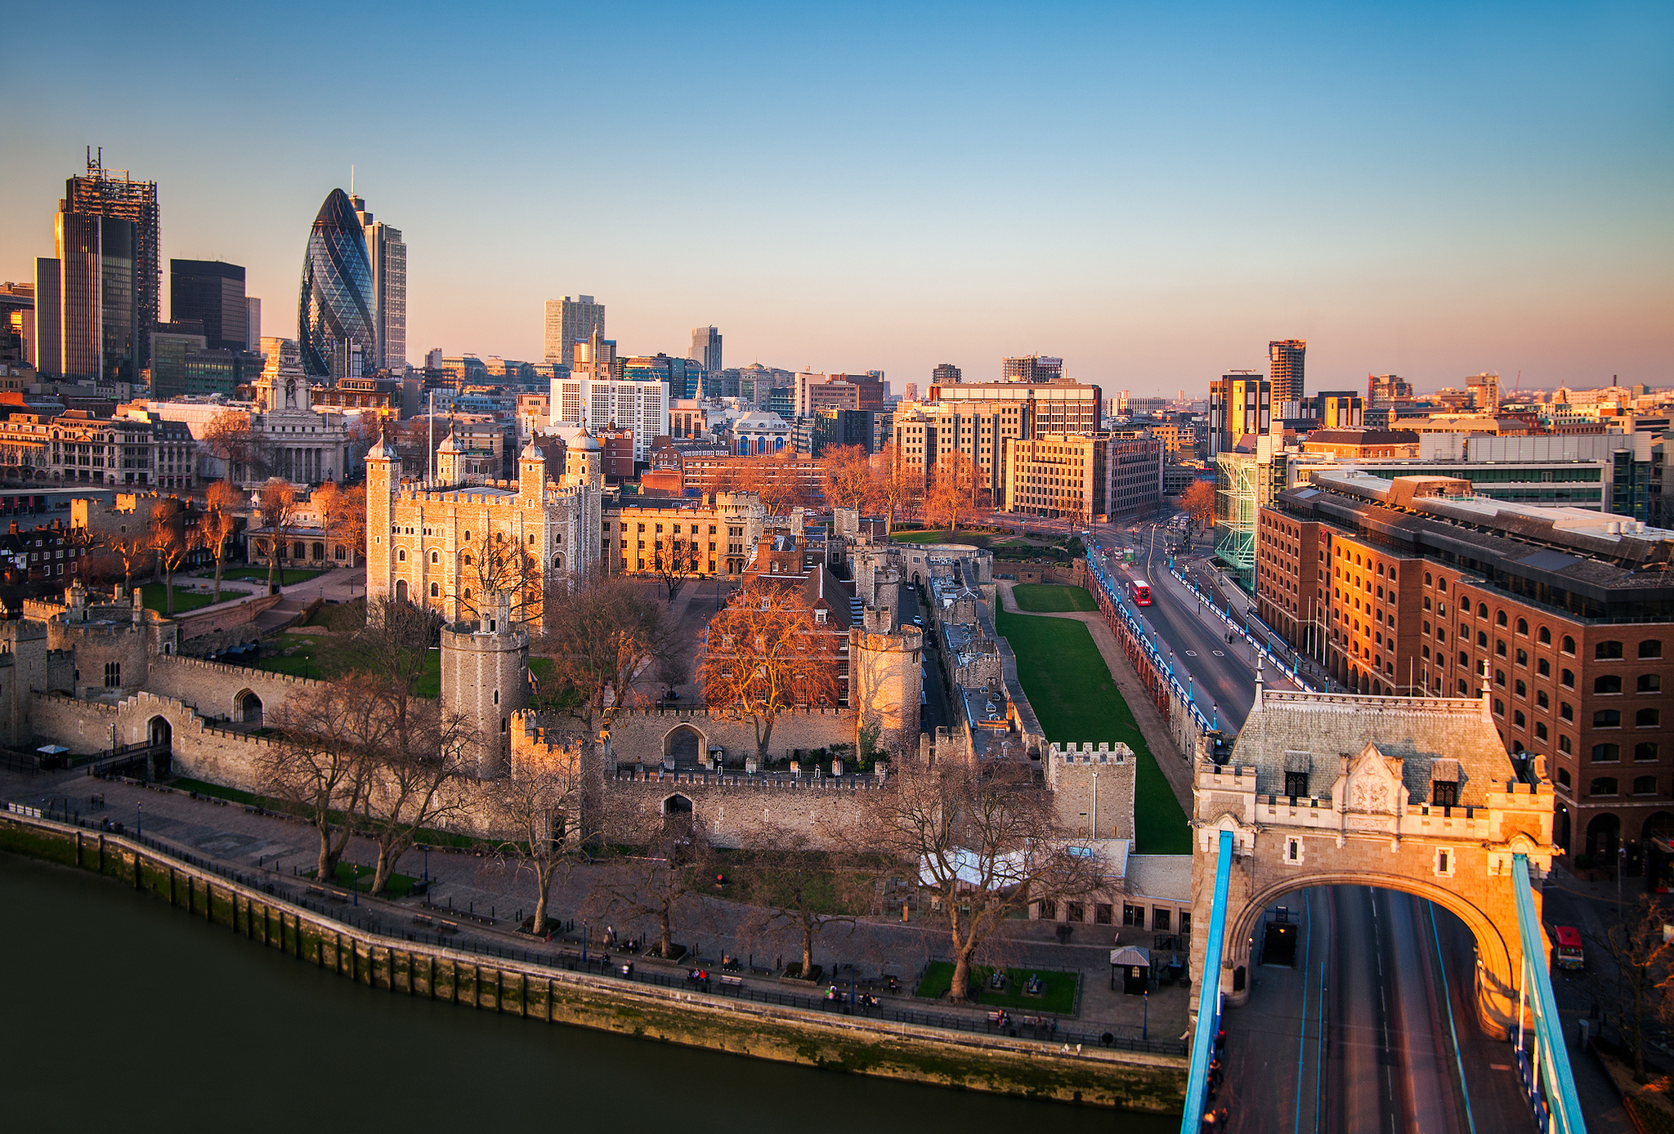

UK Future Cities Demonstrator Projects
Karl Baker | Project Manager | @karlsbaker

Slide 2
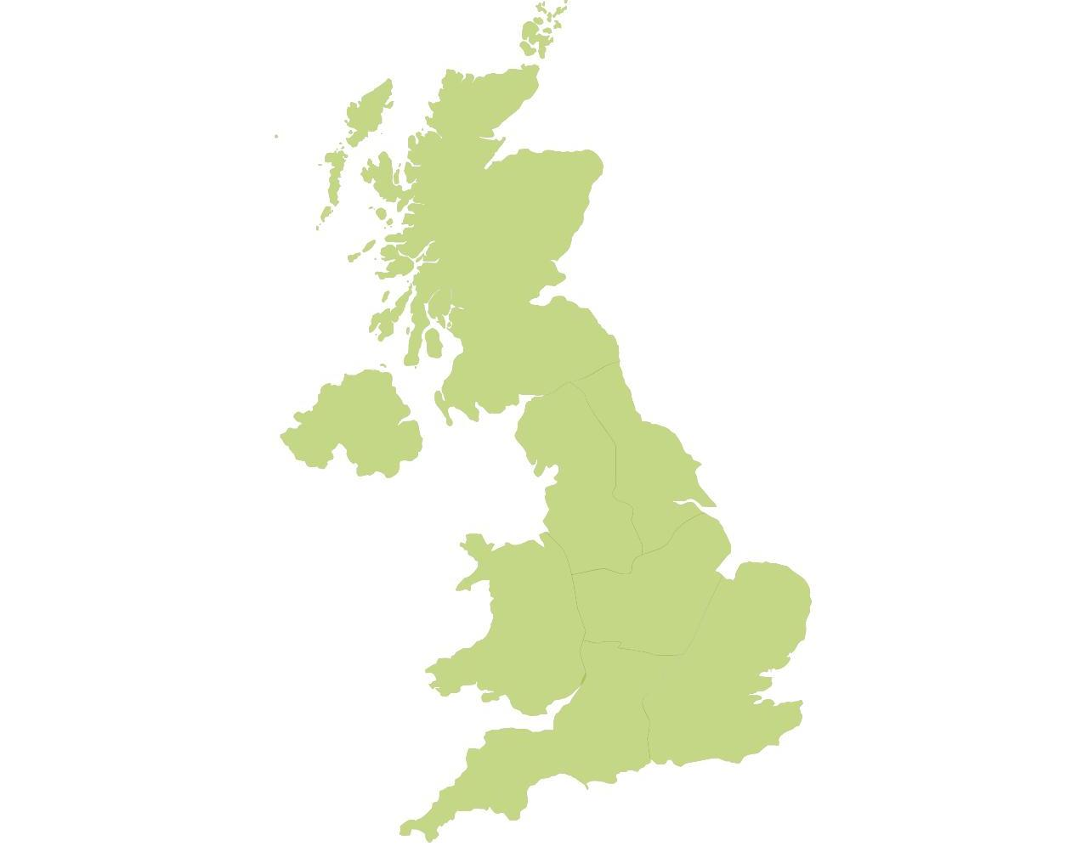

UK Demonstrators
“The projects will demonstrate at scale, and in use, the additional value that can be created by integrating city systems. The project will enable businesses to test, in practice, new solutions for connecting and integrating city systems, and will allow UK cities to explore new approaches to delivering a good local economy and excellent quality of life, whilst reducing the environmental footprint and increasing resilience to environmental change…”
Glasgow
Peterborough
London
Bristol
Notes:
©TSB Catapult Network brochure

Slide 3
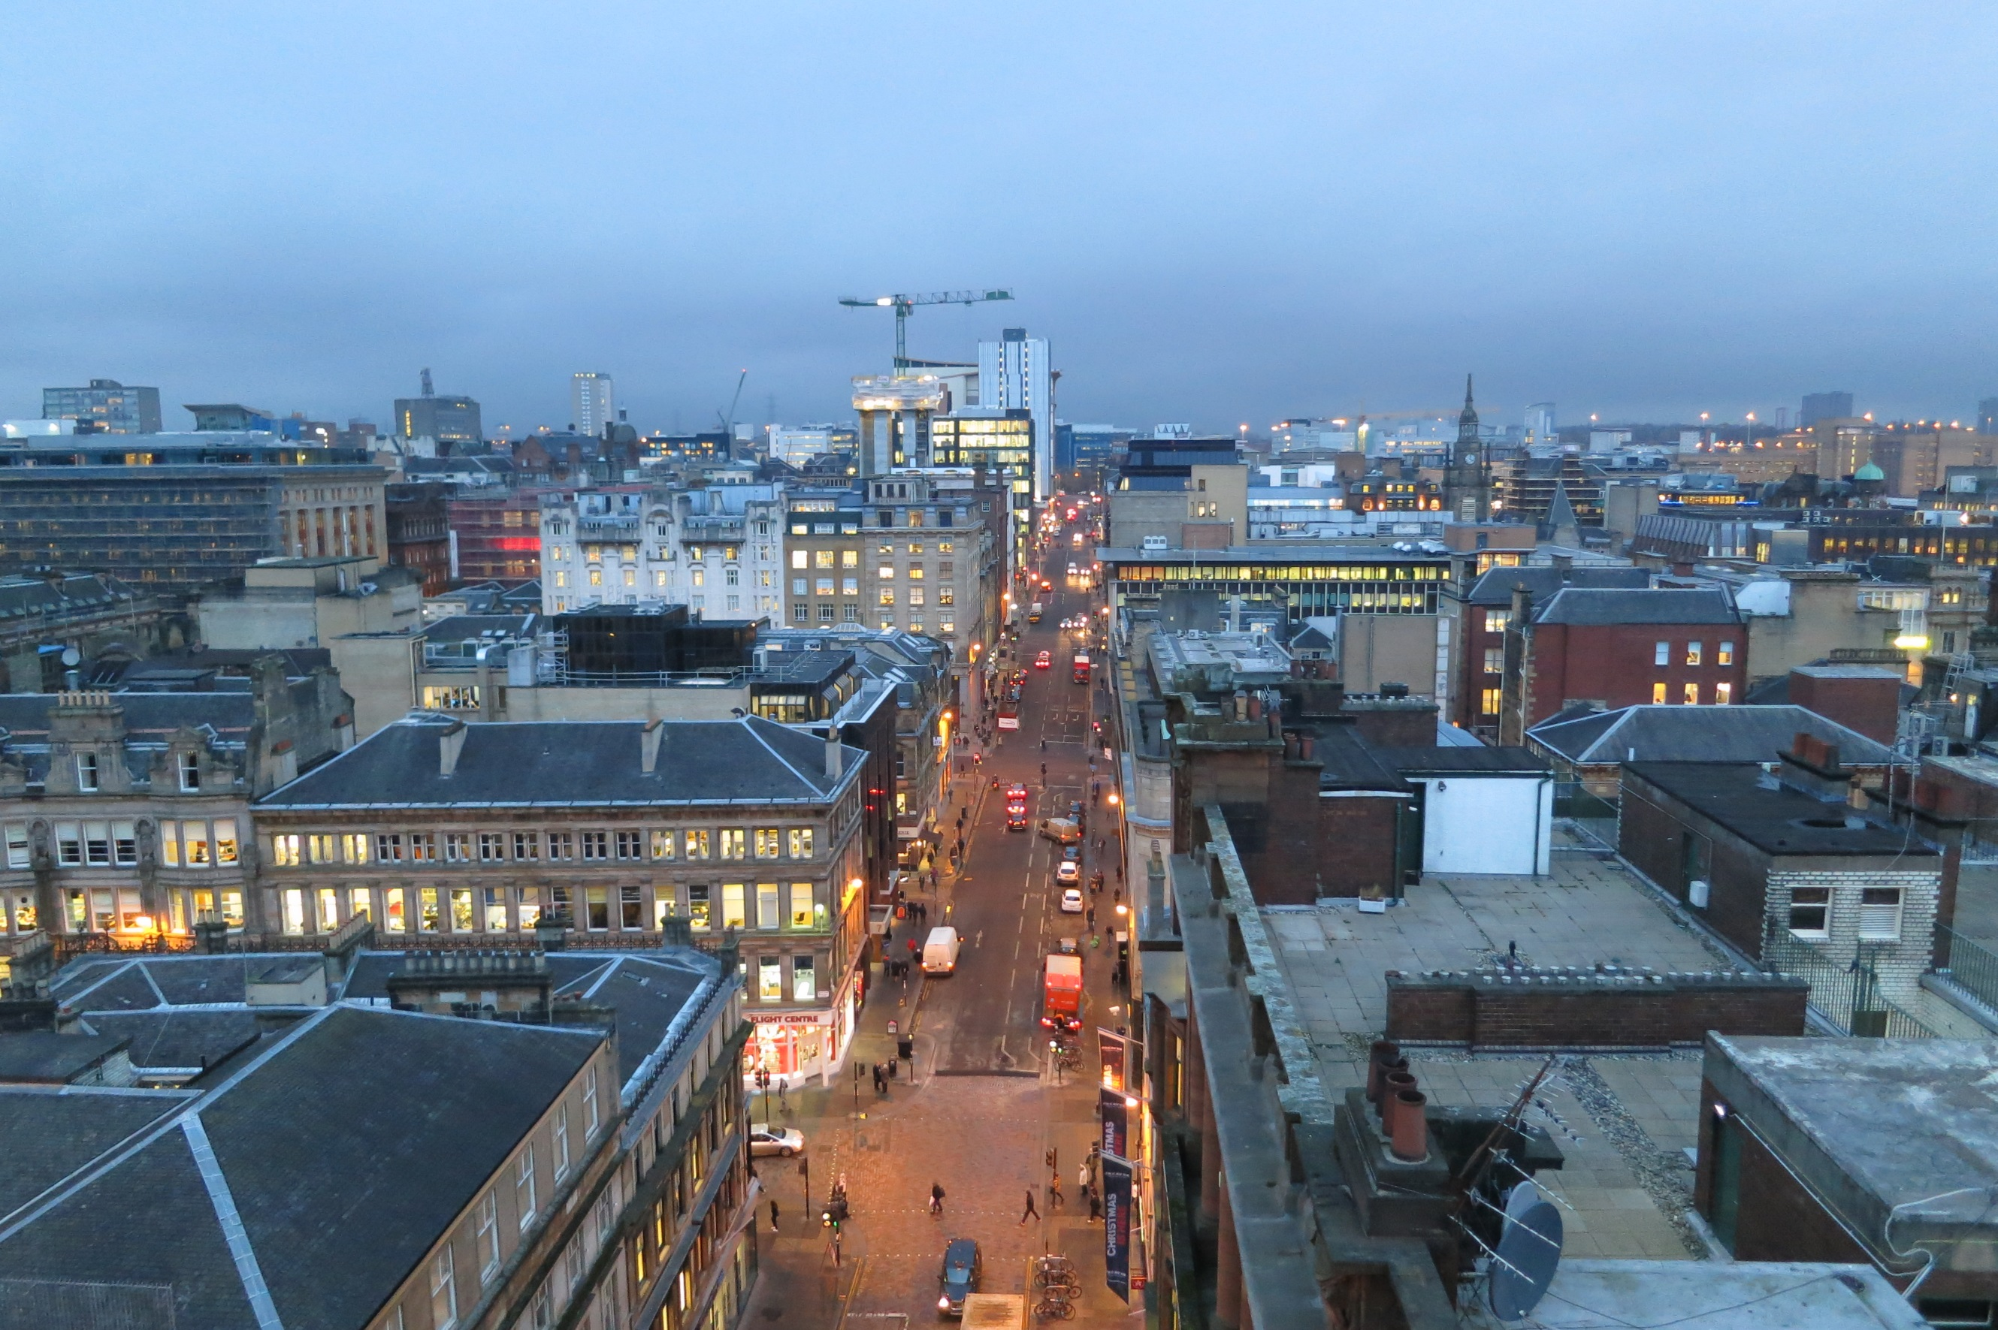
Glasgow
City technology platform
Operations centre
Street lighting
Citizen mapping

Slide 4
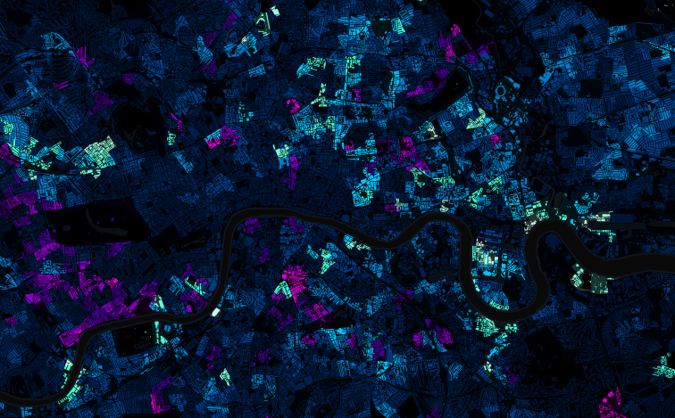

London
Notes:
©TSB Catapult Network brochure

Slide 5
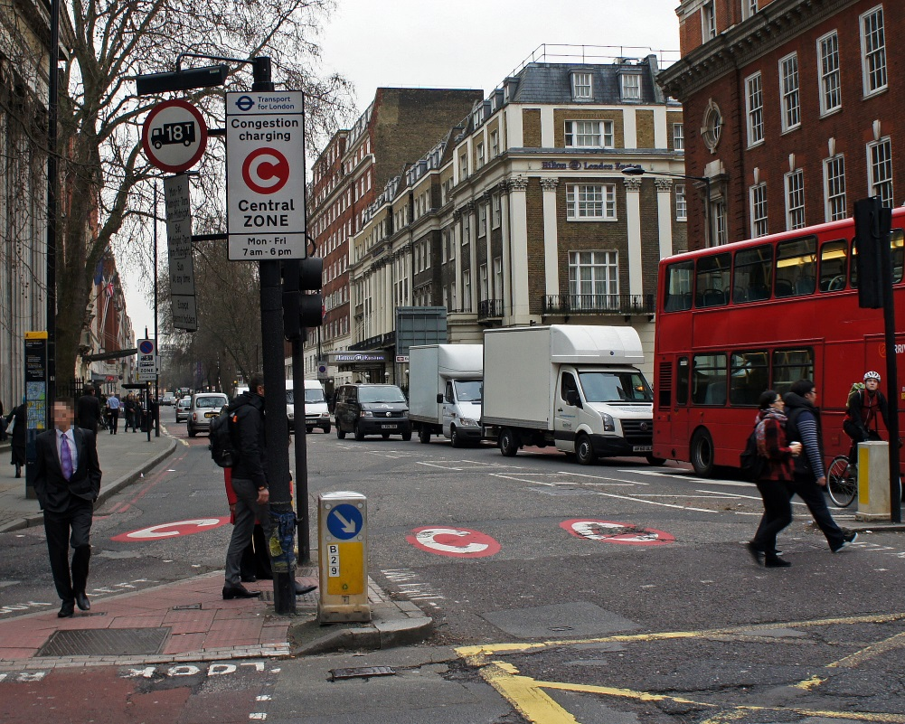
Agile urban logistics

Slide 6
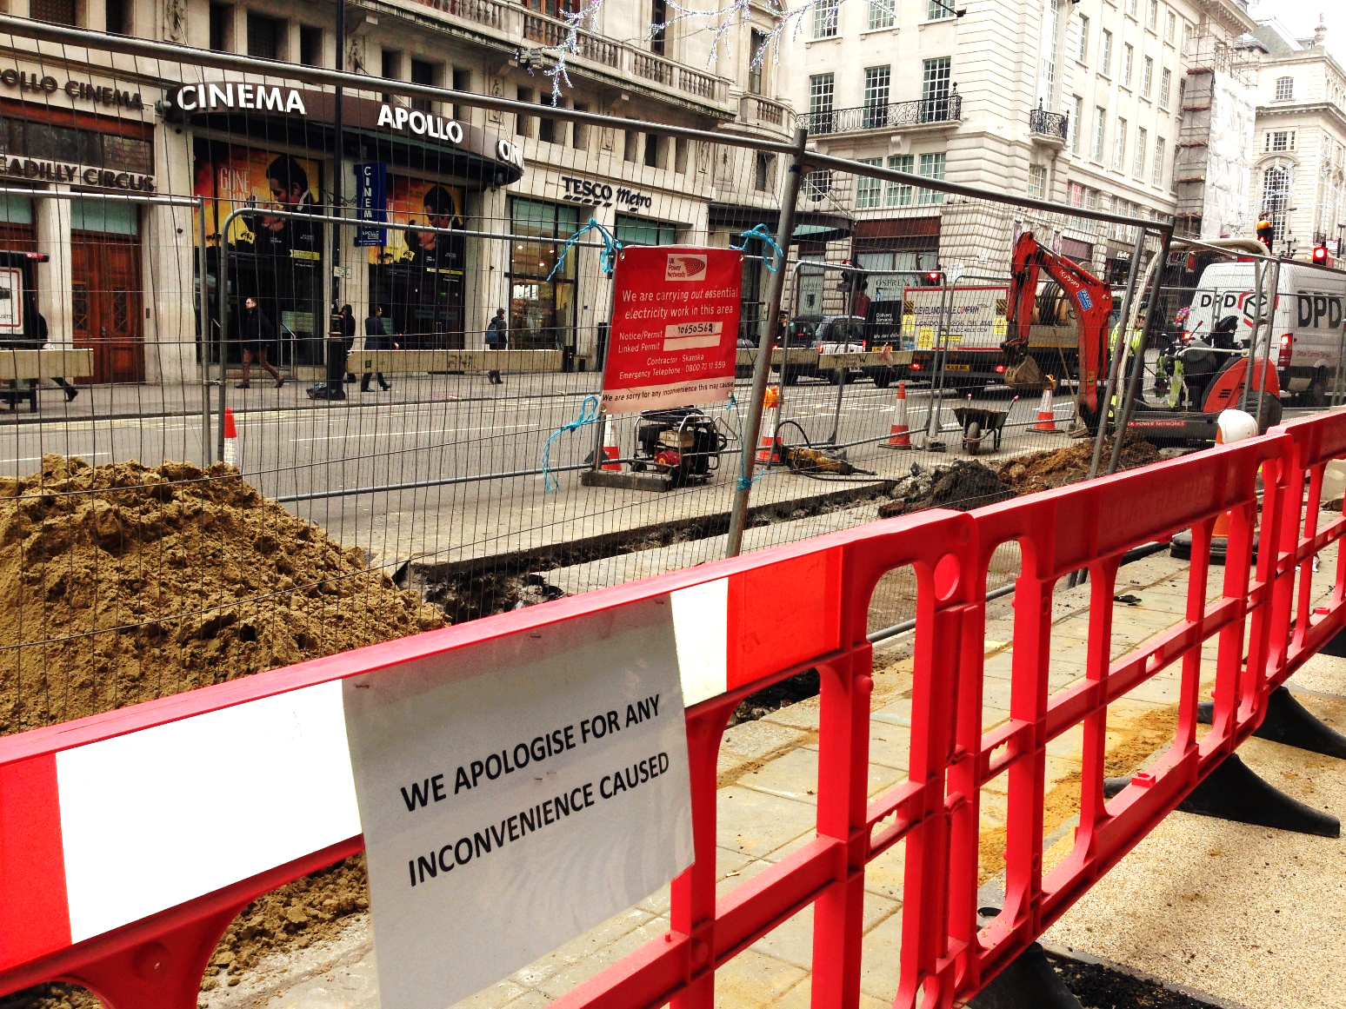
Networked utilities
Notes:
© Emma Shaw

Slide 7
Networked utilities

Slide 8

Work and volunteering platform

Slide 9


futurecities.catapult.org.uk
@FutureCitiesCat

