Slide 1


Slide 2
Update on reviews of marking and appeals
Julie Swan

Slide 3
Overview
The changes we made last year and why
What happened
What next

Slide 4
2016 changes
We required exam boards to:
  equip their reviewers to spot and correct marking errors – however large or small – but not to otherwise change marks on review
  provide reasons, on request, for the outcome of a review
  allow appeals in three AS/A level subjects (geography, religious studies and physics) on the ground of a marking error as well as on the ground of a procedural error - as a pilot

Slide 5
Our aim
To stop students on whose behalf a review was requested having their marks increased, despite no marking error having been made on their papers, while other students’ marks remained unchanged
To reduce the pressure on schools to ask for a review - just in case another mark could be found that would lift the result over a grade boundary
To address schools’ and colleges’ frustrations with the appeal arrangements, so they could appeal on the matters that really concerned them

Slide 6
Reviews
2015
90,950 (1.1%)
}
19% of grades challenged on review were changed
480,550 (6.0%)
Number (%) of grades for which a review was requested
and changed
Grades
8,026,550

Slide 7
Reviews
2015
2016
90,950 (1.1%)
480,550 (6.0%)
67,900 (0.9%)
Number (%) of grades for which a review was requested
and changed
371,600 (4.8%)
}
}
19% of grades challenged on review were changed
18% of grades challenged on review were changed
Grades
Grades
8,026,550
7,743,200

Slide 8
Reviews
2015
2016
New research
90,950 (1.1%)
480,550 (6.0%)
67,900 (0.9%)
}
418 (0.005%)
Number (%) of grades for which a review was requested
and changed
371,600 (4.8%)
Number (%) of grades challenged and changed by 2 or more grades
}
}
19% of grades challenged on review were changed
18% of grades challenged on review were changed
Grades
Grades
8,026,550
7,743,200

Slide 9
Reviews – 2016 (from new research to be published summer 2017)
2016
44% of mark changes were by just one mark
43% of mark changes were by 2 to 4 marks
13% of mark changes were of 5 marks or more
There was no mark change in 56.2% of reviews
5% more reviews resulted in no grade change in 2016 compared with 2015
Magnitude of mark changes was greater in subjective subjects
Mark
changes

Slide 10
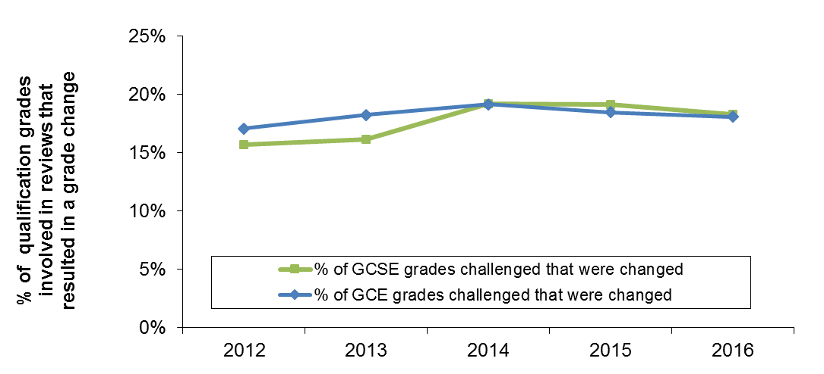
Percentage of all GCSE and GCE qualification grades challenged that resulted in a grade change, summer exam series, 2012 to 2016

Slide 11
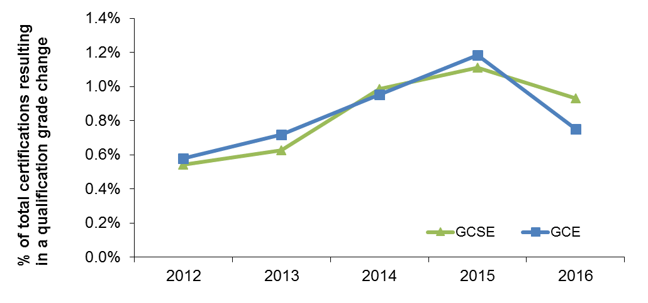
Qualification grade changes as a percentage of total certifications, summer exam series, 2012 to 2016

Slide 12
Appeals
2015
}
49 (0.0006%)
80 grades appealed in pilot subjects
7,166 (0.09%)
Number (%) of grades for which an appeal was requested
and changed (note: unusually low number in 2015)
}
5 grades changed on appeal in pilot subjects,
all on grounds of procedural error
Grades
8,026,550

Slide 13
2016
Appeals
2015
49 (0.0006%)
7,166 (0.09%)
211 (0.003%)
Number (%) of grades for which an appeal was requested
and changed
6,649 (0.09%)
}
}
80 grades appealed in pilot subjects
156 grades appealed in pilot subjects
}
5 grades changed on appeal in pilot subjects,
all on grounds of procedural error
}
16 grades changed on appeal in pilot subjects,
15 on grounds of marking error,
1 on grounds of procedural error
Grades
Grades
8,026,550
7,743,200

Slide 14
Number of appeals for GCSE and A level, summer exam series, 2012 to 2016

Slide 15
Proportion of appeals resulting in grade changes, summer exam series, 2012 to 2016

Slide 16
Evaluation of the pilot – report published 26 June 2017
Reviewed documentation, interviewed participants, observed panel hearings, assessed regulatory impact (benefits:costs), survey of schools and colleges.
While exam boards had to change their appeal arrangements to consider appeals on the ground of a marking error, this was manageable in the three pilot subjects
Marking errors that might otherwise not have been corrected were addressed
Extra costs - proportionate
Schools/colleges need more guidance when preparing an appeal case
Exam boards’ information must be clear on the appeal opportunities available

Slide 17
What next – reviews?
From 2020 exam boards must:
  make marked scripts available before their deadline for requesting a review; and
  provide reasons (automatically) for the outcome of a review
From 2018 exam boards must make sure schools and colleges allow students to know the marks for internally marked assessments

Slide 18
What next - appeals?
Exam boards must allow appeals on the ground of a marking error:
  in all AS, A levels and Project qualifications in 2017
  in GCSEs in English language, English literature and mathematics in 2018
  in all other GCSEs in 2019

