Slide 1
The Very Idea of Inter-Subject Comparability
Paul Newton
4 February 2016

Slide 2
Which is the faster racer?
Contactmusic.com
Photo credit: ATP
Contactmusic.com
Photo credit: ATP

Slide 3
Which is the faster racer?
www.formula1.com

Slide 4
Which is the faster racer?
Contactmusic.com
Photo credit: ATP
Photo credit: Karen Trim

Slide 6
Which is the faster racer?
Contactmusic.com
Photo credit: ATP
Jorge Lorenzo Forum ‏@Lorenzo99Forum

Slide 7
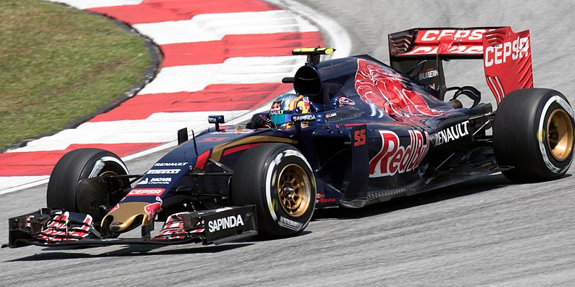
Which is the faster racer… in absolute terms?
Carlos Sainz Jr.
2015 Malaysian GP (F1)
Fastest lap: 1 min 45.507
Jorge Lorenzo
2015 Malaysian GP (MotoGP)
Fastest lap: 2 min 0.606
Photo credit: Morio
Photo Credit: Movistar Yamaha

Slide 8
Which is the faster racer… in relative terms?
www.formula1.com
www.motogp.com

Slide 9
Before trying to engineer comparability, think very hard about…
Is there any plausible basis for comparison at all?
Carlos vs. Ted – probably not
Carlos vs. Jorge – quite possibly
Do absolute or relative comparisons make more sense?
If absolute, then you’ll be limited by the adequacy of your indicator(s)
fastest lap time might be a good indicator of ‘racing pace’ when comparing F1 drivers, but
might not be a good indicator of ‘racing pace’ when comparing F1 vs. MotoGP
If relative, then you’ll be criticised for the arbitrariness of your comparison
after all, Carlos-in-a-car is blatantly far faster than Jorge-on-a-bike, and
what stops you from concluding that Carlos-in-a-car is far slower than Ted-on-a-Scalextric

Slide 10
Robert Wood (1976) (then Head of Research at ULUESEC)
“Just the thought of French and chemistry examiners sitting at the same table to discuss standards is enough to dispose of this lunatic idea.”
“there is no statistical adjustment which can equate simultaneously correlations between subjects for all boards so that grade comparisons can be put on the same footing.”
Implication: no plausible basis for comparison

Slide 11
Secondary School Examinations Council (1932) (report on School Certificate exams)
“It will be noticed that the percentages of passes awarded vary considerably […] from one subject to another; but it must not be inferred from the fact that a given percentage is low that therefore it is unduly low. A pass should mean something in terms of performance and assuming the paper is a fair one a low percentage of passes may be a proper indication of the fact that the work of the candidates was poor.”
Implication: absolute comparison

Slide 12
J.M. Crofts (1928) (Secretary to the Joint Matriculation Board)
“In a large examination is there any reason for thinking that the candidate who is this 90th percentile in Mathematics has a better brain, is a more capable scholar, is a better subject for the award of a scholarship than the candidate who occupies that position in English, or, for the matter of that, in any other subject? There is no evidence whatever in favour of this; the case cannot be proved one way or the other, and it would be unwarrantable to assume that any difference does exist.”
Implication: relative comparison

