Slide 1
Is Electricity Supply a Binding Constraint to Economic Growth in developing countries?
Neil mcculloch and Dalia Zileviciute
Energy and economic growth research programme
3-4 November, Washington d.c.

Slide 2
The questions and the answers
Is electricity supply a binding constraint to economic growth in developing countries?
To what extent is electricity being a binding constraint reflected in high average electricity prices?
The Answers
Yes!
Not much

Slide 3
Isn’t it obvious?
an estimated 1.2 billion people – 17% of the global population – did not have access to electricity in 2013
in 2015 firms in South Asia and Sub-Saharan Africa lost 10.9% and 8.8% of sales respectively due to electrical outages
But …
Lack of access and unreliability could be a symptom of poor economic performance … or of good economic performance
Several of the world’s fastest growing economies had very poor access, so lack of access doesn’t seem to have stopped them from growing.

Slide 4
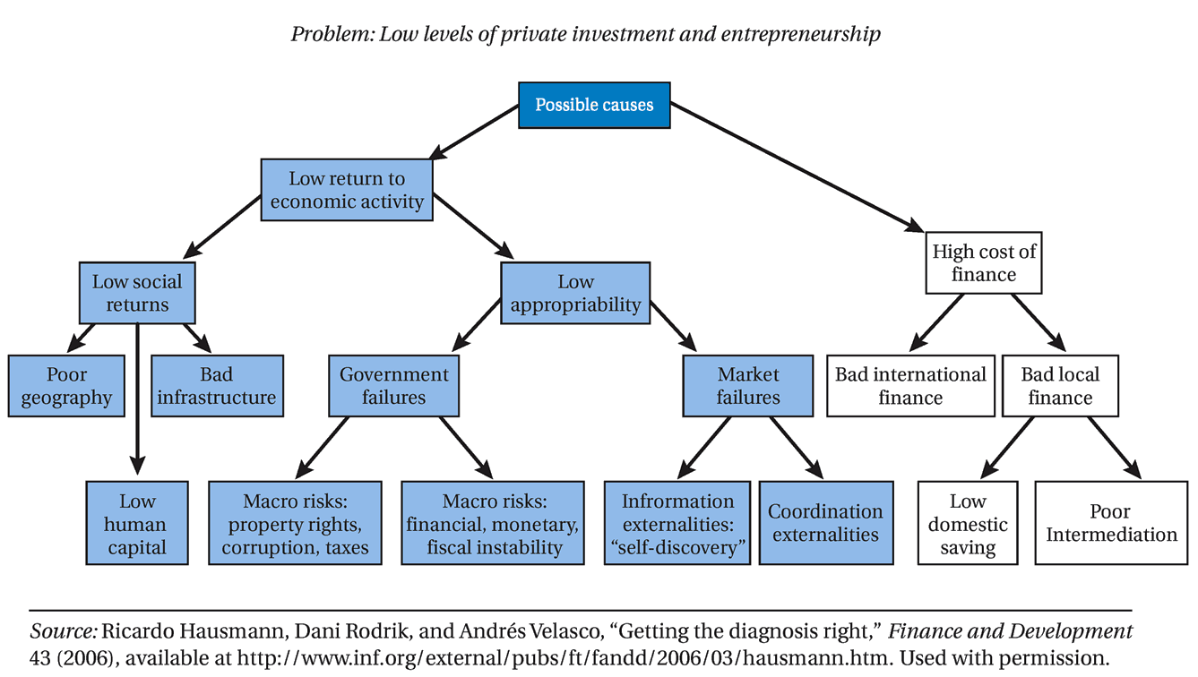
The HRV Methodology

Slide 5
Systematic Review
Inclusion
EXCLUSION
“Hausmann OR Rodrik OR Velasco AND binding AND constraints AND growth
Since 2004
Articles and studies published in English
Numerous social science research databases, including EconLit, Social Science Research Network (SSRN), EBSCOhost, Google Scholar and Google search engines, institutional websites and databases and multilateral and bilateral international development organization websites.
This initial search produced a list of 152 articles.
Didn’t use HRV methodology
Not economy wide
Poor quality application of the method
This yielded 55 studies which we reviewed.

Slide 6
Evidence extracted
Questions asked of each paper
Differential diagnosis
To what extent is electricity a binding constraint?
What evidence is presented about:
Prices
Access
Reliability/quality
Other energy issues
Are the shadow prices of electricity as a constraint high?
Do movements in the electricity constraint produce significant movements in the objective function?
Are agents in the economy attempting to overcome or bypass the electricity constraint?
Are agents less intensive in the electricity constraint more likely to survive and thrive in the economy? (Conversely, are agents more intensive in the electricity constraint more likely to fail?

Slide 7
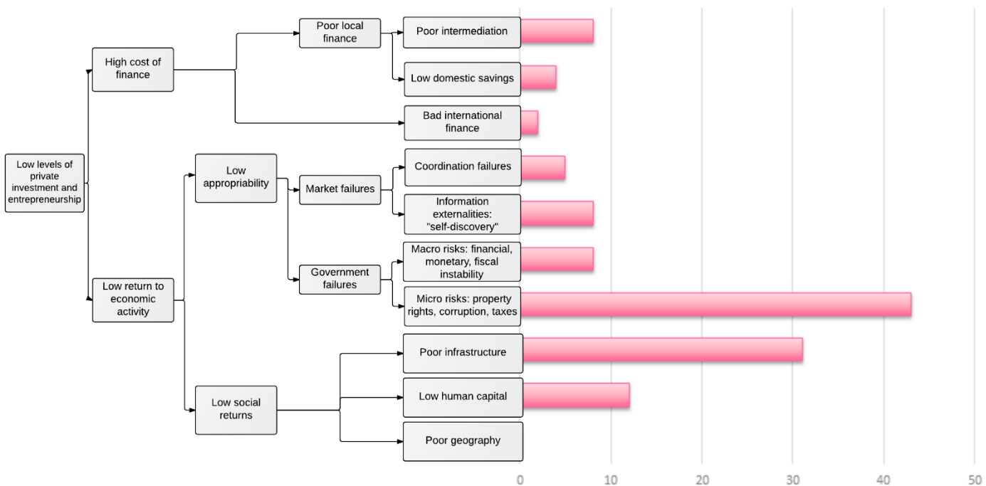

Slide 9
Nuggets of evidence
Access, reliability and prices
Differential diagnosis
Access
A huge problem – particularly in rural sub-Saharan Africa. But also major contrasts e.g. Maldives/Bhutan vs Nepal
Reliability
Huge unreliability – e.g. outages of 16-18 hours per day in Nepal
Prices
Very poor data on prices; underpricing a major problem e.g. 3.9% GDP in Ghana
Shadow prices
Very high in some countries e.g. $13 billion spent on fuel for generators in Nigeria
Production sensitivity
Benin suffers an average output loss of 6.5% because of unreliable electricity supply
Behaviour to avoid the constraint
60% of firms in Nigeria have a generator
Performance of electricity intensive sectors
Weak evidence. E.g. Aceh manufacturing firms negatively affected by lack of electricity

Slide 12
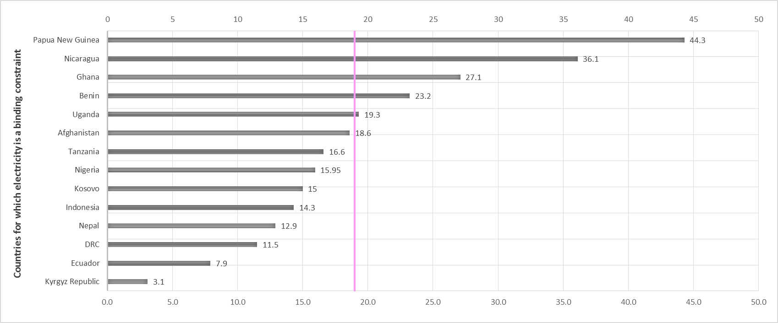
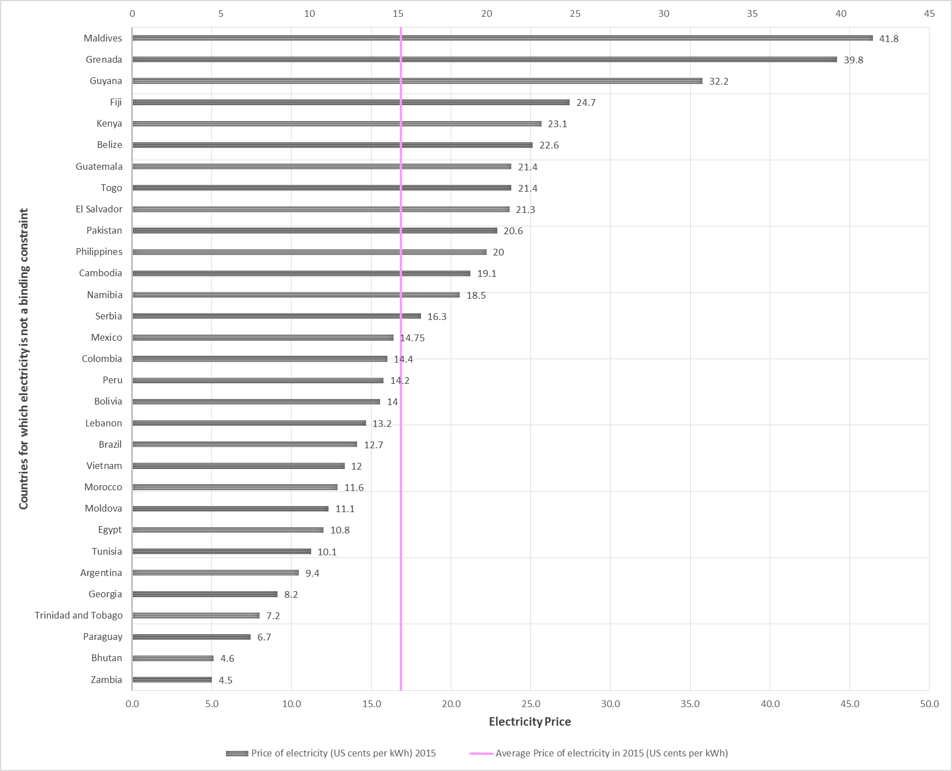
There is no significant difference between electricity prices in countries in which electricity is a binding constraint – and ones where it is not…
… but there is huge variation electricity prices across countries.

Slide 13
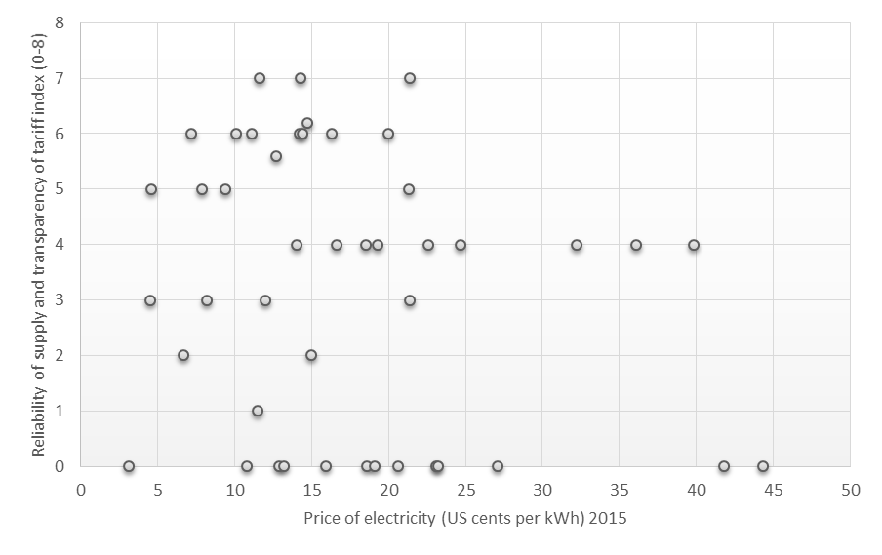
Very high prices are associated with poor reliability and transparency … but with lots of variation

Slide 14
What we know and what we don’t know
What we know
What we don’t know
Access, reliability and quality of electricity is a huge problem in Sub-Saharan Africa and South Asia and a binding constraint to growth in several countries
Official prices are a poor indicator of whether electricity is a binding constraint
Who has access to electricity, how much, when, how and at what price and how such access determines growth incomes
What electricity prices actually are – across country and time; and what consumers actually pay
Why some countries manage to make rapid progress on access and quality whilst others remain stuck

Slide 15
How EEG research can fill these gaps
1. Better understanding of electricity as a micro-economic constraint to growth
Who has access to electricity (men/women), how much, when, where from, and at what price? How does such access/reliability affect income growth of firms and households?
2. Comprehensive programme of data collection on electricity prices and costs
We need to know what drives prices in order to help policymakers get the right balance between efforts to reduce costs, improve efficiency and adjusting pricing policies.
3. Coordinated case studies exploring why poor access and quality persists
Examine the motivations and incentives faced by the key actors in different contexts. Explore instances where rapid progress has been made.
AND
4. No more Binding Constraints to Growth studies!

