Slide 1


Is the IPCC’s Fifth Assessment Report telling us anything new about climate change and food security?
Philip Thornton
ILRI
11 June 2014

Slide 2
Outline
New knowledge on climate change and climate change impacts
WG2 lessons for:
  Food security
  Adaptation
(WG2+) research gaps
  Climate variability
  Agricultural systems
  Diets
Notes:
Food prodn vs food sec. Food prodn easier

Slide 3
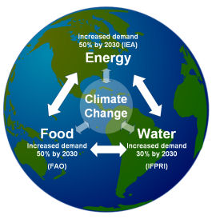
The challenge
Increased food production
  in the face of climate change
  whilst reducing the carbon cost of farming
  but not simply by farming at lower intensity and taking more land (because there isn’t enough)
Notes:
Food prodn vs food sec. Food prodn easier

Slide 4
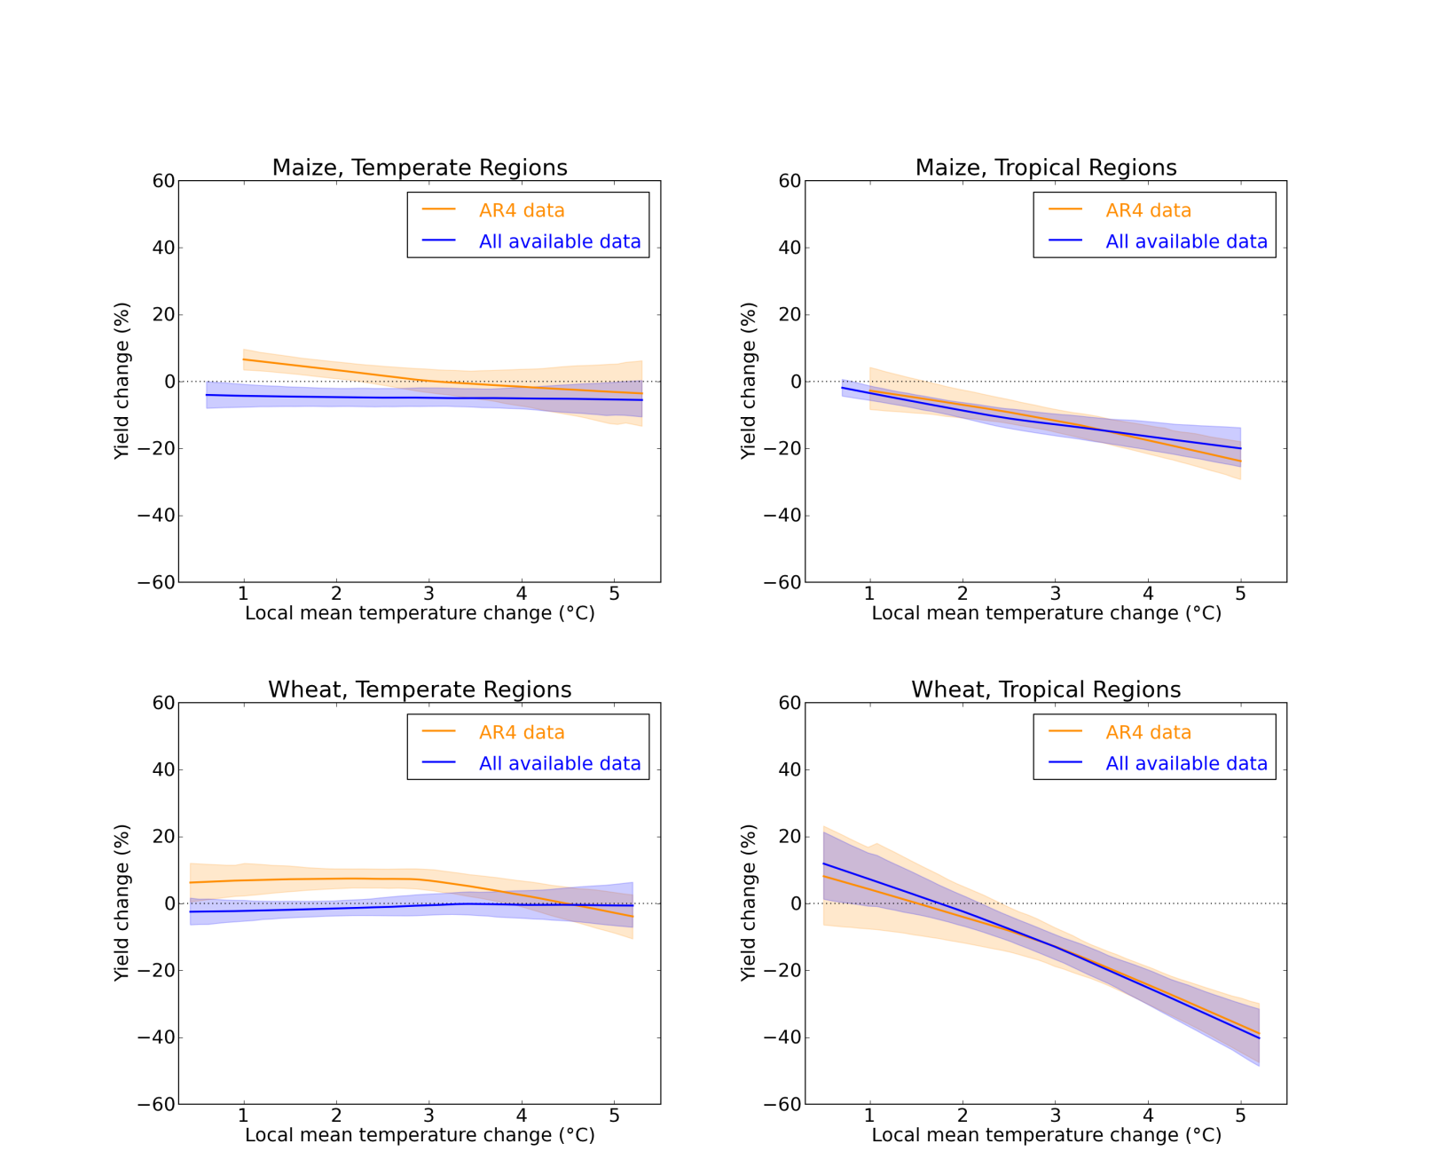
What’s new since IPCC AR4?
Signs of earlier impacts in temperate regions
Challinor et al. (2014), Nature Climate Change, doi:10.1038/nclimate2153

Slide 5
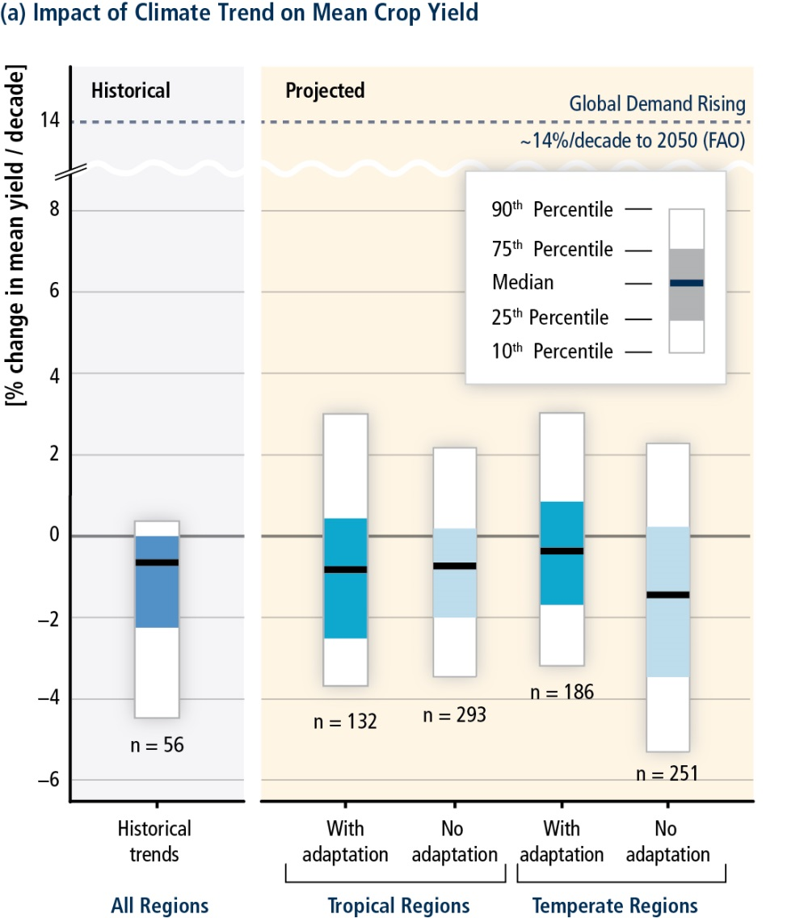
Projections are consistent with climate-induced historical trends
“Climate change has negatively impacted wheat and maize yields for many regions and in the global aggregate (medium confidence)”
[SPM page 7]
“For the major crops (wheat, rice and maize) in tropical and temperate regions, climate change without adaptation is projected to negatively impact food production for local temperature increases of 2°C or more above late-20th-century levels, although individual locations may benefit (medium confidence)”
[SPM page 17]
AR5 Chap 7
Notes:
AR4 mainly looked at future risks, but we have also looked at what is already happening, and draw some strong conclusions that net effects for some crops are already negative - and consistent with our projections
This is mean impacts again – 2 deg/decade is an average
Ie 2 deg conservative SPM point. Is climate change affecting crop yields yet, or is it yet to come?!

Slide 6
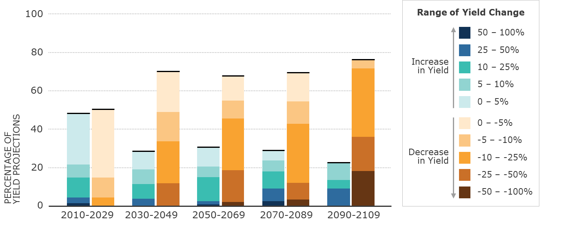
Limits to (agronomic) adaptation: when will agricultural transformations be needed?
Trop and temp
Mostly temperate
Notes:
Moving now away from these average pictures, to look at when we expect big changes
Includes agronomic adaptation, which can save us from 10-15% yield drops, but no more
5-10% drops in the 2030s; after that 25%+ drops become more common
Cf 2% per year in last slide
Ie it’s not the trends that will get you, at least not at first…

Slide 7
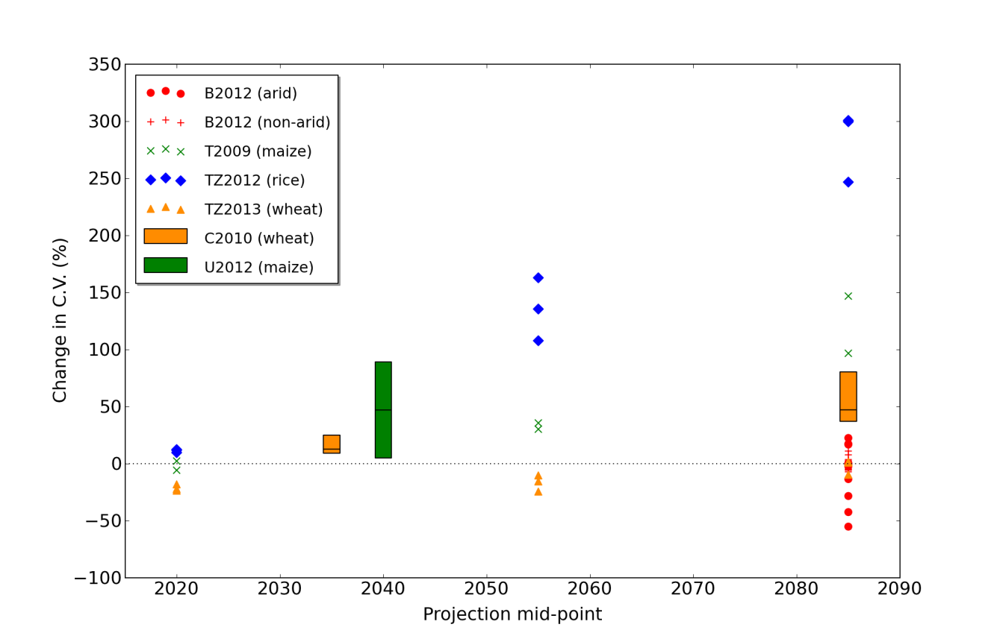
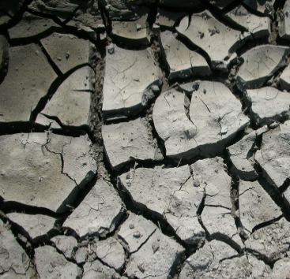
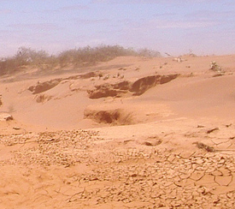
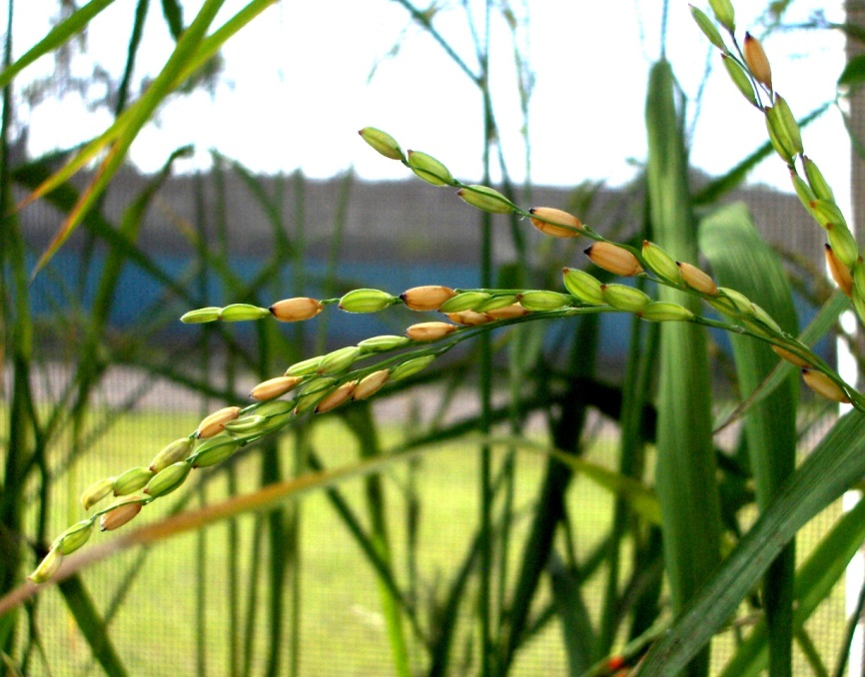
Changes in the stability of food supply
Challinor et al. (2014), Nature Climate Change, doi:10.1038/nclimate2153
Notes:
Drought and heat stress
At stage of mean yields at last IPCC
Those transitions (last slide) will need to account for this increase in variability

Slide 8
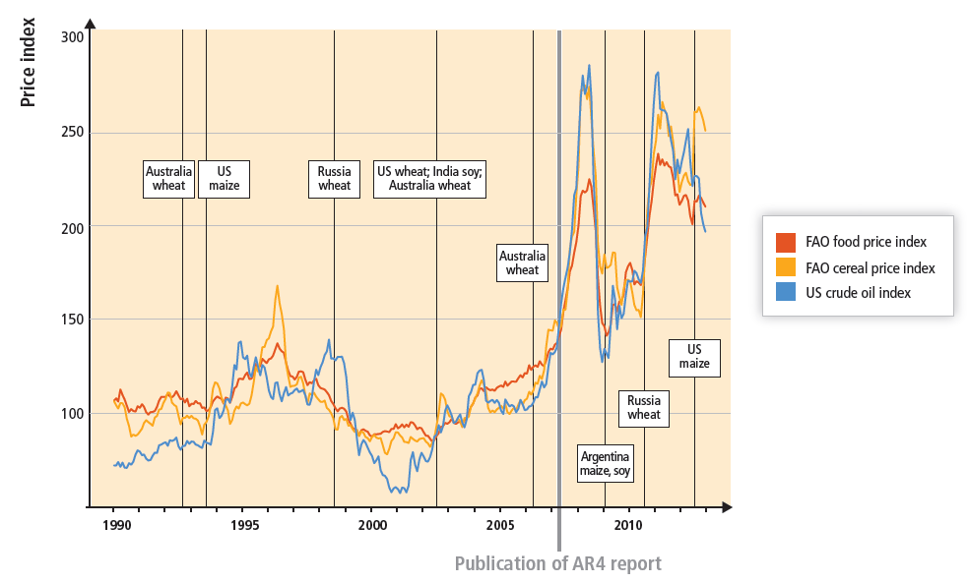
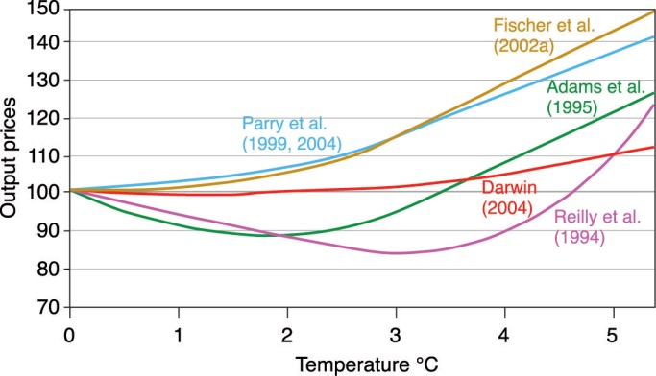
Food price volatility
Notes:
New relationships between anomalies and food prices, since AR4. Inc stronger r(oil,FPI)
Food prices respon to increased demand, e.g. biofuels (policy and oil-price driven)
But also a role for prodn, with recent spikes following production anomalies
AR4 to scale - this is something we didn’t see coming.
Econ models haven’t even got going by the current level of warming – 0.5-1 degrees. Even at 5 degrees they are way out.
(We didn’t’ produce any price graphs in IPCC2013…)

Slide 9
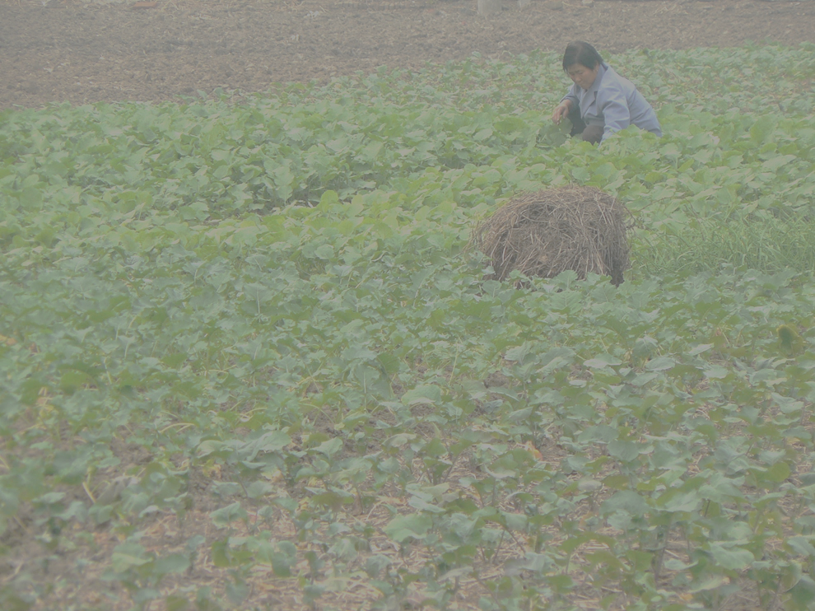
Tropics vs temperate
Tropics worse hit – affected sooner, and greater magnitude of change
Increasingly inter-dependant food markets
  And increasingly homogenous diet, globally
Smaller impacts, more opportunities in temperate regions
  → strong signal to intensify
  Affect developed country concept of “sustainability”?
  Food systems in the tropics harder to sustain (e.g. production anomalies affect sustainability of enterprises)
Notes:
V different to my title slide picture of mechanised ag

Slide 10
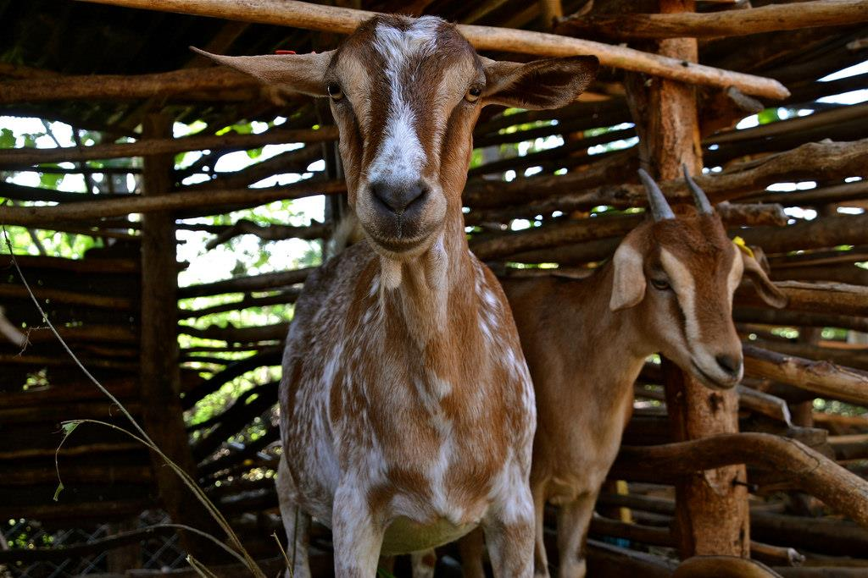
Livestock messages from the AR5
Prior conclusions confirmed (like crops): more evidence, higher confidence
Only limited, semi-robust evidence (unlike crops) for impacts on livestock systems already: livestock disease, disease vectors
For future impacts, widespread negative impacts on forage quality at both high and low latitudes → impacts on livestock productivity, production, incomes, food security
Robust evidence for negative effects of increased temperature on feed intake, reproduction, performance across all livestock species

Slide 11
Livestock messages from the AR5
Impacts of increasing climate variability on downside risk, stability of livestock production, human well-being, have not been robustly elucidated
Summaries of impacts on livestock systems with / without adaptation still not available
Many adaptation options possible in livestock systems tailored to local conditions (like cropping, fishery systems)
Costs, benefits (social, private) of adaptations not known, although:
  Substantial benefit, particularly if implemented in combination
  Benefits in managing crop-livestock interactions in mixed systems

Slide 12
Key messages, globally
On average, climate change will reduce food production
  Consistent with observed impacts
Local vs global sustainability
  Sources of our global diet
  “Area-wide” sustainability?
Less stable / predictable food supply
  Spatially: global average yield changes vs instances of large reductions
  Temporally: year-to-year variation and extremes
Notes:
[Blank the screen?]

Slide 13
Food security and food production systems
For wheat, rice, maize, climate change without adaptation is projected to negatively impact production for local temperature increases of 2°C or more above late-20th-century levels, although individual locations may benefit (medium confidence)
  After 2050 the risk of more severe yield impacts increases and depends on the level of warming
  CC is projected to progressively increase inter-annual variability of crop yields in many regions
All aspects of food security are potentially affected by climate change, including food access, utilization, and price stability (high confidence)
  Global temperature increases of > 4°C would pose large risks to food security globally and regionally (high confidence)
  Risks to food security are generally greater in low-latitude areas
IPCC WG2 SPM, 2014

Slide 14

Mean daily temperature in sub-Saharan Africa to the 2090s
Africa south of lat 18°N, all areas with LGP>40 days per year (grey mask below)
Ensemble mean, 17 GCMs downscaled to 10 arc-minutes (about 18 km)
For two emission scenarios, RCP 4.5 and RCP 8.5
Thornton & Jones (2014)

Slide 15

African agriculture in a +4 °C world
Length of growing period (%)
>20% loss
5-20% loss
No change
5-20% gain
>20% gain
To 2090, ensemble mean of 14 climate models
Thornton et al. (2010)
Notes:
The global target is to limit global climate change temperature increase to 2oC, but the global average target is not helpful in elucidating the winners and losers for agriculture at the village level. Also, it seems unlikely that this target will be met by 2050.
Four degree world – for SSA Pessimistic but not at all an unrealistic outcome. Model results show substantial losses away from equator, some small gains in parts of E Africa.
It will, however, require radical shifts in agricultural systems, rural livelihood strategies as well as food security strategies and policies.

Slide 16

Food production in sub-Saharan Africa
Not much difference in climate projections between the climate models of CMIP3 (AR4, 2007) and CMIP5 (AR5, 2014)
A +4°C for SSA arrives by the 2080s, on a high GHG emissions trajectory (RCP 8.5, the pathway we are currently on (+5°C by 2100)
Situation for agriculture a cause for considerable concern, on current emission trajectories:
  Most parts of the region will undergo contraction of growing periods (a robust result, independent of climate model used)
  Limited parts of the highlands may see expansion of growing periods (not such a robust result: it depends on the climate model used)

Slide 17
Food production in sub-Saharan Africa
Crop, grassland simulations: overall decreases in yields to the 2030s and 2050s, severe in some places.
Shifts in season start dates also likely, in addition to shifts in length of growing periods
Increases in extreme events and in climate variability are very likely, with direct impacts on livelihoods and food security
“Business-as-usual” emission scenarios globally are not an option: +4°C for African agriculture would be catastrophic for large parts of the continent
→ Huge effort needed to roll out and support risk management and longer-term adaptation actions that are climate-smart

Slide 18
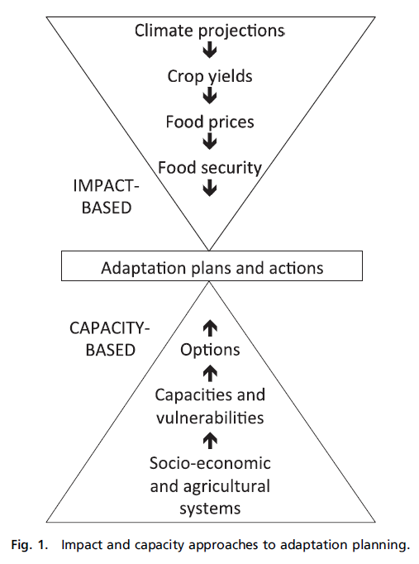
Adaptation under uncertainty: making the most of the science
Tends to be regional or global
Tends to be place-based
Vermeulen et al., 2013, 'Addressing uncertainty in adaptation planning for agriculture', PNAS 110, 8357,

Slide 19
Using climate science to determine when transitions will be required
Incremental
Systemic
Transformative
Lots of reasons for overlaps – climate is far from being the only driver of change
Notes:
(but yes later on)
Limits of adaptation in last slide point to transition points

Slide 20
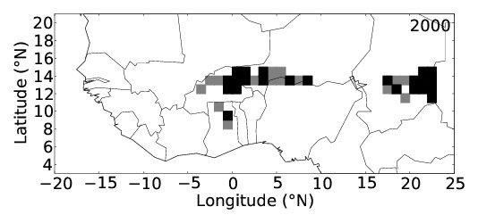
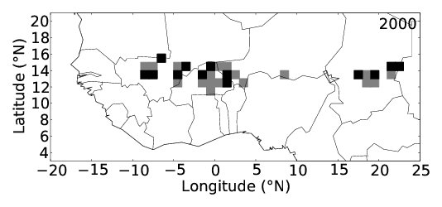
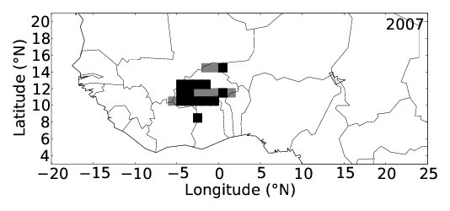
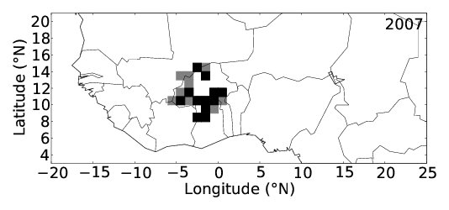
Early warning and adaptation tools
Food forecasting
Observed crop failure
Simulated crop failure
Kathryn Nicklin
Vermeulen et al., 2013, 'Addressing uncertainty in adaptation planning for agriculture', PNAS, 110, 8357
Notes:
PhD student
Earliest impacts of climate change in climate variability and extremes; although not 1:1
Good for early warning, not just adaptation

Slide 21
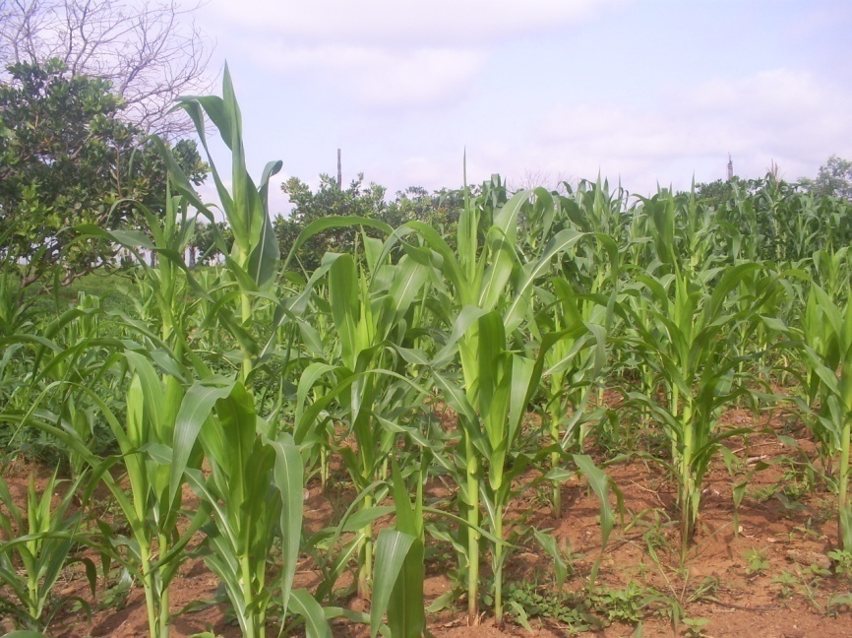
Key messages for research
Sustainability of food system enterprises in the face of
  Global trends (increasing prices, limited land, biofuels..)
  Decreased stability (increases in extremes)
Role for R&D in supporting adaptation on timescales from seasons to decades
  Limits of “simple” agronomic adaptation
  Opportunities and land use change
Limits to technology and the markets: what needs to be done, and what will it really cost?
  What else is needed?
Notes:
Economics won’t come to the rescue of developing countries
Decoupling of emissions and socio-economics is key to the credibility of future projections (because there are many more that one ‘high emissions’ world etc)

Slide 22
Critical knowledge gaps
Climate variability
Agricultural systems
“Sustainable diets”
Notes:
Economics won’t come to the rescue of developing countries
Decoupling of emissions and socio-economics is key to the credibility of future projections (because there are many more that one ‘high emissions’ world etc)

Slide 23
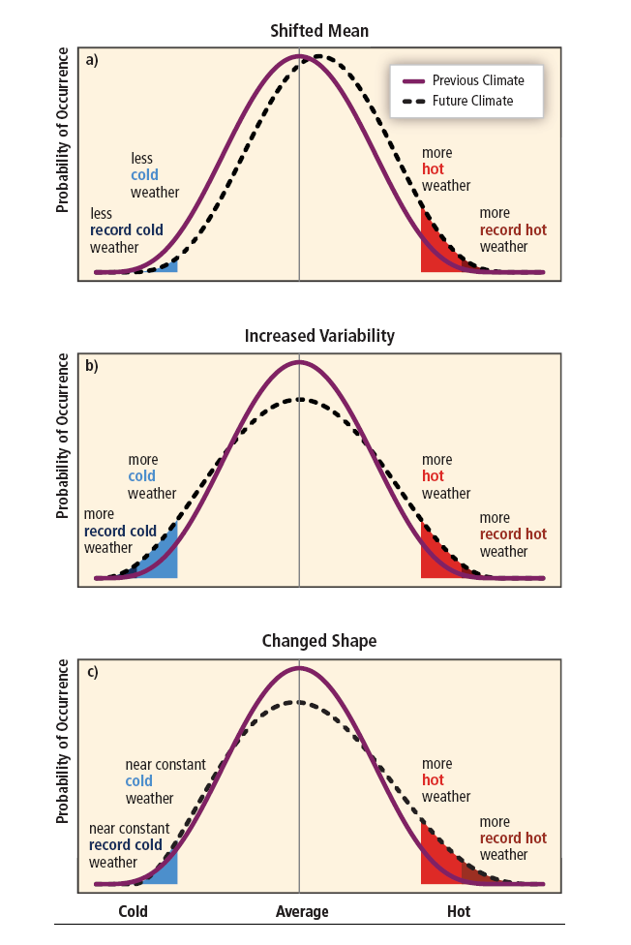
Impacts of climate change on human and natural systems
Much impacts work addresses changes in means of distributions
Changes in variability often difficult to include (downscaling, stationarity)
Climate models → weather models: yes but when?
First principles: more energy in the system → more evap/rain → more variability: yes but where, how much?

Slide 24
Climate variability affect food insecurity
Rainfall variability can have substantial effects on agricultural growth at the national level; at local level it can crush households
Can we demonstrate links from rainfall variability to food availability, and then to food insecurity and poverty?
How might these links be affected in the future with increased climatic variability?

Slide 25
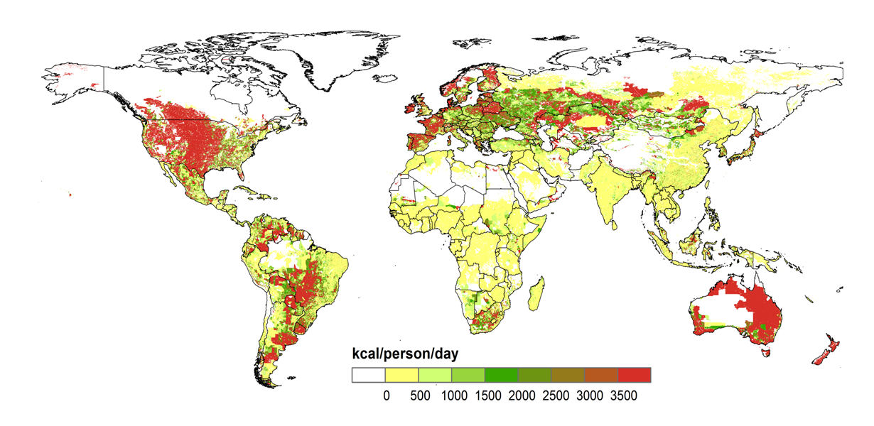
Kilocalorie availability per capita from animal source foods
Livestock systems mapping
Regionally-specific livestock diets
Livestock model simulations
Milk and meat from ruminants
Meat and eggs from monogastrics
Numbers matched with FAOSTAT at country level
Herrero et al. (2013), PNAS

Slide 26
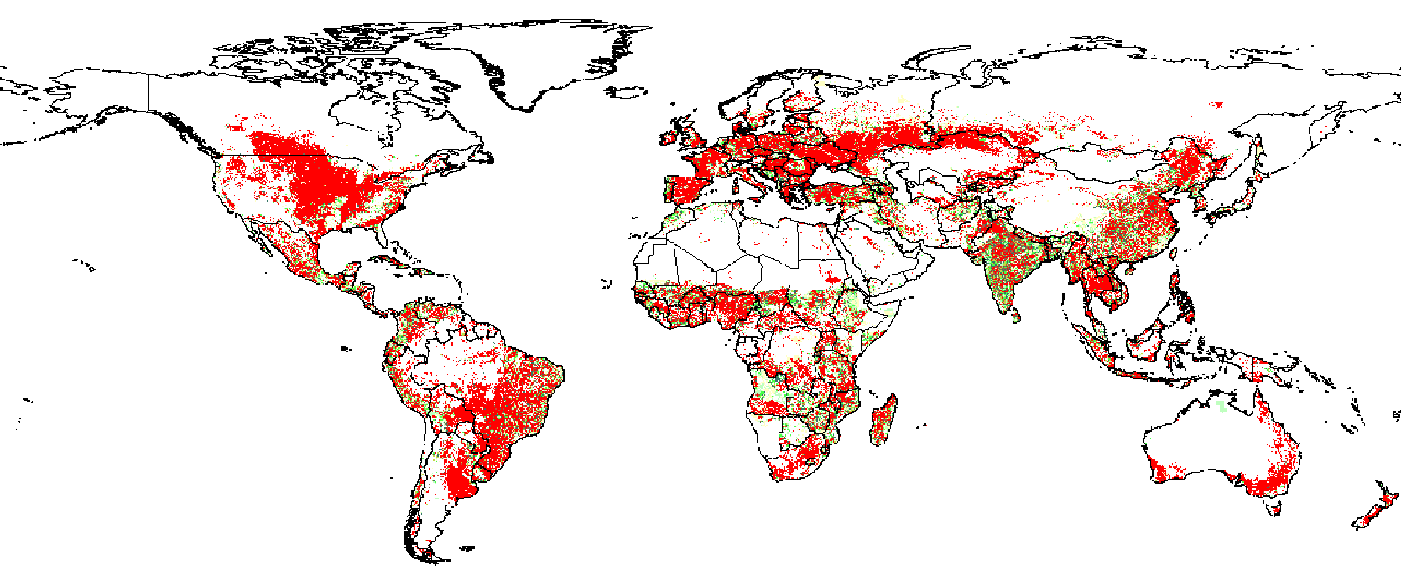

Kilocalorie availability per capita from crops
SPAM crop area data (2000) for 14 food crops / crop groups (cereals, pulses, roots and tubers, bananas)
Matches FAOSTAT country data (2000)
Thornton et al. (2014), GCB

Slide 27
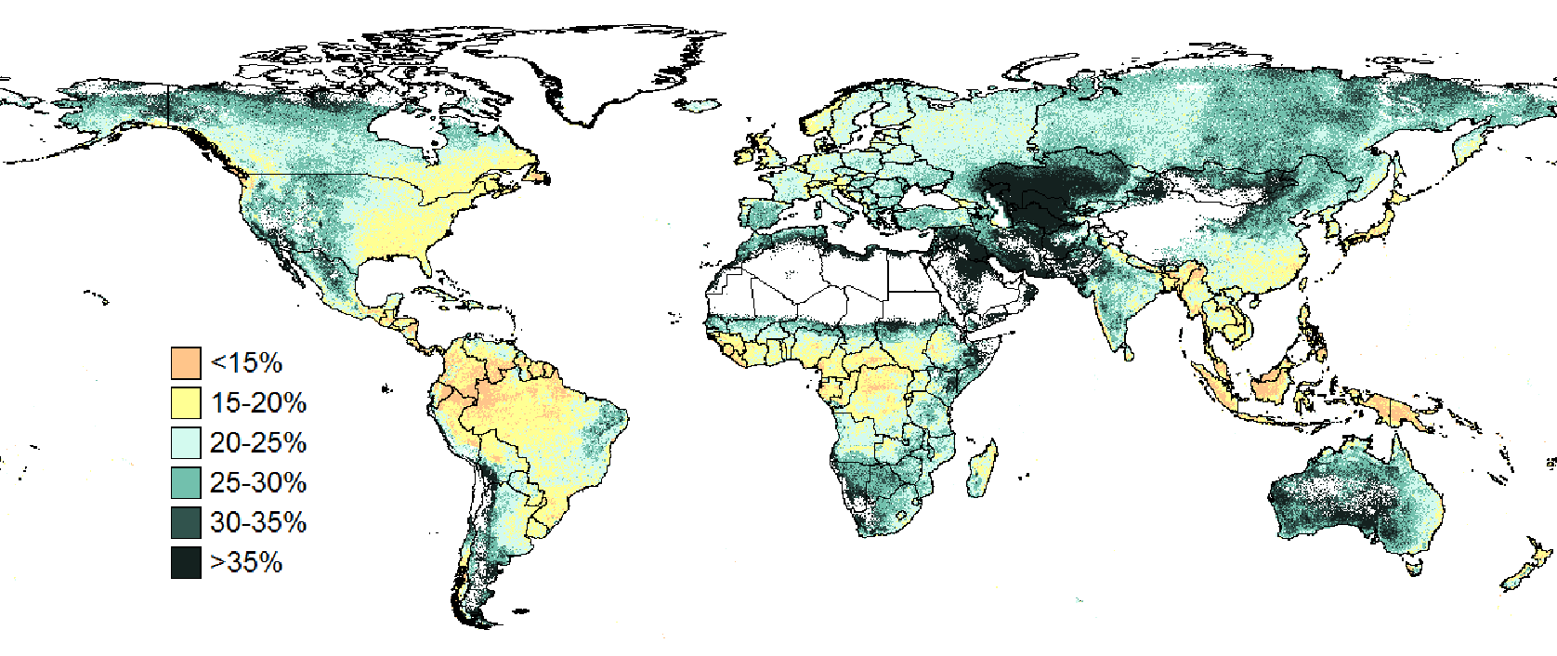
Simulated annual rainfall coefficient of variation %
Jones & Thornton (2013)

Slide 28
Calorie availability and rainfall variability
5.4 billion people (90%) live in places that produce some crop and livestock calories; of total calories, 70% from 14 crops, 30% from livestock
22% of people live in developed regions, producing 60% of the calories
78% of people live in developing countries, producing 40% of the calories;
In developed regions, “food insecurity” (children underweight) increases as rainfall variability increases
In developing countries, “FI” increases up to 30% rainfall CV then falls
slightly (food imports/food aid?)
8x more people live in high rainfall variability areas in developing countries than in developed countries (407 million vs 54 million)
These areas of high rainfall variability in developing countries account for only 3% of all available calories (for 10% of the population)
Thornton et al. (2014), GCB

Slide 29
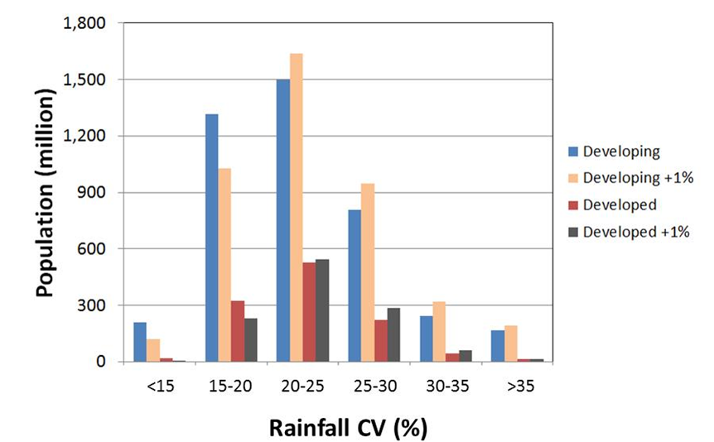
Impacts of an across-the-board increase in rainfall CV of 1% on population distribution by rainfall variability
100 million more people (+25%) developing
20 million more (+40%) developed
→ more underweight children in the future (all other things being equal)
Thornton et al. (2014), GCB

Slide 30
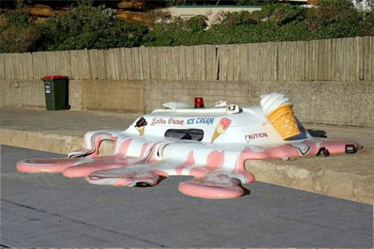
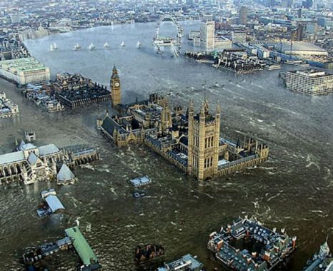
We don’t yet know many details of future variability change
→ define different “types” of climate change (means and variation) and evaluate their impacts
→ Adaptation options will look different in a world defined by changes in mean climate only, compared with a world defined by changes in mean climate and climate variability

Slide 31

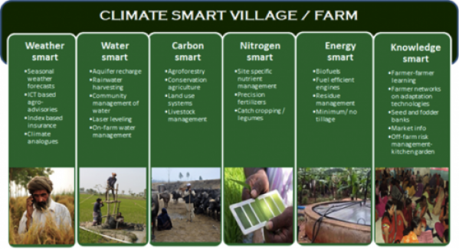
CC impacts at local level: households and climate-smart villages
Network of 21 CCAFS research sites
Testbed for suites of adaptation and mitigation
Portfolios of interventions
A model for scaling up appropriate interventions (Asia)

Slide 32
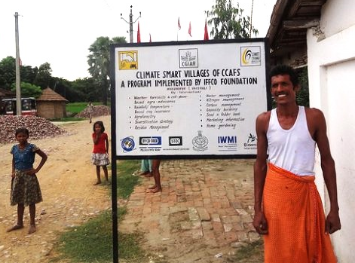
Households and CSVs
Data-rich, well-characterized
Baselines
IMPACT-Lite household data sets
Multi-Centre work in many sites over many years
Evaluating options at different scales
Regional scenarios & modelling
Household modelling

Slide 33
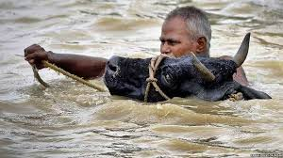
Challenges
Human dimensions in the models: what can we realistically capture?
How to deal with systems transitions & dynamics into the future?
Do we know enough about synergies / trade-offs at the level of the farming system (crops, livestock, …)?
Can we deal effectively with highly heterogeneous systems?
How to link multi-scale model-based assessments to development outcomes?

Slide 34
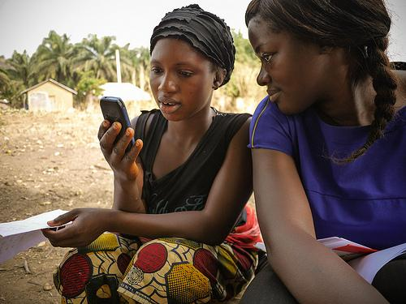
Opportunities
Big ICT
Big Data
  Data are going social
  “Repurposing” in many different ways
  Brute force of “n=huge” obviates precision, long waits, big $
New approaches – e.g. farms of the future: beyond climate analogues to socio-economic-biophysical analogues at different scales?
Beyond lip-service: process matters, as does understanding how humans learn and how they change

Slide 35
Three strategies for feeding the world more sustainably
Increasing productivity (managing the supply side)
Gains in many parts of the world (developed countries and Latin America and Asia). Lots of ongoing research on how to sustainably intensify global food production, bridge yield gaps of crops and livestock, improve value chains
Reducing waste in food value chains
Post-harvest losses and at the post-consumption stage. Some work going on
Consuming more sustainable diets (managing the demand side)
Modifying what we eat could have significant impacts on the use and and water, reduce GHG emissions, and have important health and nutritional benefits

Slide 36
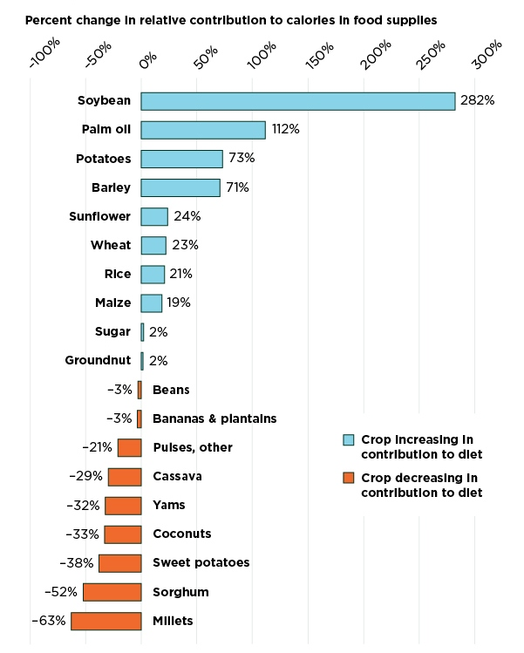
Increasing homogeneity in global food consumption since 1960
We have shifted the relative importance of crops in our diets
And hence are more dependent on fewer, more widespread, crops
Khoury et al. (2014) PNAS doi: 10.1073/pnas.1313490111

Slide 37

Increasing homogeneity in global food supplies
Causes
But also urbanisation
Research focused on “big” staple crops
Implications
More calorie-dense food available
BUT
Micro-nutrients from minor crops, livestock products?
Excess food in places: obesity, diabetes, heart disease
Genetic resource diversity and conservation
Food system more vulnerable to climate variability and pests/diseases

Slide 38

Sustainable diets
Integrated studies of local food systems, dietary diversity, nutritional quality, cultural preferences
Beyond kilocalories → quality
Implications of diet shifts? Nuanced analyses
What role can policy play – “nudging” people towards specific behavioural change?

Slide 39
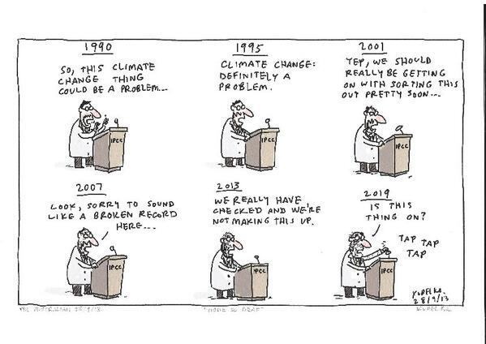

p.thornton@cgiar.org
p.thornton@cgiar.org
http://ccafs.cgiar.org

