Slide 1
Social Mobility Barometer
Public attitudes to social mobility in the UK, 2021
March 2021

Slide 2
About the Commission
The Social Mobility Commission is an advisory non-departmental public body established under the Life Chances Act 2010 as modified by the Welfare Reform and Work Act 2016. It has a duty to assess progress in improving social mobility in the UK and to promote social mobility in England. It consists of twelve commissioners and is supported by a small secretariat.
The Commission board comprises:
Interim Co-Chairs
Steven Cooper, Chair of Experian UK and incoming CEO of Aldermore Bank Plc
Sandra Wallace, Partner and Joint Managing Director at law firm DLA Piper
Commissioners
Saeed Atcha MBE, Chief Executive of the charity Youth Leads UK
Alastair Da Costa, Chair of Capital City College Group
Pippa Dunn, Co-Founder of Broody, helping entrepreneurs and start ups
Sam Friedman, Associate Professor in Sociology at the London School of Economics
Harvey Matthewson, Aviation Activity Officer at Aerobility, a charity for disabled people
Jessica Oghenegweke, BBC Earth Kids presenter and student at Brunel University
Farrah Storr, Editor-in-Chief of ELLE UK
Jody Walker, Director of retail company TJX Europe
Liz Williams MBE, CEO of FutureDotNow, a coalition focused on accelerating digital skills
Sammy Wright, Vice-Principal of Southmoor Academy in Sunderland
The functions of the Commission include:
monitoring progress on improving social mobility.
providing published advice to ministers on matters relating to social mobility.
undertaking social mobility advocacy
Social Mobility Commission, Sanctuary Buildings, 20 Great Smith Street London SW1P 3BT contact@socialmobilitycommission.gov.uk

Slide 3
Foreword
Everyone’s lives have been turned upside down in the last year but those from disadvantaged backgrounds have fared so much the worst. More likely to lose their jobs, miss out on home schooling or fail to get an apprenticeship, they are also more likely to be in front line jobs and at greater risk of catching the virus.
Our latest Social Mobility Barometer 2021 surveys 4,693 UK adults and gives a timely snapshot of perceptions of where the pandemic has impacted most, who has suffered and what needs to be done by government and others. It reveals that most people think that COVID-19 has had the biggest impact on mental health (55%) and social interaction (44%) but also that the pandemic has led to even greater social inequality.
The YouGov poll shows that over half (56%) of all adults in the UK think that social inequality has increased as a result of the pandemic. Almost four fifths (79%) of adults believe there is now a large gap between social classes in Britain with 34% stating that it’s a very large gap.
In 2019, our State of the Nation report revealed that social mobility had stagnated for at least four years, with big increases in child poverty since 2012. Now without urgent, targeted action, social mobility looks set to go backwards and the attainment gap between the wealthy and disadvantaged will grow ever wider.
The respondents say that boosting employment (47%) and addressing people’s mental health (46%) should be the top priorities for the government’s recovery programme, followed by access to education (33%). Schools, employers and government all have their part to play. The Commission has recently called for more digital access for children, extra teaching hours to allow pupils to catch up and more opportunities for apprenticeships – all of which help disadvantaged families.
Regional differences in perception are also apparent, despite the national reach of the pandemic. Over a third (35%) of those living in the North of England felt COVID-19 had impacted on employment in their area more than other parts of the country, while only 17% said the same in parts of the South.
Steven Cooper and Sandra Wallace
Interim Co-Chairs

Slide 4
Foreword (continued)
There were also big regional differences in perceptions of opportunities. People in London are much more likely to think the opportunities to progress in their area are ‘good’ (74%) than people in the North East (31%).
Our research last autumn, looking at socio-economic data throughout England, showed dramatic differences in earnings for those from disadvantaged backgrounds depending on where they lived. This year we hope to work with central government, local leaders and metro mayors to share best practice and encourage more targeted action in the “coldest spots” across England.
The social mobility agenda could not be more relevant than it is now. The pandemic is exposing those without jobs, welfare claimants, people in cramped housing with no outside space, and students fearful of their future. There are families without basic provisions – let alone laptops. The Commission wishes to seize this moment of greater public awareness to help drive and deliver an agenda for fairness and equal opportunity, particularly in the regions.
Our move to the Cabinet Office next month should let us help shape that agenda from the heart of Whitehall. The poll shows that people think that local and central government should do more to boost social mobility. Our job in the next few months is to help ensure that happens.
Steven Cooper and Sandra Wallace
Interim Co-Chairs of the Social Mobility Commission

Slide 5
Methodology
All figures, unless otherwise stated, are from YouGov Plc. Total sample size was 4,693 adults. Fieldwork was undertaken between 27 January - 1 February 2021. The survey was carried out online.
The figures have been weighted and are representative of all UK adults (aged 18+).YouGov ensured that the survey was representative based on several criteria:
Age
Gender
Political attention
Region
Social grade
Education level
General election vote in 2019
EU referendum vote in 2016
YouGov is registered with the Information Commissioner and is a member of the British Polling Council

Slide 6
Top line findings
Overall
Around half of the public (48%) consider themselves to be working class, 36% middle class and 0% upper class. Those aged 50 to 64 are most likely to describe themselves as working class (54%).
79% of adults across all regions say there is a large gap between social classes in Britain today, while 11% say there is a small gap. Those who live in Scotland and those in Northern Ireland are most likely to think there is a large gap (both 84%).
39% of the public think it’s getting harder for people from less advantaged backgrounds to move up in British society. 28% say it’s staying much the same, while 23% say it’s getting easier.
The impact of coronavirus
56% of the UK adults think the coronavirus outbreak has increased inequality in Britain: 33% say by ‘a lot’ and 23% by ‘a little’.
Most people (55%) think the pandemic has had the biggest impact on mental health. 44% cite lack of social contact while 26% say employment opportunities.
Nearly half (47%) of UK adults believe that the government should make employment opportunities one of their priorities as the country recovers from the pandemic. Other priorities should include mental health (46%) and education (33%).
Women are more likely than men to believe that the effect on mental health is one of the biggest impacts of the coronavirus pandemic and that it should be a priority in the recovery. (59% vs 51% and 51% vs 42% respectively).
Regional differences
People in the South are much more likely to describe the opportunities for progression in their area as ‘good’: 74% in London; 31% in the North East.
Three quarters (74%) of adults believe there is a ‘very’ or ‘fairly’ large difference in the opportunities available in different parts of Britain today. 16% said there was ‘not much’ or ‘no difference at all’.
Sample size 4693 adults in UK.
Fieldwork: 27th January – 1st February 2021.

Slide 7
Top line findings (continued)
Generational differences & impact of background
People aged 25 to 49 are least likely to think that everyone in Britain has a fair chance to go as far as their talent and hard work will take them (28%). This contrasts with 47% of people aged 65+.
Older generations are more likely to believe they are better off than their parents, on a number of different measures. A net total of 72% of people over 65 say they received better education than their parents – compared with 48% of those aged 18 to 24. (Net total is the total who are ‘better off’ minus the total who are ‘worse off’).
Young people are more likely than their older counterparts to think that it’s becoming easier for people from less advantaged backgrounds to move up in British society. 35% of 18 to 24 year olds say it’s becoming easier, compared with 19% of 25 to 49 year olds.
Ethnic differences*
Black and minority ethnic (BME) people are more likely than white people to say that their background has hindered their career. 23% of BME respondents say that their family background is a disadvantage for progression at work – compared with 14% of white respondents.
58% of BME respondents say that employers should have to take action to try and improve social mobility. This is compared to the UK average of 42%.
Government support
The public says that the government is not providing enough support to those who are ‘just about managing’ (64%) and the least well off (52%).
When asked which institutions should be doing more to promote social mobility and provide opportunities for everyone, 53% say central government while 42% point to local government.
When asked which institutions are best equipped to have an impact on social mobility and ensure opportunities for all, the most popular answer was ‘schools’ (46%). This was followed by central government 37%, and employers 36%.
Sample size 4693 adults in UK. Fieldwork: 27th January – 1st February 2021. *The sample size was too small to allow analysis of individual ethnic groups.

Slide 8
Around half of UK adults say they’re working class, while a third say they’re middle class
Working class
48%
Middle class
36%
48% of UK adults think of themselves as working class. Those most likely to identify themselves as working class are aged 50 to 64 (54%), compared with 40% of 18 to 24 year olds.
People over 65 are most likely to identify as middle class (43%) compared to the UK average of 36%.
One in 10 (11%) of all respondents do not consider themselves to be any of these classes, while 5% ‘don’t know’.
Upper class
0%
None of these
11%
Don’t know
5%
Sample Size: 4693 adults in UK (unweighted sample size by age: 18-24 n=369, 25-49 n=1878, 50-64 n=1166, 65+ n=1280). Fieldwork: 27th January – 1st February 2021

Slide 9
Four-fifths of adults think there is a large gap between social classes in Britain
How large or small do you think the gap is between
different social classes in Britain today?
79% ALL UK ADULTS % A FAIRLY / VERY LARGE GAP
18 – 24 year olds
Large gap
Small gap
Not sure
25 – 49 year olds
Percentage of people in each region
Who say there’s a large gap…
79% of all UK adults believe that a large gap exists between social classes in Britain (with 34% describing it as ‘very large’ and 45% as ‘fairly large’) – 10% said there was a ‘fairly small’ gap and 1% ‘very small’.
There are regional differences: 84% of people in Scotland and Northern Ireland, say there’s a large gap, compared with 75% of people in the South West of England.
Breaking this down by age, people aged 25 to 49 are most likely to say there is a large gap (80%), followed by 50 to 64 year olds (79%), those aged 65+ (77%) and then the 18 to 24 year olds (75%).
Large gap
Small gap
% | Region
84% | Scotland
84% | Northern Ireland
81% | London
80% | North West
79% | South East
79% | Wales
79% | Yorkshire & the Humber
78% | West Midlands
77% | East Midlands
77% | North East
76% | East of England
75% | South West
Not sure
50 – 64 year olds
Large gap
Small gap
Not sure
65+ year olds
Large gap
Small gap
Not sure
Sample size: 4693 adults in UK (unweighted sample size by age: 18-24 n=369, 25-49 n=1878, 50-64 n=1166, 65+ n=1280) (unweighted sample size by region: North East n=181, North West n=429, Yorkshire and the Humber n=362, East Midlands n=345, West Midlands n=335 , East of England n=416, London n=452, South East n=603, South West n=432, Wales n=495, Scotland n=543, Northern Ireland n=100).
Fieldwork: 27th January – 1st February 2021

Slide 10
The impact of coronavirus

Slide 11
Over half of all adults think the coronavirus pandemic has increased inequality in Britain
Generally speaking, do you think the coronavirus outbreak has...
56% % INCREASED INEQUALITY A LOT / A LITTLE
3% % DECREASED INEQUALITY A LOT / A LITTLE
56% of adults in the UK say that inequality has increased in Britain due to the coronavirus pandemic.
A third (33%) say it’s increased by ‘a lot’ – and only 3% believe that inequality has decreased (2% by ‘a little’ and 1% by ‘a lot’).
A quarter (25%) say that the coronavirus outbreak has made no difference to inequality in Britain.
A small but sizable portion (16%) say they ‘don’t know’ if there has been any impact on inequality.
Sample size 4693 adults in UK. Fieldwork: 27th January – 1st February 2021.

Slide 12
Most people think the pandemic has had the biggest impact on mental health
What do you think have been the most negative impacts of coronavirus
on people in your local area? Please tick up to 2.
55% of adults think that the repercussions on mental health have been one of the most negative impacts of the coronavirus pandemic on people in their local area. This is closely connected to the second most commonly cited negative impact, which is the lack of social contact (44%).
To aid the country’s recovery, people think that the government should prioritise employment opportunities (47%), mental health (46%) and access to education (33%). These are the most popular responses.
And thinking about the measures the Government take as the country recovers from the coronavirus, which of the following issues do you think they should prioritise?
Please tick up to 2.
Sample size 4693 adults in UK. Fieldwork: 27th January – 1st February 2021.

Slide 13
Women are more likely to advocate mental health as a priority for the country's recovery
Adults who think that the effect on people’s mental health has been one of the most negative impacts of the coronavirus pandemic in their area:
People under the age of 65 are most likely to think that the effect on mental health has been one of the most negative impacts of the coronavirus pandemic for people in their local area – 25 to 49 year olds (62%) are most likely to say this.
Women are more likely than men to say that the effect on mental health is one of the biggest impacts of the pandemic (59% vs 51%).
As the country recovers from the pandemic, 25 to 49 year olds are the age group most likely to say that mental health should be a priority for the government (52%). Over half of women think this (51%), compared with 42% of men.
Adults who think mental health should be a priority for the government as the country recovers from the coronavirus pandemic:
Sample Size: 4693 adults in UK (unweighted sample size by age: 18-24 n=369, 25-49 n=1878, 50-64 n=1166, 65+ n=1280) (unweighted sample size by gender: Male n=2068, Female n=2625).
Fieldwork: 27 January – 1 February 2021.

Slide 14
People believe the impact of coronavirus is spread evenly across the country
Do you think your area has suffered more or less than other parts of the country, due to coronavirus, in terms of the following...
Across the country, and across a range of factors, the majority of people think that their area has been impacted to about the same degree as anywhere else.
This is most apparent in education where 64% say the situation in their area is similar to elsewhere. Around half also thought the impact had been similar in terms of employment, health and living standards (51%, 52% and 53% respectively).
However, a quarter (24%) of all respondents thought that their area had suffered more in terms of employment opportunities than other parts of the country.
Sample size 4693 adults in UK. Fieldwork: 27th January – 1st February

Slide 15
People in the North are the most likely to say that they have suffered more than others in terms of education and employment
Do you think your area has suffered more or less than other parts of the
country, due to coronavirus, in terms of the following...
Across the UK, the majority of people think that their area has been impacted about the same as others when considering the effect of the pandemic on education and employment.
People in the North of England are the most likely to say that they have suffered more in terms of education and employment (21% and 35% respectively).
People in the South are the least likely to feel that they have been unfairly impacted, with only 8% saying that they have suffered more than others in terms of education, and 17% in terms of employment.
Sample Size: 4693 adults in UK (unweighted sample size by region: London n=452, Rest of South n=1451, Midlands/ Wales n=1175, North n=972, Scotland n=543, Northern Ireland n=100).
Fieldwork: 27th January – 1st February 2021.

Slide 16
People in the North are also the most likely to say that they have suffered more than others in terms of living standards
Do you think your area has suffered more or less than other parts of the
country, due to coronavirus, in terms of...
Across the UK, the majority of people think that their area has been impacted about the same as others when considering the effect of the pandemic on their living standards and health.
People living in the North of England are the most likely to say that their living standards have suffered more than others (33%). A much smaller percentage (7%) say their area has suffered less and 45% say it’s about the same as it is in other parts of the country.
In the South of England, 20% say they have suffered less than other areas in terms of living standards, and a similar proportion (21%) say they’ve suffered less than others in terms of health.
Sample Size: 4693 adults in UK (unweighted sample size by region: London n=452, Rest of South n=1451, Midlands/ Wales n=1175, North n=972, Scotland n=543, Northern Ireland n=100).
Fieldwork: 27th January – 1st February 2021

Slide 17
The impact of background

Slide 18
Social mobility is ‘becoming harder’ for those from less advantaged backgrounds
Generally speaking, do you think it is becoming easier or harder for people from less advantaged backgrounds to move up in British society?
All UK adults
Two-fifths (39%) of the public think that it is becoming more difficult for people from less advantaged backgrounds to move up in British society.
The same is seen across most age groups, with those aged 25 to 49 years old (42%) and 50 to 64 years old (41%) most likely to think it is becoming harder.
The findings are in line with our previous Social Mobility Barometer report, which was based on a YouGov survey taken in March 2019. For example, this year, 23% say social mobility is becoming easier (22% in 2019). Those aged 18 to 24 are the most likely to think that it’s becoming easier (35% in 2021 and 32% in 2019).
Sample Size: 4693 adults in UK (unweighted sample size by age: 18-24 n=369, 25-49 n=1878, 50-64 n=1166, 65+ n=1280). Fieldwork: 27th January – 1st February 2021.

Slide 19
Nearly half the population say where you end up depends on your parents and background
Which of the following best reflects your view?
All UK adults
46% of UK adults believe that where you end up in society is mainly determined by your background and who your parents are. More than half of the people in the younger age groups are likely to say the same (51% of 18 to 24 year olds and 52% of 25 to 49 year olds).
Around a third (35%) of all adults in the UK believe that everyone has a fair chance to go as far as their hard work will take them. The over 65s are most likely to think this (47%).
While figures are based only on a small sub-sample of ethnic minority respondents, the survey suggests that over half of BME respondents (54%) believe that where individuals end up is mainly determined by their background and who their parents are. Additionally, only a quarter (25%) of BME respondents believe that everyone has a fair chance to go as far as their talent and hard work will take them.
18 – 24 year olds
25 – 49 year olds
50 – 64 year olds
65+ year olds
White
BME*
Sample Size: 4693 adults in UK (unweighted sample size by age: 18-24 n=369, 25-49 n=1878, 50-64 n=1166, 65+ n=1280) (unweighted sample size by ethnicity: White n=4390, BME n=240).
Fieldwork: 27th January – 1st February 2021. *The sample size was too small to allow analysis of individual ethnic groups.

Slide 20
People are most likely to say that their background has no impact on their education or career
Thinking about your family background, do you think it gave
you any advantages or disadvantages in…
People are more likely to think that their family background has had no impact on their education or career than they are to consider it a help or a hindrance.
45% say their background has not been an advantage or disadvantage for their education, and the majority of people say the same for their choice of career (51%) and progression at work (58%).
Only a third (33%) say their family background gave them advantages in their education, a quarter (25%) in their choice of career and one-fifth (20%) in their progression at work.
Sample size 4693 adults in UK. Fieldwork: 27th January – 1st February 2021.

Slide 21
The more educated you are, the more likely you are to say that your background has helped you
Thinking about your family background, do you think it gave you any advantages or disadvantages in…
The higher an individual's level of education, the more likely they are to believe that their family background has been helpful in getting them there.
Nearly half (48%) of those with a high level of education feel that their background has been advantageous. That’s 28% higher than those who achieved a low level of education and 15% above the national average (see page 19). A similar pattern can be seen with career choice.
When asked about progression at work, the trend remains, but to a much lesser degree.
Sample size: 4693 adults in UK (unweighted sample size by highest education level Low=1296, Medium n=1997, High n=1400). Fieldwork: 27th January – 1st February 2021.

Slide 22
People say their ethnicity could have an impact on their education and career
Thinking about your family background, do you think it gave you any advantages or disadvantages in…
Based on the relatively small sub-sample of ethnic minority respondents, the survey found BME people are more likely than white people to say that their family background has had an impact on their education, career choice and progression at work.
When asked about their education, BME people are more likely to say that their family background has given them an advantage (47% for BME respondents vs 31% for white respondents).
However, BME adults are also more likely to say that their background disadvantaged their choice of career (26% BME vs 16% White) and progression at work (23% BME vs 14% white).
Sample size: 4693 adults in UK (unweighted sample size by ethnicity: White n=4390, BME n=240).Fieldwork: 27th January – 1st February 2021. *The sample size was too small to allow analysis of individual ethnic groups.

Slide 23
Are things better than they
used to be?

Slide 24
People say they’re better off than their parents in lots of ways, including their education
Do you think you’re better or worse off than your parents
were in terms of…
When asked to compare themselves to their parents, people are more likely to say that they’re better off, rather than worse off, on a range of measures. They are most likely to cite their education (64% say they’re better off vs 6% who say they’re worse off). They also feel better off in terms of their finances (49% vs 26%), standard of living (48% vs 18%), housing (37% vs 28%), position in society (29% vs 13%), and job satisfaction (29% vs 22%).
However they feel more negatively about their job security (33% say they’re worse off vs 29% who say they’re better off).
Sample size 4693 adults in UK. Fieldwork: 27th January – 1st February 2021.
24

Slide 25
The over 65s think they are better off than their parents in every way from finances to social standing
Do you think you’re better or worse off than your parents in terms of…
The graph shows whether age groups feel better off or worse off than their parents on a range of measures. The bars illustrate the net total, which is the percentage who feel ‘better off’ minus the percentage who feel ‘worse off’
People aged 65+ believe that they are better off than their parents in terms of their education (72%), overall standard of living (65%) and their financial situation (62%). All figures provided are net totals.
People aged 18 to 49 are most likely to feel worse off than their parents with regard to housing, job security and job satisfaction.
People aged 50 to 64 say they’re better off than their parents on all measures, apart from job security (-10%).
A larger proportion of 25 to 49 year olds (net total of -22%) report feeling worse off than their parents for housing – they feel more worse off than any other age group (and compared with any other measure).
Sample Size: 4693 adults in UK (unweighted sample size by age: 18-24 n=369, 25-49 n=1878, 50-64 n=1166, 65+ n=1280). Fieldwork: 27th January – 1st February 2021.

Slide 26
People in Northern Ireland feel more socially mobile than anywhere else in the UK
Do you think you’re better or worse off than your parents in terms of…
People in Northern Ireland are more likely to say that they are better off than their parents in terms of their education (74%), overall standard of living (53%), housing (47%) and job security (33%) than any other region in the UK. They are 23% more likely to say they are better off in terms of housing than Londoners (47% vs 24%).
Over two-fifths (43%) of Londoners say they are worse off for housing, and 20% say they have a worse overall standard of living.
People in the rest of the South are the second most likely to say that they’re worse off in terms of housing (31%).
Sample Size: 4693 adults in UK (unweighted sample size by region: London n=452, Rest of South n=1451, Midlands/ Wales n=1175, North n=972, Scotland n=543, Northern Ireland n=100).
Fieldwork: 27th January – 1st February 2021.

Slide 27
Nearly half the sample feel better about their finances than they did a decade ago
All UK adults
Around half (44%) of all the adults in the UK say that their current financial situation is better now than it was ten years ago. It is not possible to tell from the survey how related this is to the coronavirus outbreak; however, it could be connected to those who have saved money due to lockdown.
Around a quarter (26%) believe that their financial situation is about the same, and a similar proportion (24%) think it has got worse.
For all social groups surveyed, we have calculated the net score (which is the percentage of people who feel better off, minus the percentage of people who feel worse off). The higher the percentage, the more positive the group feels.
The largest positive net is seen in grade ‘B’ (31%), followed by ‘A’ (28%) and ‘C1’ (26%). Class ‘E’ is the most likely to report feeling worse off. Only 26% of those in ‘E’ say they’re better off, while 37% say they’re worse off, resulting in the only negative net score across the board (-11%).
Generally speaking, would you say your current financial situation is better or worse than it was ten years ago or is it about the same?
(Broken down by social grade)*
Sample Size: 4693 adults in UK. (unweighted sample size of social class: ‘A’ n=596, ‘B’ n=875, ‘’C1’ n=1291, ‘C2’ n=802, ‘D’ n=512, ‘E’ n=614). *Not including those who ‘refused’ or were ‘unknown’: n=3.
Fieldwork: 27th January – 1st February 2021.

Slide 28
Generational differences

Slide 29
People say Generation X had the most opportunities… while the Silent Generation lost out
People born in the 1960s and 1970s, who are sometimes referred to as Generation X, are believed to have had the most opportunities to move up in society (24%) and the most freedom to do what they wanted in life (27%).
People born since the year 2000 (known as Generation Z) are also considered to have had the most freedom (27%) along with the best educational opportunities (30%).
People born before WW2 (the Silent Generation) are considered to have had the least opportunities in terms of ability to move up in society (1%), education (1%) and freedom (2%).
A small percentage say that there is no real difference across the generations.
Sample size 4693 adults in UK. Fieldwork: 27th January – 1st February 2021.

Slide 30
Generation Z is thought to have experienced the highest standard of living
The generation born since the year 2000 (also known as Generation Z) is thought to have experienced the highest standards of living (24%). A similar proportion (22%) believe that the highest standards have been enjoyed by people born in the 60s and 70s (Generation X).
Generation X is most likely to be thought of as having the best financial situation overall (25%), followed by Generation Y, who were born in the 1980s and 90s (20%) and Baby Boomers who were born in the 1940s and 50s (19%).
The most disadvantaged cohort is thought to be the Silent Generation, who were born before the Second World War – they received the lowest scores on all three measures.
Sample size 4693 adults in UK. Fieldwork: 27th January – 1st February 2021.

Slide 31
People think that the oldest and youngest generations have lost out in the job market
Baby Boomers – those born in the 1940s and 50s – are believed to have had the most job security (31%).
Generation Z (those born after the year 2000) are perceived to have the least job security (4%). This is despite the fact that they are believed to have enjoyed the best educational opportunities. See page 29.
4% believe that Generation Z have had the most job security (in 2021 and in 2019. A similar portion say the same about job satisfaction (5% in 2021 and 4% in 2019).
Sample size 4693 adults in UK. Fieldwork: 27th January – 1st February 2021.

Slide 32
Regional differences

Slide 33
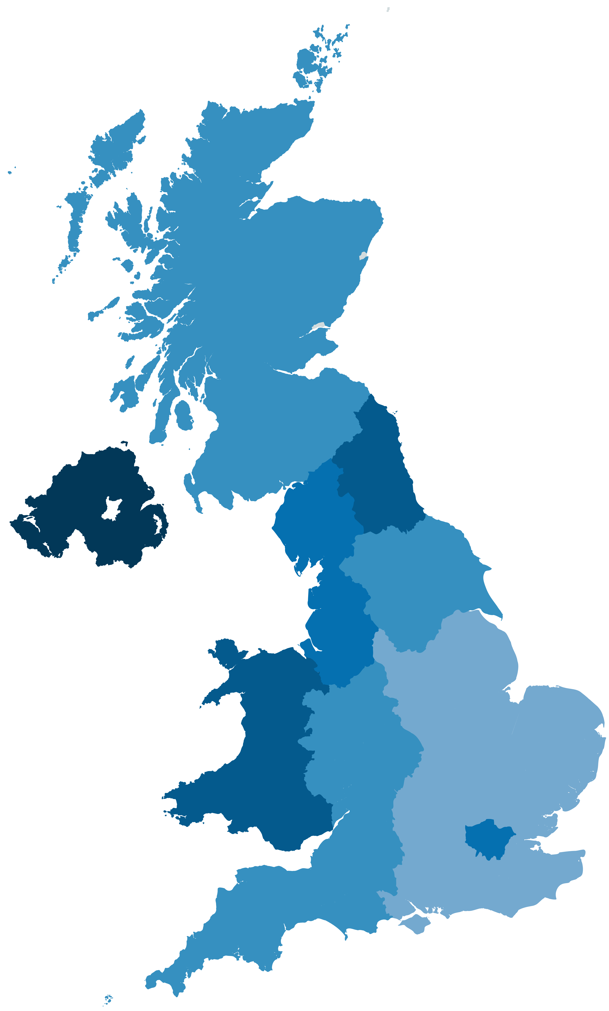
Three quarters of adults see a divided nation for opportunities
How much difference, if any, do you think there is in the opportunities available in different parts of Britain today?
% of adults who say that there are large differences in opportunities in different parts of Britain
75%
All UK adults
90%
86%
89%
76%
Three quarters (74%) of all UK adults think that there is a ‘very large’ or ‘fairly large’ difference in the opportunities available across Britain today - while only 16% said there was ‘not very much’ or ‘no difference at all’.
In Northern Ireland, people are most likely to see regional differences (89%), followed by the North East (86%) and Wales (79%).
Adults in the East Midlands are least likely to see differences but are still overwhelming likely to say that there are large regional differences in terms of opportunities available (68%).
72%
68%
50%
% of adults who say that there are large differences in opportunities in different parts of Britain :
72%
69%
79%
76%
73%
71%
% | Region
89% | Northern Ireland
86% | North East
79% | Wales
76% | London
76% | North West
75% | Scotland
% | Region
73% | South West
72% | West Midlands
72% | Yorkshire & the Humber
71% | South East
69% | East of England
68% | East Midlands
Sample size: 4693 adults in UK. (unweighted sample size by region: London n=452, South East n=603, South West n=432, West Midlands n=335, East Midlands n=345, East of England n=416, Wales n=495, North East n=181, North West n=429, Scotland n=543, Northern Ireland n=100). Fieldwork: 27 January – 1 February

Slide 34
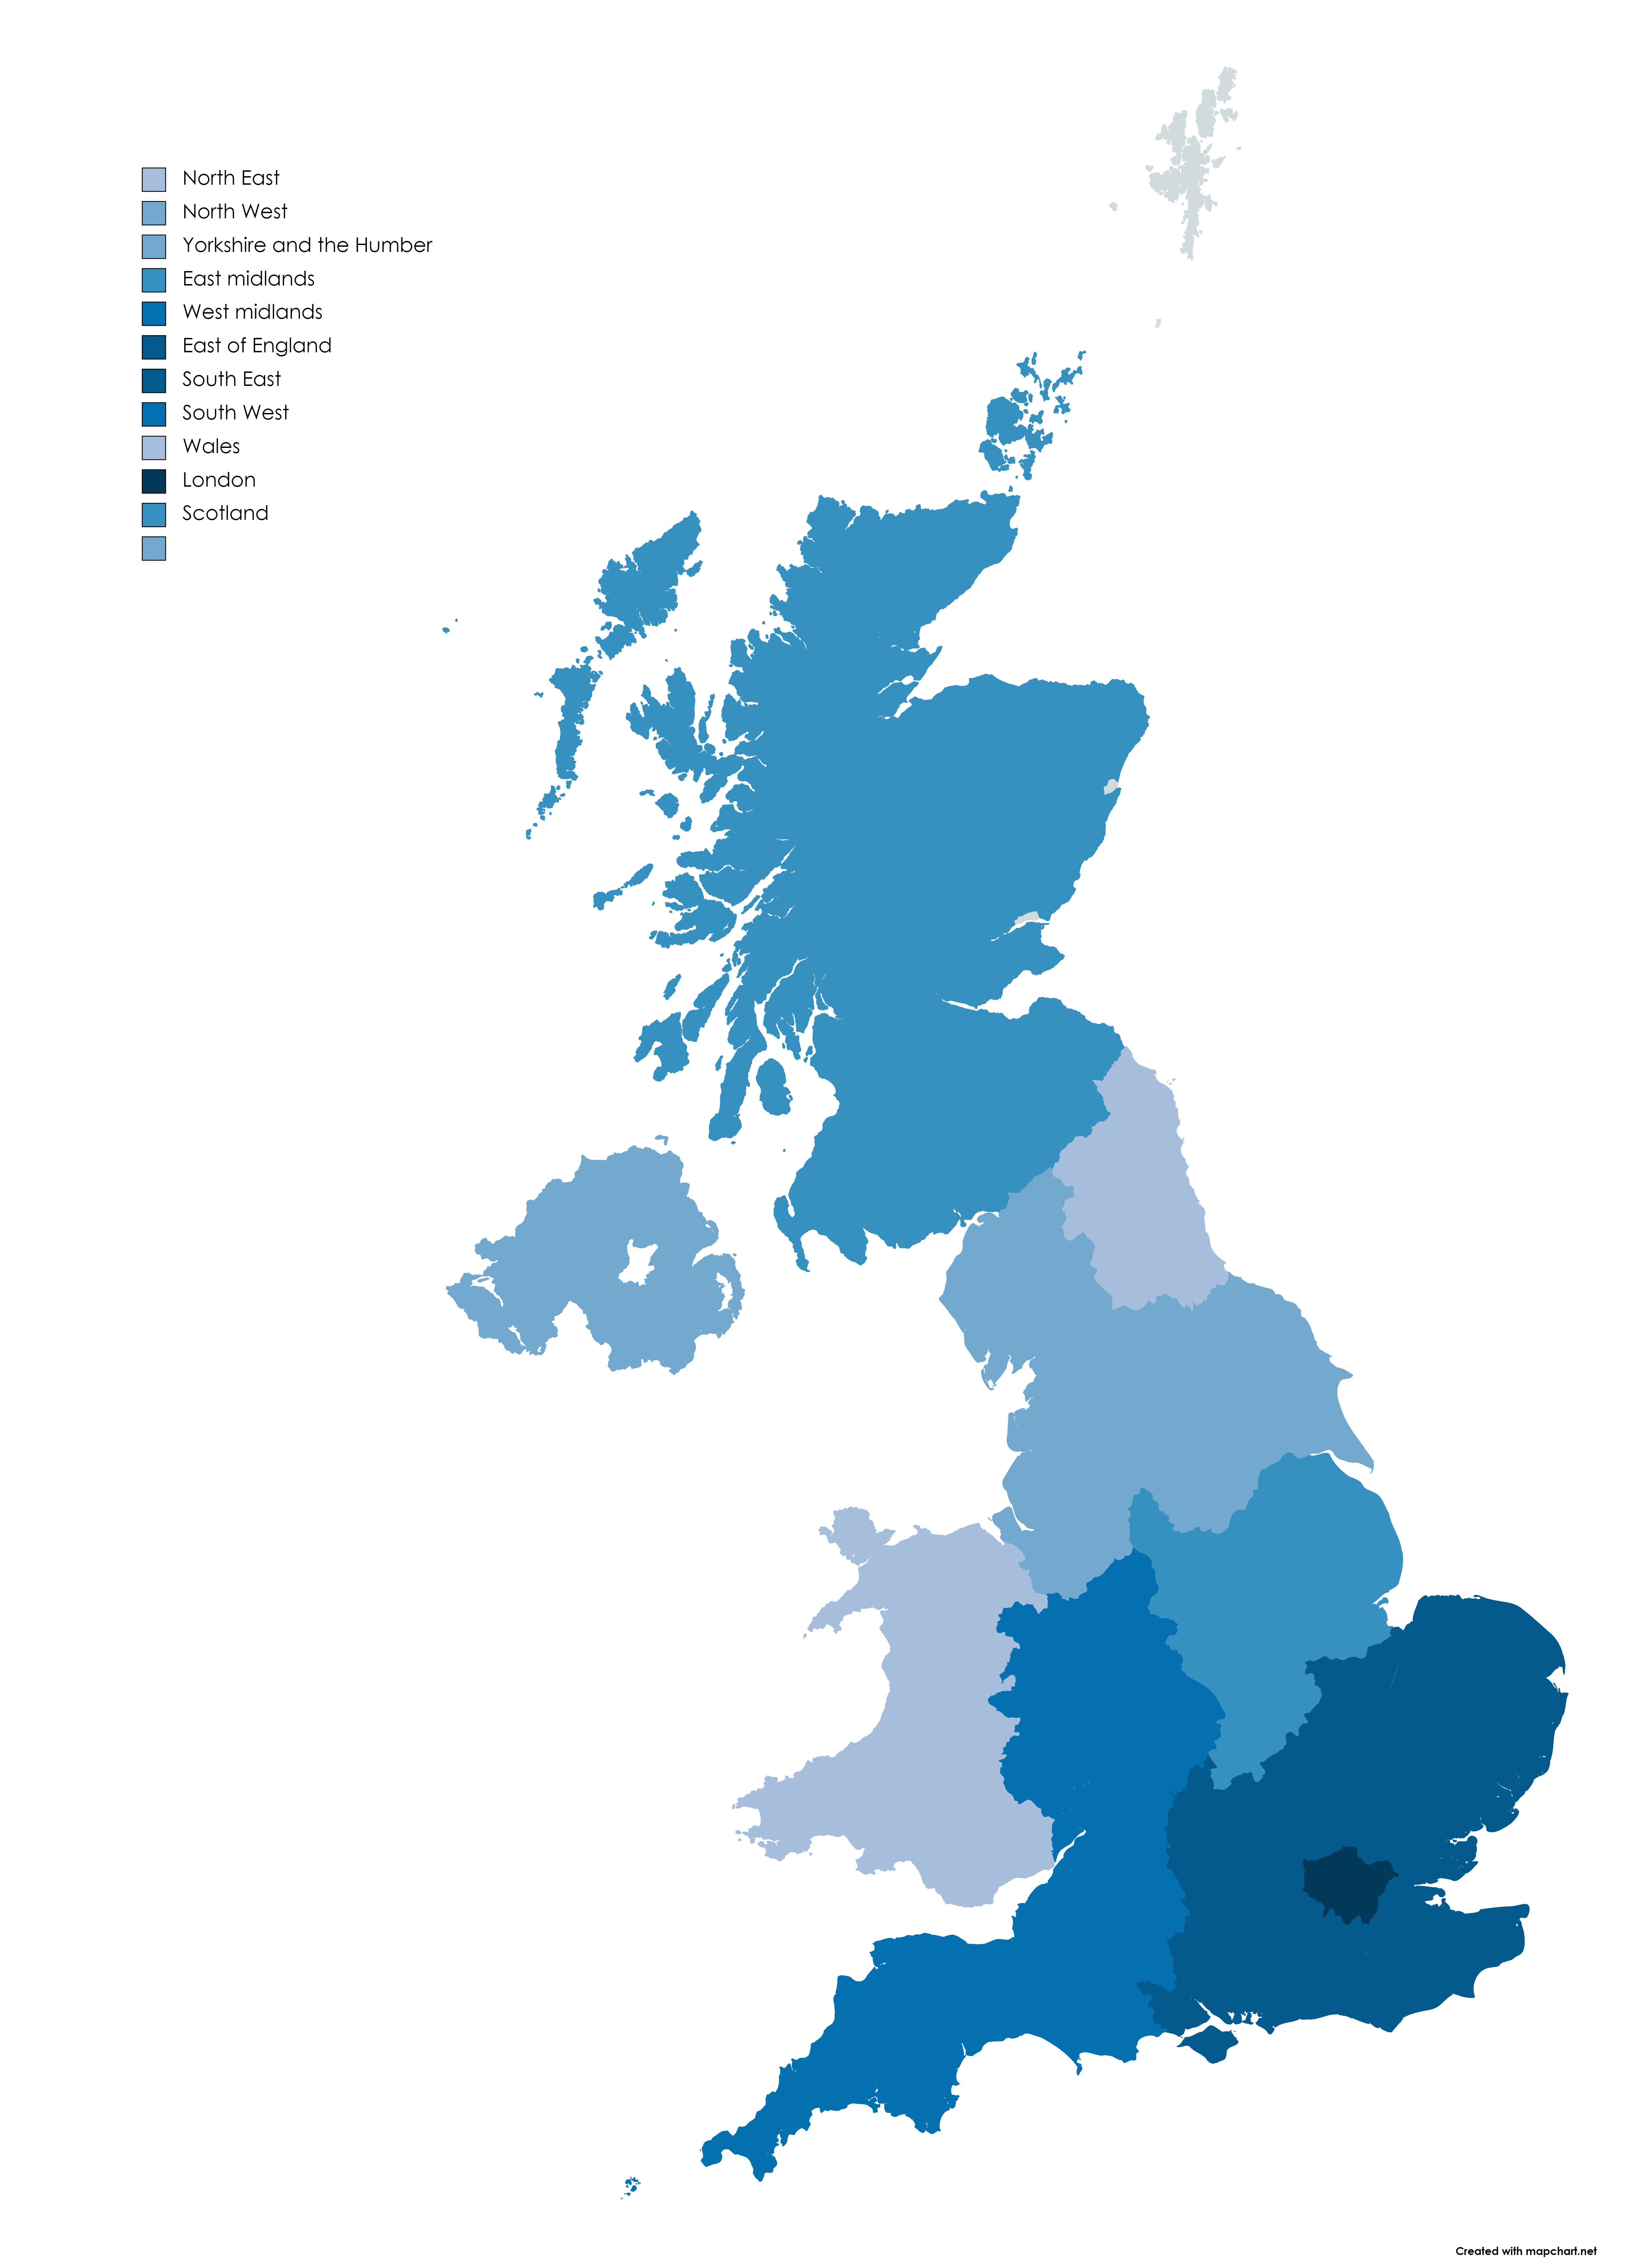
People in the South East are twice as likely to say they have good opportunities than people in the North East of England
Considering the area you live in, compared to other parts of the United Kingdom, do you think the opportunities available for people to progress are…
% of adults who say that the opportunities to progress in their area are good
49%
All UK adults
80%
31%
45%
45%
44%
20%
Over half (53%) of the public say there are ‘very’ or ‘fairly good’ opportunities for people to progress in their area. In London 74% say they have good opportunities. Figures are high across the South of England, particularly the South East (65%).
People in the North are less likely to say that their area gives more opportunities than anywhere else. In the North East, only 31% rated their area as ‘good’ for progression.
Yorkshire & the Humber (44%), the North West (45%) and Wales (35%) are also given low ratings by their residents.
49%
52%
64%
35%
% of adults who say that opportunities to progress in their area are good:
74%
50%
65%
% | Region
74% | London
65% | South East
64% | East of England
52% | West Midlands
50% | South West
49% | East Midlands
% | Region
49% | Scotland
45% | North West
45% | Northern Ireland
44% | Yorkshire & the Humber
35% | Wales
31% | North East
Sample size: 4693 adults in UK. (unweighted sample size by region: London n=452, South East n=603, South West n=432, West Midlands n=335, East Midlands n=345, East of England n=416, Wales n=495, North East n=181, North West n=429, Scotland n=543, Northern Ireland n=100). Fieldwork: 27 January – 1 February

Slide 35
Support from government
and employers

Slide 36
People say that those who are ‘just about managing’ are not getting enough government support
Thinking about different groups in society, generally speaking do you think each of the following get too much, not enough or about the right amount of support from the Government?
People who are the least well off
People who are just about managing
Two-thirds (64%) of the population say that those who are ‘just about managing’ are not getting enough support from the government. Only 2% say that they’re getting too much support.
Just over half (52%) say that the government should be doing more for the least well off in society. However 11% say that they’re getting too much support.
The majority of people (60%) say that those who are most well off in society get too much support from the government – only 21% feel that those who are ‘fairly comfortable financially’ get too much support.
People who are fairly comfortable financially
People who are the most well off
Sample size 4693 adults in UK. Fieldwork: 27th January – 1st February 2021.

Slide 37
People say that government should do more for social mobility – and schools could offer a solution
Which of the following is best equipped to have an impact on social mobility and ensuring opportunity for all (including those from disadvantaged backgrounds)? Please tick up to three.
When people were asked which institutions are best equipped to improve social mobility, and promote equal opportunities, the most commonly cited response was ‘schools’ (46%) followed by central government (37%) and employers (36%).
People thought that government should be doing more to ensure opportunities for all, with central government (53%) and local government (42%) most frequently cited.
And which, if any, of the following do you think SHOULD be doing more to impact on social mobility and ensuring opportunity for all (including those from disadvantaged backgrounds)? Please tick all that apply.
Sample size 4693 adults in UK. Fieldwork: 27th January – 1st February 2021.

Slide 38
Young people say employers should take action to improve social mobility
Do you think employers should or should not have to take
action to try and improve social mobility?
All UK adults
White
Two-fifths (42%) of UK adults think that employers should have to take action to improve social mobility. This is more than in our 2019 survey (31%).
The younger you are, the more likely you are to say that employers should take responsibility (53% of 18 to 24 year olds vs 36% of people aged 65+).
Based on the relatively small sub-sample of ethnic minority respondents, the survey found people from BME backgrounds are more likely to think that employers should take action than white respondents (58% compared with 41%).
BME*
18 – 24 year olds
50 – 64 year olds
25 – 49 year olds
65+ year olds
Sample Size: 4693 adults in UK (unweighted sample size by age: 18-24 n=369, 25-49 n=1878, 50-64 n=1166, 65+ n=1280) (unweighted sample size by ethnicity: White n=4390, BME n=240
Fieldwork: 27th January – 1st February 2021. *The sample size was too small to allow analysis of individual ethnic groups.

Slide 39
Trends over time

Slide 40
For the past five years, people have said there’s a large gap between the social classes – but now they think it’s getting easier for the least advantaged to move up
79% of UK adults believe there is large gap between social classes in Britain, continuing a small upward trend from 2018 and 2019 (75% and 77% respectively). We are now at the same level that we were in 2017.
People are most likely to say that their own background has had no advantages or disadvantages in terms of impacting on their career and education. However a third (33%) say that their background has given them advantages with their education, which is slightly down on 2019’s figure of 35%.
More people than ever say that it’s becoming easier for the less advantaged sectors to move up in society – 23% agreed with this in 2021 compared with 18% in 2017. However, two-fifths (39%) think it’s getting harder (no change from 2019).
Sample size for March 2017: 4723 UK Adults. Fieldwork: 6-9 March 2017. Sample size for March 2018: 5520 UK Adults. Fieldwork: 19-22 March 2018. Sample size for October 2018: 1656 GB Adults. Fieldwork: 9-10 October 2018. Sample size for March 2019: 4860 UK adults. Sample size for February 2021: 4693 UK adults. Fieldwork: 27 January – 1 February.

Slide 41
Despite coronavirus, more people than ever say that their financial situation is ‘better’ than it was a decade ago
Better
Same
Worse
Don’t know
There has been a steep increase in the proportion of people who say that their current financial situation is better than it was 10 years ago (44% in 2021 vs 37% in 2017). A decreasing proportion say their financial situation is getting worse (24% in 2021 vs 31% in 2017).
For the past four years, around half the population has consistently said that the least well off don’t get enough government support (52% in 2021).
A high proportion of people (64% in 2021) have also consistently been saying that those who are ‘just about managing’ need more support.
Overall, people see a divided Britain, with large differences in opportunities, depending on where you live. 74% report seeing ‘large differences’ in 2021, which is up slightly since 2017 (71%).
Do you think those who are least well off get too much, not enough, or about the right amount of support from the government?
Sample size for March 2017: 4723 UK Adults. Fieldwork: 6-9 March 2017. Sample size for March 2018: 5520 UK Adults. Fieldwork: 19-22 March 2018. Sample size for October 2018: 1656 GB Adults. Fieldwork: 9-10 October 2018. Sample size for March 2019: 4860 UK adults. Sample size for February 2021: 4693 UK adults. Fieldwork: 27 January – 1 February.

Slide 42
Any enquiries regarding this publication should be sent to us at the Social Mobility Commission, Sanctuary Buildings, 20 Great Smith Street, London, SW1P 3BT. Email: contact@socialmobilitycommission.gov.uk
This document is also available from our website at: https://www.gov.uk/government/organisations/social-mobility-commission
© Copyright 2021

