Slide 1
MCA update:
Julie Carlton
Seafarer Safety and Health Manager
Maritime and Coastguard Agency
13 November 2018

Slide 2
Fees
Fee applies from
13 November 2018 | £95
13 November 2019 | £105
13 November 2020 | £115

Slide 3
Fees
Consultation on alternatives to statutory fee
Seeking a balance between
  Economic viability for ADs
  Shipowners and seafarers concerns about uncontrolled prices

Slide 4
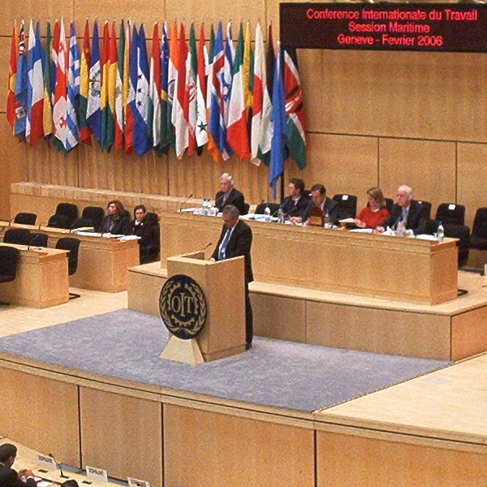
ILO Work in Fishing
Convention (ILO 188)
Adopted 14 June 2007
Came into force internationally 16 November 2017
Ratified by 12 members
UK implemented 25 October 2018
Progressive implementation from 30 November 2018
Living and working conditions for all fishermen, all fishing vessels

Slide 5
ILO 188
Medical certs phase-in
 | Vessel | Operating area | Date required
1. | Any vessel | Subject to inspection in foreign port | 31 May 2019
2. | Any vessel over 24m | Operating more than 7 days | 31 May 2019
3. | Any vessel over 24m not covered by 1 and 2. |  | 30 Nov 2019
4. | Any vessel under 24m | Operating more than 72 hours | 30 Nov 2019
5. | Any vessel under 24m | Operating outside UKCS/200nm from UK | 30 Nov 2019
6. | Any vessel under 24m not covered by 1, 4 or 5 | Operating no more than 72 hours | 30 Nov 2023

Slide 6
Grandfather rights
Guidance for AD manual - draft
Existing fishermen (at 30 Nov 2018)
Limited to 5 years (from 30 Nov 2018)
Evidence to be provided
  Working in the industry
  Working safely with pre-existing medical condition

Slide 7
Grandfather rights
Medical condition stable/well-controlled for five years
    Insight into condition and treatment
    Compliance with treatment
    No emergency treatment
    No fitness-limiting complications
Risk of sudden incapacitation under 5%
Specialist advice if needed
If any of above do not apply, discuss with MCA/CMA
Avoid “temporarily unfit” if possible (and safe)
Non-UK fishermen- existing medical certificates accepted for up to 2 years

Slide 8
Documentation
Revised ENG1
  ILO 188 cited in heading
  Fishing box (use “other” box if using old style cert.)
  Deck or engine
  GR – to be hand-written after restriction if applying grandfather rights
Annual statistics to distinguish fishermen from Jan 2019

Slide 9
Documentation
MSN 1886 (M+F) | Medical fitness standards | Replaces MSN 1839(M)
MSN 1883 (F) | Medical examination process for fishermen | NEW
MSN 1887 (M) | Medical examination process for merchant seafarers | Guidance from MSN 1839(M) to be published
MIN 575 (F) | Grandfather rights
Notes:
Generally assume MLC standards apply, but the UK has taken up the concession in the Convention as regards requirement for inspection.
This will be clarified in the next version of MGN 490/491, which are being replaced by three notices – inspection, and one each for the two substantial equivalencies for crew accommodation (under 200GT and 200 – 500GT).

Slide 10
What to expect
153 fishing vessels 24m and over
  Includes 29 over 45m
  7 crew
496 fishing vessels of 15m or more but less than 24m
  4.5 crew
5068 under 15m
  1.7 crew
Total fishermen in UK – 12, 000
  2014 figures

Slide 11
What to expect
Concentrated in fishing areas
ID issues (no discharge book)
Seafarer Hospital Society/Fishermen’s Mission running “health checks”
  Addressing “fear factor”
  Time for amendment of life
  Identifying new health concerns

Slide 12
Any questions?

