Slide 1
Smart Waste Tracking Challenge event
26 June 2018
@defradigital

Slide 2
What I will cover
Why waste?
What's so challenging about it?
Some things that might help you
Notes:
[not sure if this is needed

Slide 3
Why waste tracking?
Notes:
So why waste tracking?
It doesn’t sound very glamorous does it?
Have you thought about how it sounds to your friends?
I’m working on a project to track stuff that we throw away because we don’t have a use for it
To which the response is surely: why are you tracking stuff we don’t have a use for?
It sounds pointless, but it is actually quite the opposite

Slide 4
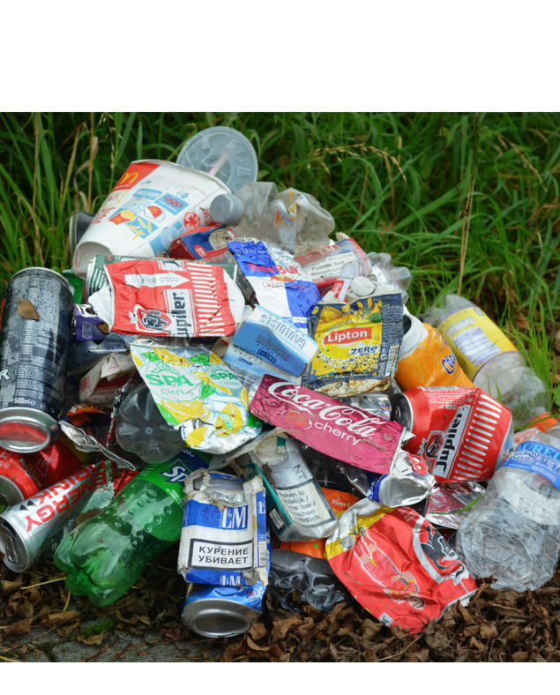
What happens to waste when we throw it away?
Notes:
Because answering this question……..
Is both difficult and important.
It is difficult because there are lots of types of waste, we deal with waste in lots of different ways, but we don’t record this accurately or consistently
And it is important because how we manage our waste effects our environment, our economy and society

Slide 5
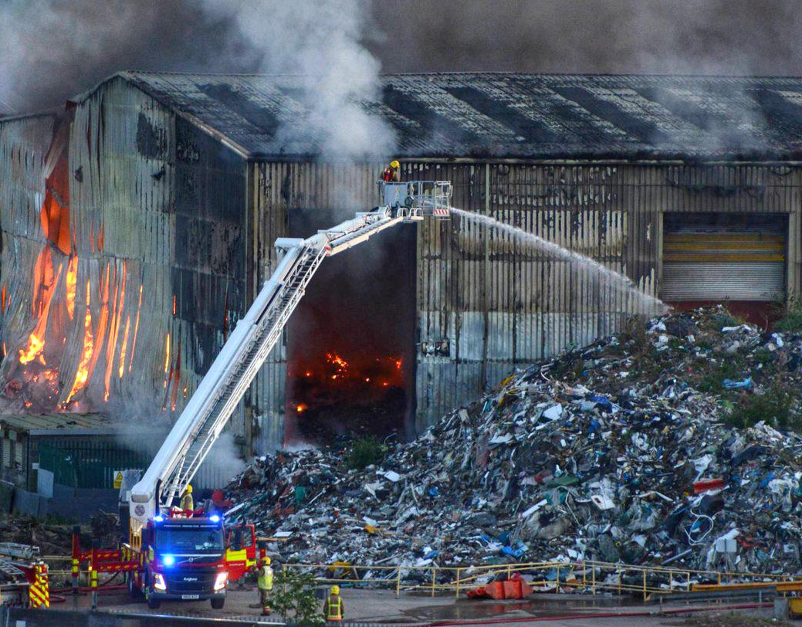
Waste can cause harm…
Notes:
If we manage waste in the wrong way it can cause harm in many forms:
In this country poorly or illegally managed waste creates fly infestations, dust, odour, air and water pollution.
It severely effects local housing, business and infrastructure.
It can be a cause of large scale fires or pollution incidents.
Give example, eg waste fire, – with reference to picture
Estimates suggest the cost to the economy of illegal waste activities run to several hundreds of millions of pounds
And of course outside of this country there are often less strict controls and this harm can be magnified – as the imagery of plastic waste in our oceans shows.

Slide 6
…but we can also create value from waste
Notes:
But it is also important to understand what happens to our waste when it is thrown away because we can create value from it as a resource
We all know this really:
Paper and glass can be recycled
Food waste can be turned into compost
Waste electronics contain many valuable components
Even waste that can’t be turned into secondary materials can be burned to generate energy
[summary sentence w/r to strategy or chief scientists report]

Slide 7
“We need to put in place the fundamental building blocks of data gathering and analysis to ensure we know the types, amounts and quality of waste, and where it is generated and ends up”
From waste to resource productivity
Notes:
There are lots of different policy approaches governments can take to minimise the harm and maximise the value of waste
But key to any of them is having the right data
Or as recent report from the Gov Chief Scientific adviser puts it…

Slide 8
The building blocks of waste data
What is it?
Where does it comes from?
How much is there?
Where does it go?
What happens to it?
Notes:
Specifically, the building blocks of data we need are:
We have this information for some wastes for some points in the waste chain
But what if we had it for all wastes – each point in the chain
If we could join up– or track – waste like this, it could help government, regulators and businesses

Slide 9
The data can help inform policy
Are we meeting recycling targets?
Do we have enough waste processing infrastructure capacity?
What markets are emerging for waste materials?
Are we collecting the right amount of landfill tax?
Notes:
This is because the same core data set can help us to answer a lot of policy questions.
If we know where waste comes from, where it goes to and what is done to it we can answer questions like
Are we meeting our legal recycling targets?
Do we have enough waste processing infrastructure capacity?
What markets are emerging for waste materials?
Are we collecting the right amount of landfill tax?

Slide 10
It can help us tackle waste crime
Waste disappears from the chain
Waste descriptions change when they shouldn’t
Timings and patterns of transfers that don’t make sense
The wrong waste ends up in the wrong place
Notes:
Similarly this information would be a vital enforcement tool for regulators
It can help us tackle waste crime by identifying where
Waste disappears or doesn’t reach next stage (illegal dumping)
Waste description changes (landfill tax avoidance)
Strange patterns of transfers (fraud schemes)

Slide 11
And it can support business
Visibility of waste destination
Scope for efficiencies
New markets (open data?)
Less paperwork

Slide 12
To use innovative technology to record and track individual movements of waste through the economy
Notes:
So this is our challenge…
Just to unpack this statement slightly.
The Solution needs to enable businesses to record or collect the most useful data on movements of the waste they handle
I distinguish between record and collect because some businesses will have their own systems that do this. We don’t want to replace those systems but they need to share some of the data they collect with us [reword]
This data needs to be available in a usable form for the business, the regulatory and government, and we will want to consider opportunities for open data
Because we think this is crucial to effective waste regulation and policy, and to helping drive improved business productivity and investment

Slide 13
“We will work with industry to explore options to introduce electronic tracking of waste”
Notes:
And the importance of this is reflected in key UK government strategies
For the UK government this Govtech challenge delivers commitments in 25yr Env Plan and Industrial strategy to…”work with…
It also supports commitments we are looking at developing in the forthcoming UK Government resources and waste strategy planned for later this year
So waste tracking joins up priorities across government in relation to xyz

Slide 14
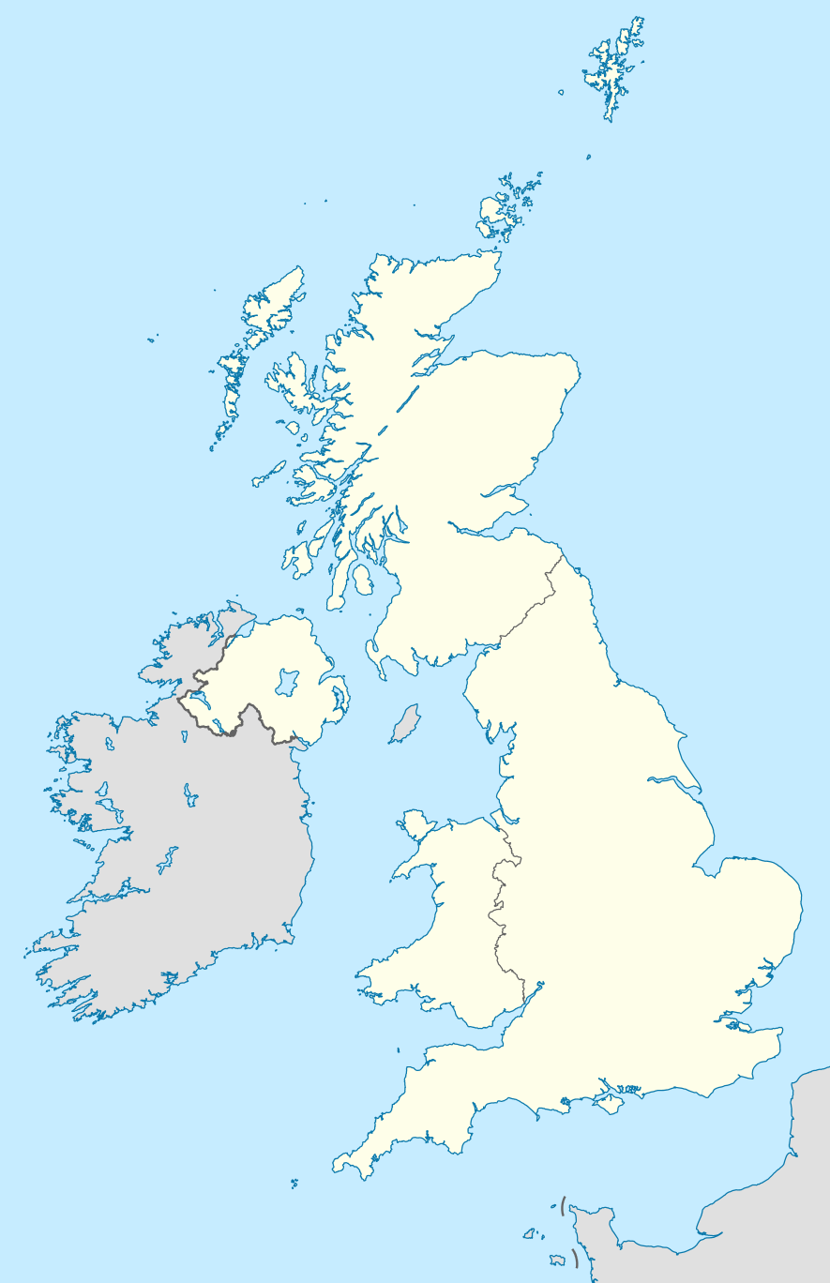
We want this to work at a UK level
We want this to work at a UK level
Notes:
The challenge also builds on discovery work conducted by the four nations
At different times over the last couple of years different governments and agencies across NI, Wales, England and Scotland have taken a lead in looking at this challenge
We have done some initial work looking at user needs, data requirements, legacy systems and so on
We are very aware that many companies work at a UK level, and we think the greatest benefits stem from developing a solution that could work for all four nations so we would like to work in partnership on this

Slide 15
What is so challenging about waste tracking?

Slide 16
We produce a lot of waste
We produce a lot of waste
We produce a lot of waste
Notes:
We produce 200m tonnes of waste a year in the UK
That means a solution is going to need to record and store a large number of waste transactions
Previous estimates have suggested that under the current system of regulations businesses generate over 25m notes to record the transfer of both hazardous and non-hazardous waste each year

Slide 17
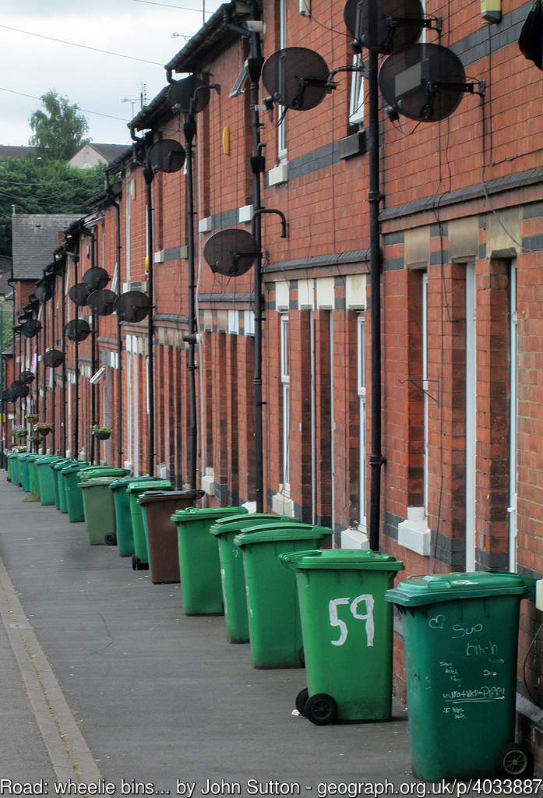
Waste comes from many different sources
Waste comes from many different sources
Moving forward – shaping ourselves and our environment to enhance our success going forward
Notes:
this waste comes from many different sources
So this is factory waste
But waste also comes from:
Kerbside collections
Collection points
Council recycling centres (tips)
Offices and shops
And it is collected in different ways, directly by councils, by companies operating on their behalf or purely through commercial arrangements between businesses and waste companies
We are interested in covering all waste streams, so we can household waste and commercial waste

Slide 18
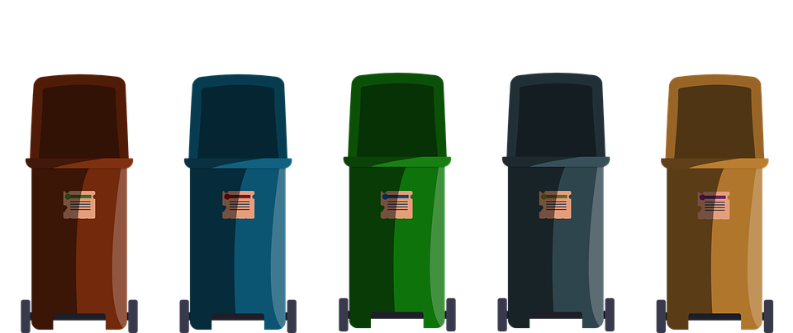
Over to you –
Thoughts, perceptions, feelings?
The choices are yours.
There are lots of types of waste
Notes:
There are lots of types of waste
And they can be described by:
- their origin
- material
- physical and chemical properties
In the UK there are xx codes for describing waste according to EU rules
But that makes describe waste difficult and technical. People often get waste descriptions wrong
We can have the best waste tracking system in the world but it will be useless if the information users record is inaccurate or of poor quality
So the solution needs to design in ways of supporting good quality and accurate record keeping
It also needs to provide assurance mechanism and analytics that help users identify when this is not happening or things are going wrong

Slide 19
Waste chains are complex
Waste chains are complex
Moving forward – shaping ourselves and our environment to enhance our success going forward
Notes:
And because there are lots of types of waste there are lots of ways of dealing with it
Whereas once waste ended up in the local landfill, waste chains now are complex and have international dimensions
Give example

Slide 20
Waste is difficult to trace
Waste is difficult to trace
Notes:
But even relatively simple waste chains are difficult to fully trace
This is a mechanical treatment facility it takes in truckloads of mixed waste from households and businesses
It then essentially sorts that waste.
Some goes to an incinerator to be burned
Some goes to landfill
Some is recovered for recycling
This waste is out of its container, it is mixed around. Waste from the same source may end up in three different destinations
So a solution to the challenge needs to accommodate that. Identify the best way of giving certainty of initial destination and a good idea of final destination within the realms of possibility

Slide 21
Some things that might help you

Slide 22
Fully compatible with own business needs and data collection methods
This is what businesses have told us
This is what businesses have told us
Protect commercially sensitive data
Allow data imports into own systems
capable of operating offline and in remote or sensitive locations
Notes:
To draft – key themes from user research

Slide 23
Improve data quality with automatic validation
This is what regulatory officers have told us
This is what regulatory officers have told us
Provide for data in real time
Moving forward – shaping ourselves and our environment to enhance our success going forward
Provide ability to identify trends
Be simple, quick and easy to use
Notes:
To draft – key themes from user research

Slide 24
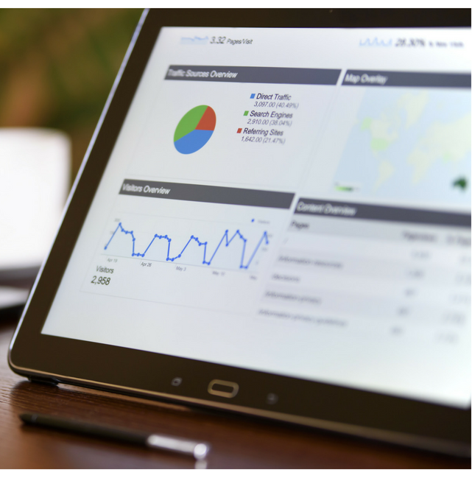
The proposal can be for all or part of the solution
The proposal can be for part or all of the solution
Notes:
Check with innovate uk - Proposal for all or part of the service?
Collection, submission, analytics, access

Slide 25
The proposal can leverage ideas
The proposal can leverage existing ideas
Notes:
Explain point on R&D spend – how it can fit with bidders existing IT – need to check this with Innovate UK

Slide 26
Regulations
can help
Moving forward – shaping ourselves and our environment to enhance our success going forward
Notes:
Explain waste transfer notes and haz waste consignment notes

Slide 27
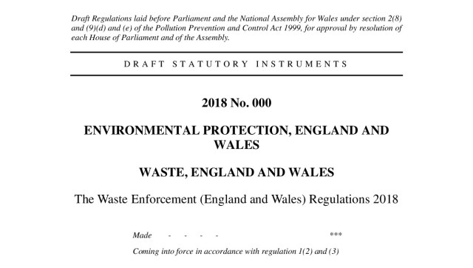
Regulations
can change
Regulations can change
Notes:
Explain in particular the EU circular economy package
Good test of future proofing

Slide 28
Think about where the record starts…and ends
Think about where the record starts…and ends
Moving forward – shaping ourselves and our environment to enhance our success going forward
http://www.yunphoto.net/en/
Notes:
The challenge is purposely called waste tracking, not resource and waste tracking.
Tracking waste in itself is a big enough challenge without expanding that to all material resources
And we are interested in waste, in its own right, for sound regulatory and policy purposes – such as tackling waste crime
BUT some companies have come to use and said. I want complete traceability of my product from the point it comes on the market. That’s because I think I’m going to have pay for that products disposal as part of a producer responsibility scheme.
And at the other end of the waste chain the trail for us often goes cold when waste ceases to be a waste and becomes a secondary material
If you see opportunities to make these links through your solution that would be very interesting.

Slide 29
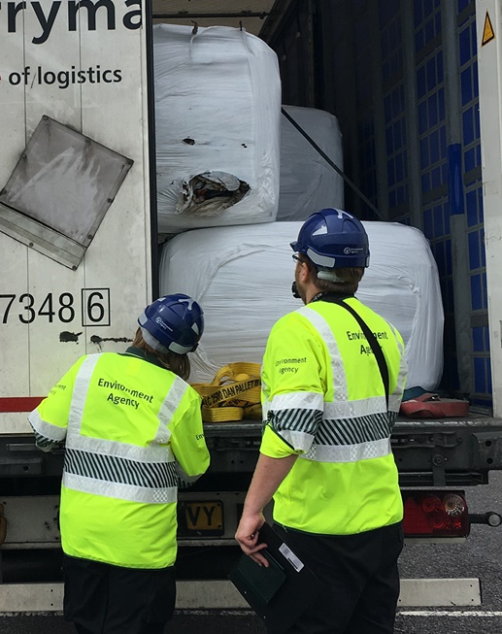
Over to you –
Thoughts, perceptions, feelings?
The choices are yours.
Think about domestic and international movements
Notes:
Explain that waste doesn’t stop at our borders
Capacity to track beyond borders also would be beneficial

Slide 30
Think about how you would work with us
Moving forward – shaping ourselves and our environment to enhance our success going forward
Notes:
Previous research available etc
All very exciting etc

Slide 31
Questions?
@defradigital

Slide 32
Smart Waste Digital Tracking Challenge
Closing date for registration:
18 July 2018 @ 12.00pm
Competition closes:
25 July 2018 @ 12:00pm
WasteTracking@defra.gsi.gov.uk

