Slide 1
MI @DFID: “The brilliant basics”
Toby Wicks
Head of Management Information
t-wicks@dfid.gov.uk

Slide 2
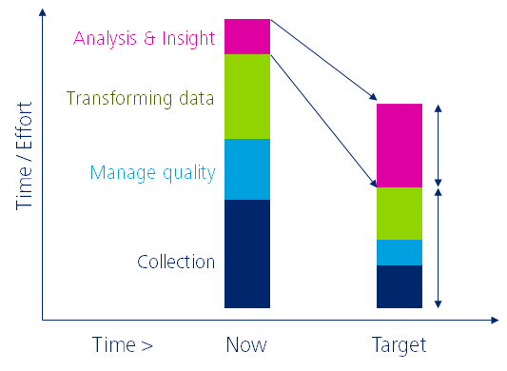
Where do we want to be?
Analysis & insight
Transforming data
Time / Effort
Manage quality
Collection
Nov 2014 Target
(BIS and Deloitte)

Slide 3
How will we get there?
Bringing MI to life @DFID
“Brilliant basics”
Infrastructure
and process
for easy access
Effective and user friendly tools
Streamlined processes from data entry to decision
Continuous improvement to corporate reporting
Iterative development of technical infrastructure
Fit-for-purpose information
Central source of “good enough” data
Data are trusted and appropriate for use
Simple business rules in systems etc.
Standards driven at the point of data entry
Culture of
ownership and
accountability
People trust and use data more effectively from source to decision
SROs driving MI quality & use
Virtuous circle of data quality improvement
Shared platform of focussed and coordinated MI improvements
Skills &
capability
Capability within DFID increased to deliver effective MI
Effective solutions support understanding of programme delivery
Existing resources maximised
Communication and knowledge transfer through existing networks
1
2
3
4

Slide 4
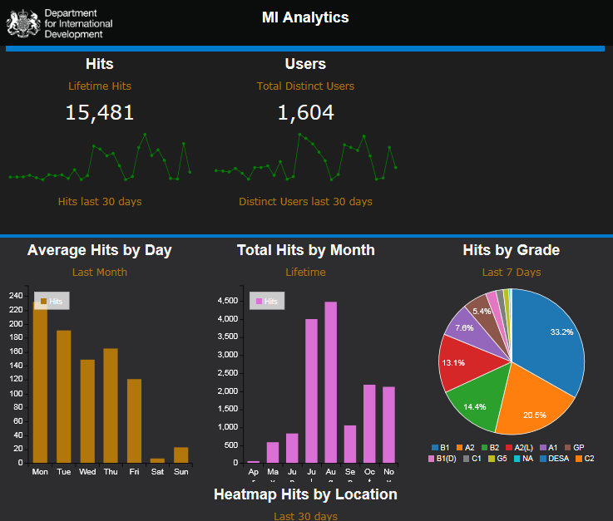
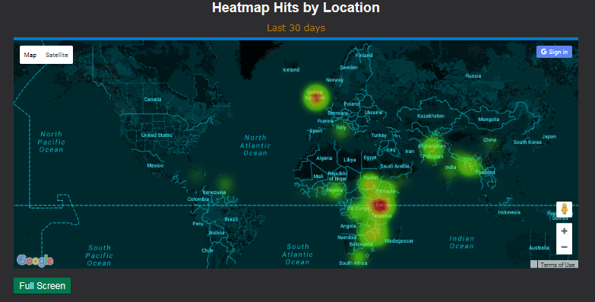
We’re starting to use data on who is accessing what MI to make sure our content is hitting the mark…

Slide 5
MI user group composition
32 staff to cover the diversity of the business

Slide 6
Top three takeaways
1
Keep it simple
2
Focus on the decision and what’s “good enough”
3
Keep close to the “coal face”

Slide 7
Topics for discussion… now or offline…
1
MI to your Inbox: How much can you handle?
2
Capability: Creative solutions to up-skill existing employees?
3
More and better use of others’ data
Toby Wicks
t-wicks@dfid.gov.uk

