Slide 1
The Global Chemistry Network
David James
Executive Director, Strategic Innovation
Jim Iley
Executive Director, Science and Education
3rd September 2013

Slide 2
THe royal society of chemistry
Leading professional body for chemists
Founded in 1841
48,000 global members
(but 350,000 plus actively engaged with RSC)
Not-for-profit

Slide 3
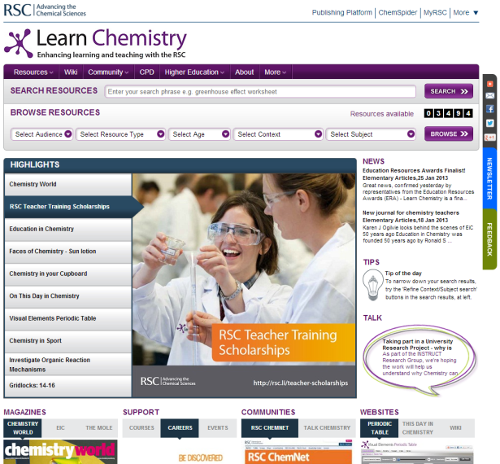
About the rsc
Renowned international publisher of chemical science information
Supporter of chemical science education
Campaigner for science

Slide 4
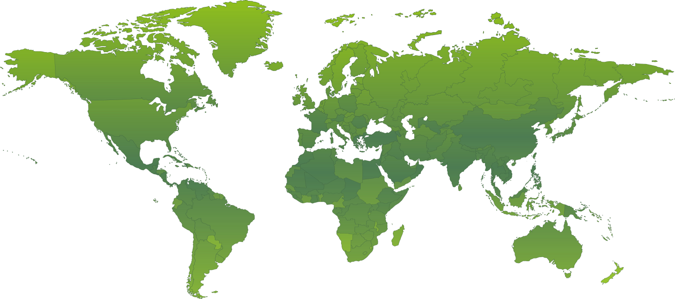
Rsc locations worldwide
London and Cambridge, UK
Philadelphia, USA
Beijing and Shanghai, China
Bangalore, India
Tokyo, Japan
PACN
São Paulo, Brazil

Slide 5
OUR VISION
A chemistry data repository:
Tools
Models
Services
that increases the value and impact of researchers' funded work

Slide 6
The Future
Chemical scientists will be able to be instantly connected globally around their research
Large amounts of data and other content will be open, discoverable and shared making collaboration far easier and more rapid
New software tools will be developed that will harvest and exploit vast amounts of data to construct major new repositories of knowledge
This “openness” will drive innovation on an unprecedented scale
Educators will exploit data-rich content and new technologies to develop innovative skills training at all levels
A new global community will emerge (industry, academia, educators and funders) that will replace the existing structures and mechanisms for enabling researchers to do what they do, report what they do, and have what they do recognised

Slide 7
Our role
The global chemistry society
We will lead our community through:
Building a research data management in collaboration
Exemplar projects - demonstrating the value of Open Data
Links to professional development and recognition

Slide 8
Knowledge
An environment for data deposition
An environment for data validation, curation and model building
A platform for open collaboration
An environment for micropublishing
An environment for open innovation

Slide 9
Knowledge
We are already…...
Managing complex data
Extracting the “chemistry” from articles, patents….
Working with the chemical science community
Creating online platforms to deliver knowledge

Slide 10
What are we Building?
Not just deposition – but micropublishing
Micropublishing is deposition with recognition and reward
Data - structures, reactions, spectra…….
And more - protocols, models, software……
All these data objects are “DOI’ed” for citation purposes (altmetrics)
Integration to chemistry blogging software and Electronic Laboratory Notebooks
Recognising the need for embargo management

Slide 11
Skills - Micropublishing
Submit and curate data, for example, chemical structures (ChemSpider)
“Micropublish” community-built models, algorithms, simulations to support scientific investigation
ChemSpider Synthetic Pages
Ethyl 3-(1-pyrenyl)acrylate (3.02 g, 10.1 mmol) was firstly dissolved in ethyl acetate (70 ml). Ethanol (70 ml) and the 10% Pd/C (2 mol%) were then added to the mixture and the air evacuated out the system and replaced with hydrogen. The reaction was left to stir under a hydrogen balloon at room temperature for 29 hours. The reaction mixture was then filtered through a pad of celite with ethyl acetate a...

Slide 12
Recognition and Reward
For submission, curation and engagement, especially students; develop new metrics (Altmetrics) for community content for data and professional development; no longer IF alone – total contribution/impact
Impact
Peer review
expert opinion
Citations
Usage
downloads
page views
Alt-metrics
No. of links
Citable ‘data objects’
Profile interactions
Professional development

Slide 13
Where are we now?
ChemSpider (www.chemspider.com)
International researcher profile in development
Building professional development recognition -AltMetrics
Building “intelligent chemistry” not just a “dead” repository

Slide 14
Community
RSC is already committed to supporting open collaboration
Open PHACTS – EU/Pharma industry pre-competitive collaboration – semantic data integration across chemistry/biology/pharmacology
PharmaSea – Deep sea natural products extraction and characterisation – novel compound identification and data hosting in ChemSpider

Slide 15
Community
RSC already provides the UK’s National Chemical Database Service (EPSRC-funded)
Universities now requiring an infrastructure for the chemistry
Bristol University – National Compound Collection
Southampton University – ELN development
Warwick University - micropublishing for synthetic chemistry
Cambridge University - Molecular Informatics Centre
Imperial College - research data management

Slide 16
Exemplar Projects…..
RSC Open Source Drug Discovery in Neglected Diseases
In collaboration with the Council for Science and Industrial Research (OSDD, India)
Now extended to include the Medicines for Malaria Venture and the Drugs for Neglected Diseases Initiative (both Geneva)
FAPESP (Sao Paulo State Funding Council, Brazil) also to participate
Pan Africa Chemistry Network

Slide 17
The CHallengeS
Sustainability
Lack of cross-discipline support and coordination
Fragmentation of valuable resources into institutional repositories

