Slide 1
Completing the UCD604 – Information regarding a sanction for Universal Credit
There will be occasions when a UCD603 has been referred due to non-compliance and before the DM has made a decision the claimant has complied / undertaken the mandatory activity
It is therefore important to complete the UCD604 to advise the WC / DM via District Restart Triage inbox of the date of compliance.
So that if a sanction is applied it can be ended quickly and correctly.
The PRaP referral is noted as a DNA and essentially closed, the claimant no longer has the opportunity to comply after 30 days have passed, and so the UCD604 has to be completed and that “you deem the Potential Participant as no longer required to undertake the mandatory activity”. That date on the UCD604 will be used to end the open-ended sanction, if one has been applied.
When a UCD603 has been raised due to non-compliance with failing to attend the initial meeting, and the claimant has still not complied by the end of the 30 working day period.
The UCD604 has multiple options depending on the circumstances that have lead to it being raised. (includes details around disputed compliance)
But for this purpose we will focus on failure of the initial meeting or on going interventions / activities.

Slide 2
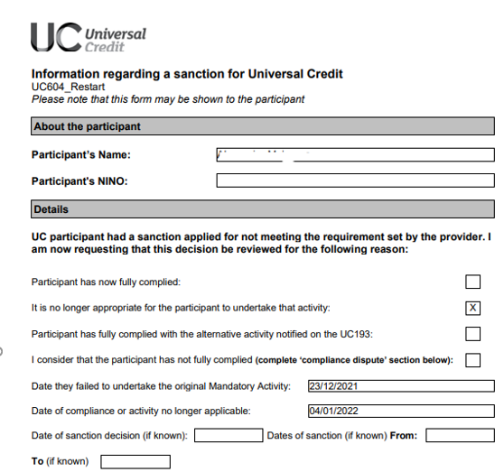
Completing the UCD604 – Information regarding a sanction for Universal Credit
Self explanatory
Compliance
They have complied and now attend an initial meeting or the mandated activity set
They have not engaged, and 30 days have passed. Deemed compliance as claimant not longer has opportunity to attend a meeting.
Continue to complete the remaining parts of the form

Slide 3
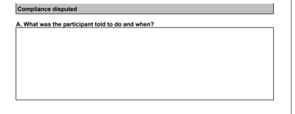
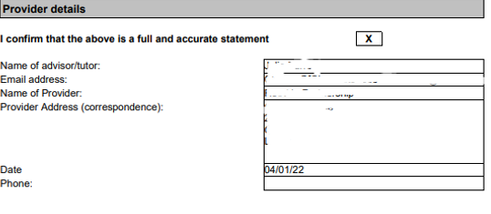
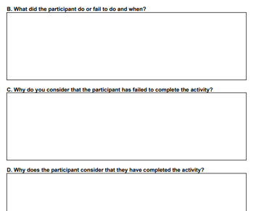
Completing the UCD604 – Information regarding a sanction for Universal Credit
Boxes A – D relate to disputed compliance
Final section provider details – complete as appropriate.

