Slide 1
Stansted Mountfitchet Modelling Review
5th December 2022

Slide 2
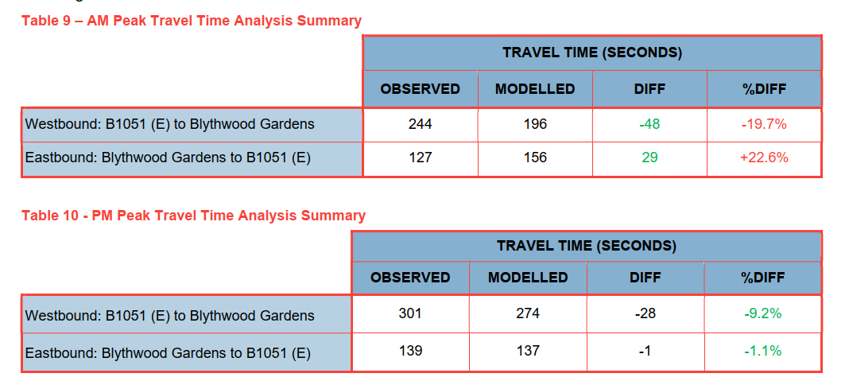
Base Model Journey Time Validation
Issues with the journey time validation in the AM Peak
Journey times are outside the acceptable threshold (+/-15%) in both directions (see tables 9 & 10 from LMVR below)
At section 6.9 in the LMVR it is mentioned that the routes satisfy the TAG criteria because they are within 60s of the observed time. This criterion refers to strategic models and for routes longer than 3km as mentioned in section 4.3.3 of TAG Unit M3.1 shown below.
For a micro-sim model, like this one with routes just over 1km the +/-15% criterion should be achieved for at least 85% of the routes for the model to be considered successfully validated.
Model validation in the AM Peak is not considered acceptable.

Slide 3
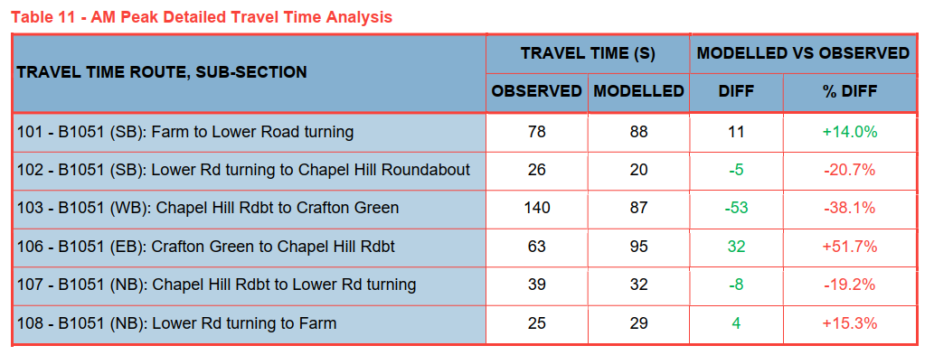
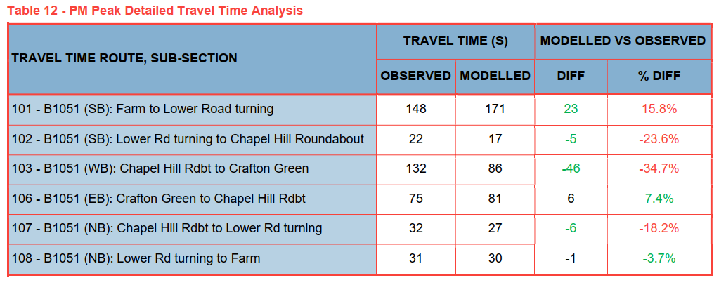
Base Model Journey Time Validation – Detailed Analysis
Issues with the sub-section at Chapel Hill (103 and 106 in Tables 11&12 of the LMVR)
In the AM Peak the westbound direction is 53s faster in the model, while the eastbound direction is 32s slower in the model than the observed journey times.
The observed journey times indicate that the eastbound direction in the AM Peak is a lot faster than the westbound (63s vs 140s), while in the model the are very close (87s vs 95s).
This means that the give way system coded in the model to replicate the narrow street, with on-street parking that basically allows one direction to pass at a time, is not accurate, as based on the available data it should favour one direction over the other.
A similar issue is observed in the PM Peak but mainly for the westbound direction being a lot faster in the model.

Slide 4
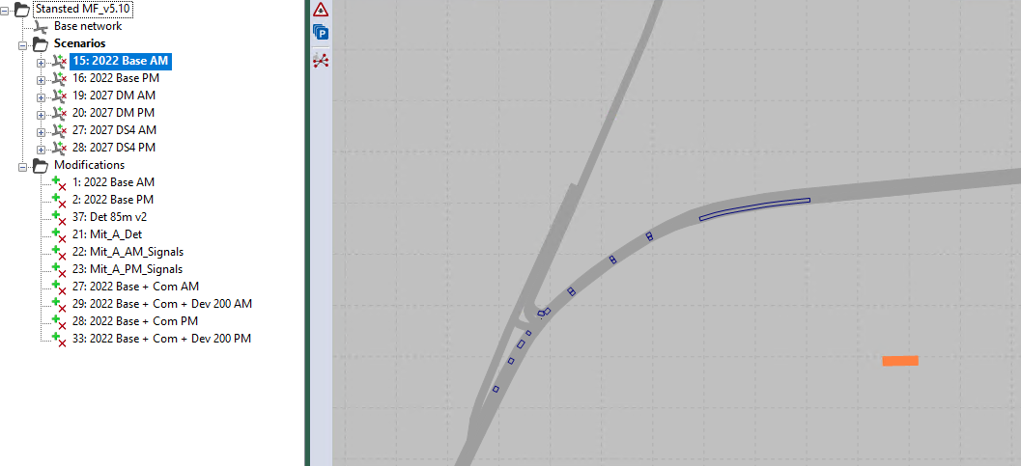
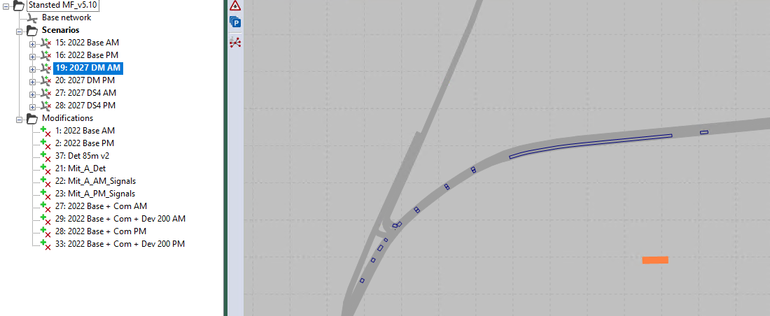
Future Year models - Signals
New modifications introducing changes at the signals
Base model detectors
Changes at the signal controllers at B1051/ Lower St junction from base model to future year models.
This is referred as mitigation in the modifications list, but the results of the future year models without this mitigation are not shown, while the mitigation is not explained in report.
Future year model detectors

Slide 5
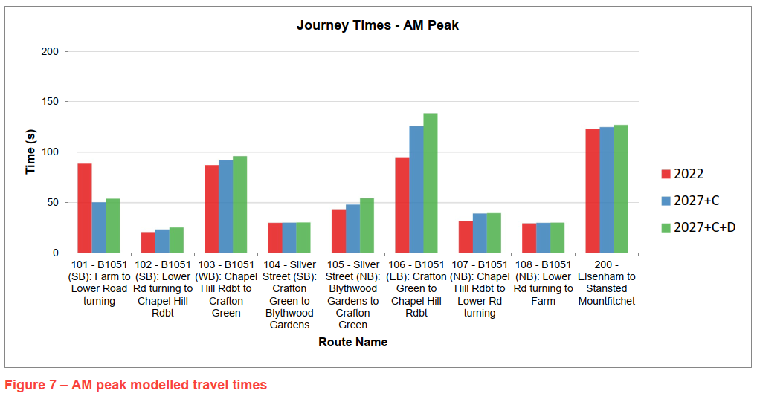
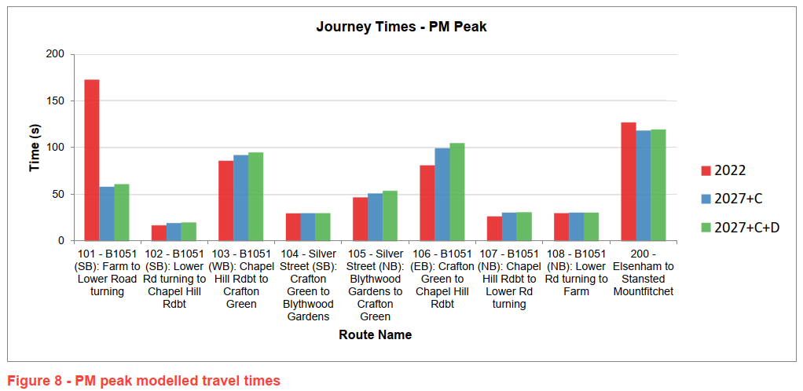
Future Year models – Journey Time Results
The Journey Time results shown in Figures 7 & 8 of the modelling report, indicate significant journey time improvements in the future year models compared to the base year model in both peak hours at B1051 southbound (section 101).
The journey times at the opposite direction (section 107) only increase slightly.
This is related to the changes at the signal controller put in place in the future year models.
The results without this mitigation would be useful to be included in the modelling report.

Slide 6
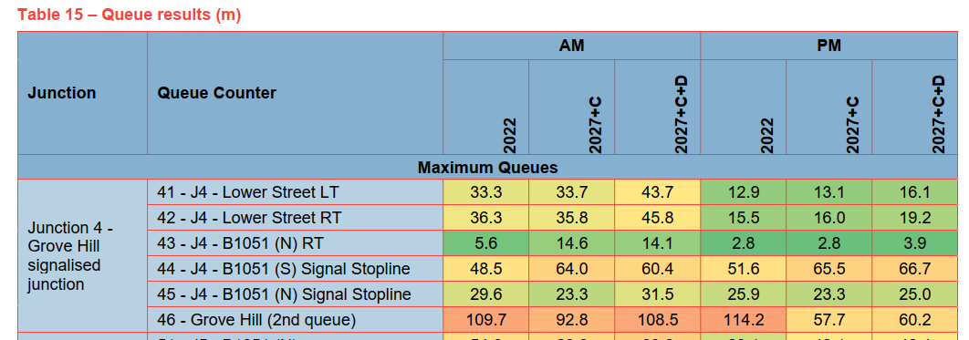
Future Year models – Queue Results
This change at the signals at B1055 / Lower St junction implemented as mitigation in the future year models improves the journey times at the southbound direction at the future year models, while the northbound journey times only increase slightly.
The queues at the northbound direction also increase by 2-3 vehicles in both AM and PM Peak based on the queue results highlighted below.
The distances from Lower St / B1051 to Lower St mini roundabout is 110 m. While in the modelling report it is mentioned that in the scenario with the development the max queue never exceeds this distance (tables 16 & 17), looking at the detailed VISSIM modelling results there are such instances in 2 out of 20 runs in the AM peak and 4 out of 20 runs in the PM Peak (example in screenshot at the right).
This is not happening in the base model, with the existing signals configuration, which are probably set up like this for safety reasons.

Slide 7
Overall Comments & Recommendations
The journey time validation of the AM peak hour is not at acceptable levels and should be revisited aiming for modelled journey time of both main routes to be within +/-15% of the observed.
The coding of the give-way mechanism at Chapel Hill (to replicate the narrow road, with vehicles from one direction passing at a time) needs to be recalibrated so that the westbound direction is slower, as observed journey times indicate.
This would improve the JT validation
The changes at signal controller at Lower St / B1051 junction introduced in the future year models, as a mitigation, increase the queues at Lower St northbound with instances of queues extending back to Lower St / Chapel Hill / Church Rd mini roundabout.
This happens in 2/20 runs in AM Peak and 4/20 in PM Peak
The results without the mitigation would be useful to be included in the modelling report.
Following these changes the models should be reran and the new results should be used to inform on the impact of the proposed development at the network performance.

Slide 8
Thank You

