Slide 1
Dr Helen Stephenson CBE
Chief Executive
Annual Public Meeting
12 October 2022
Cardiff and online
Notes:
Hello, and thank you for taking part in our annual public meeting.
This meeting is taking place both as a traditional in-person event here in Cardiff, and online.
We hope this format offers a good balance in terms of access to the Commission – to our people and our work – and we welcome your feedback on how you experience today’s meeting.
A hybrid public meeting is just one small example of a wider theme of continuity and change.
The theme applies to society more widely, and charities’ role within it. But it has resonance for us as regulator too.
Our core purpose has remained unchanged for decades, and arguably centuries.
We are the oldest still-surviving regulatory body in England and Wales (and quite possibly the world), having been formed in the mid 19th century.
And indeed legislation to promote charitable acts and charitable assets dates far further back in history.

Slide 2
Peter Erle QC, first Chief Charity Commissioner
Appointed 1853
Notes:
On the right here is a bust of the first Chief Commissioner for England and Wales – the Rt Honourable Peter Erle.
He was, like our current Chair, a barrister, indeed a QC – the Q in question of course being Queen Victoria. Although, I think the similarities may end there as our founding Commissioner used to travel the country visiting charities on his horse.
The bust lives in the Commission’s offices, and helps remind us that there has long been consensus that for charity to flourish, it needs also to be effectively regulated.
But how we do this – the priorities we set, and the tools we use, has changed a great deal since Peter Erle’s time.
We are continuously evolving our approach in response to changing needs and risks, and new opportunities. The new opportunities often come in the form of technological advancement…as Orlando has mentioned.

Slide 3
Notes:
And in that context, I’d like to talk today about an important journey of change that we are just about to begin, which Orlando briefly touched on.
It relates to charity trustees.
There are around 700,000 trustees, who together hold over 928,000 trustee positions governing the nearly 170,000 charities on our register.
They are the lifeblood of the charity sector in Wales and England.
It’s vital that they have access to authoritative guidance and support about how to run their charities.
Many feel confident about their understanding, but our research, and the evidence of our case work, suggests there is room for improvement.

Slide 4
Trustees are twice as reliant on colleagues or other trustees and the internet as they are on CCEW for guidance
Yonder trustee research 2022
Notes:
And at the moment, 41% of trustees never come to the Commission when they are looking for advice and guidance.
Just under a third come to us less than once a year. And only 10% come to us regularly in a given year.
This slide is drawn from research published earlier this year – showing that trustees are twice as likely to go to colleagues or the internet than the Commission when they need guidance.

Slide 5
Trustees who use the Charity Commission are more likely to correctly understand their duties
Trustees using our guidance are more likely to correctly understand their duties
Yonder trustee research 2022
Notes:
Meanwhile, those who do use our guidance tend to find it helpful – and, crucially are more likely to correctly understand their duties than those who don’t, as this graph demonstrates.

Slide 6
We need to talk
Notes:
So we want more trustees to come for us for help and advice. In fact, over time, we want to achieve a fundamental shift in our relationship with individual charity trustees.
As Orlando has alluded to this in his speech…, we want to move to place where we are engaging 1:1 with individual trustees.
In the long term, we want to ensure we hold them in a more supportive, proactive, meaningful regulatory relationship.
Ensuring trustees have access to authoritative, accessible and timely guidance, as and when they need it. And that will vary depending on each individual trustee’s circumstances – how long they’ve been a trustee, what their charity does, and whether they are on the board of more than one charity.
This will not happen overnight, but I want to set out the changes we are aiming to make over the years ahead.

Slide 7
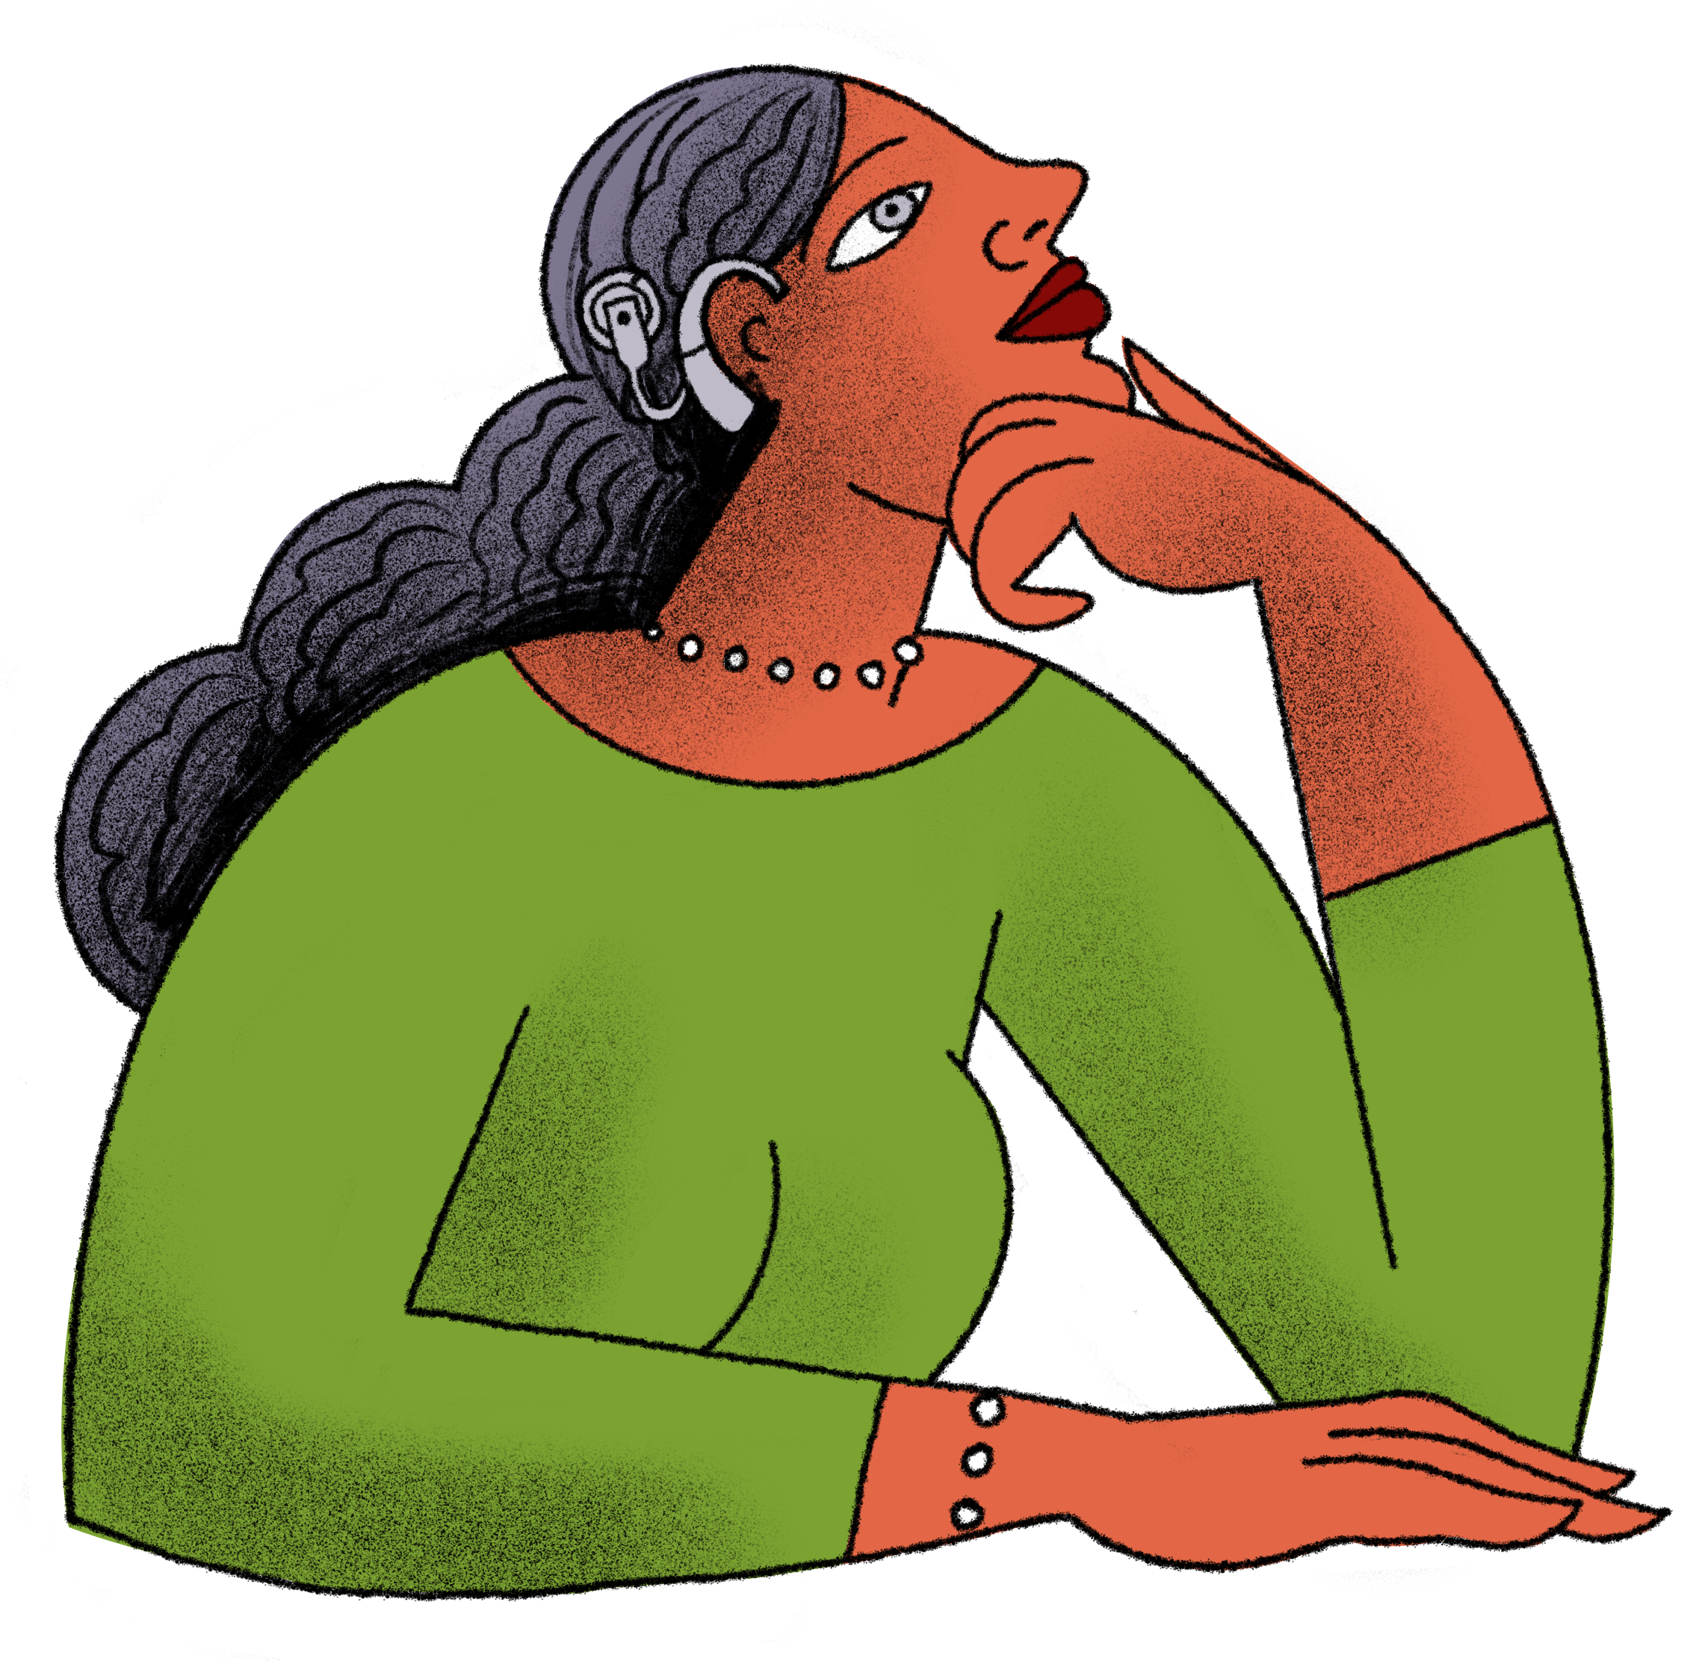
My Charity Commission Account
Notes:
It begins with a new service – My Charity Commission Account.
In time, this will allow each trustee to login to the Commission's services directly and individually.
I’d like to show you briefly what will be on offer down the line.

Slide 8
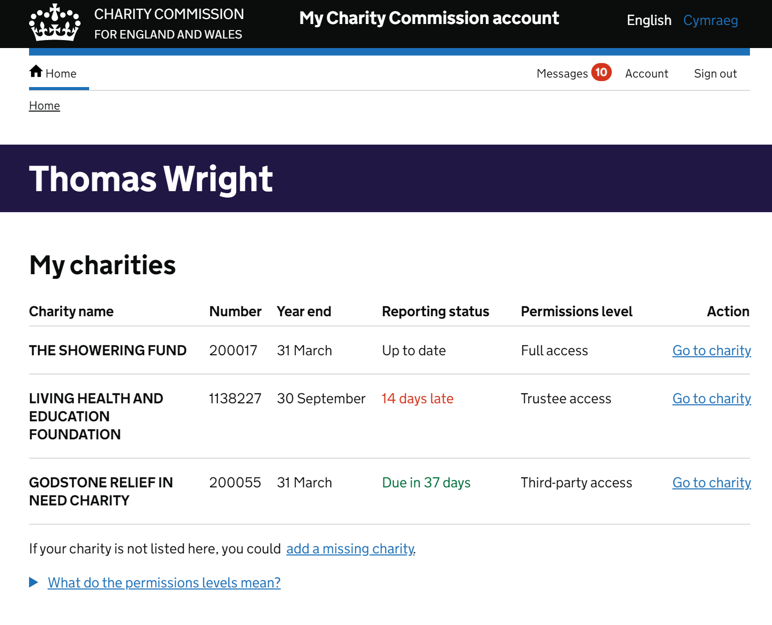
A better overview
Notes:
Please note these slides show proto-types – the final product may look a little different…
First – you’ll have a better overview of your charities and of our services than is available now.
As you can see here – our invented trustee Thomas is on the board of three charities – one of which is overdue in filing its annual information.
A personal log-in that gives an overview of all your charities also helps trustees take appropriate personal responsibility for shared duties such as filling information on time.
We know, from the same research I mentioned earlier, that many trustees do not realise that they are all individually and collectively responsible for these basic duties.
We hope this small but significant change will help trustees in meeting their duties.

Slide 9
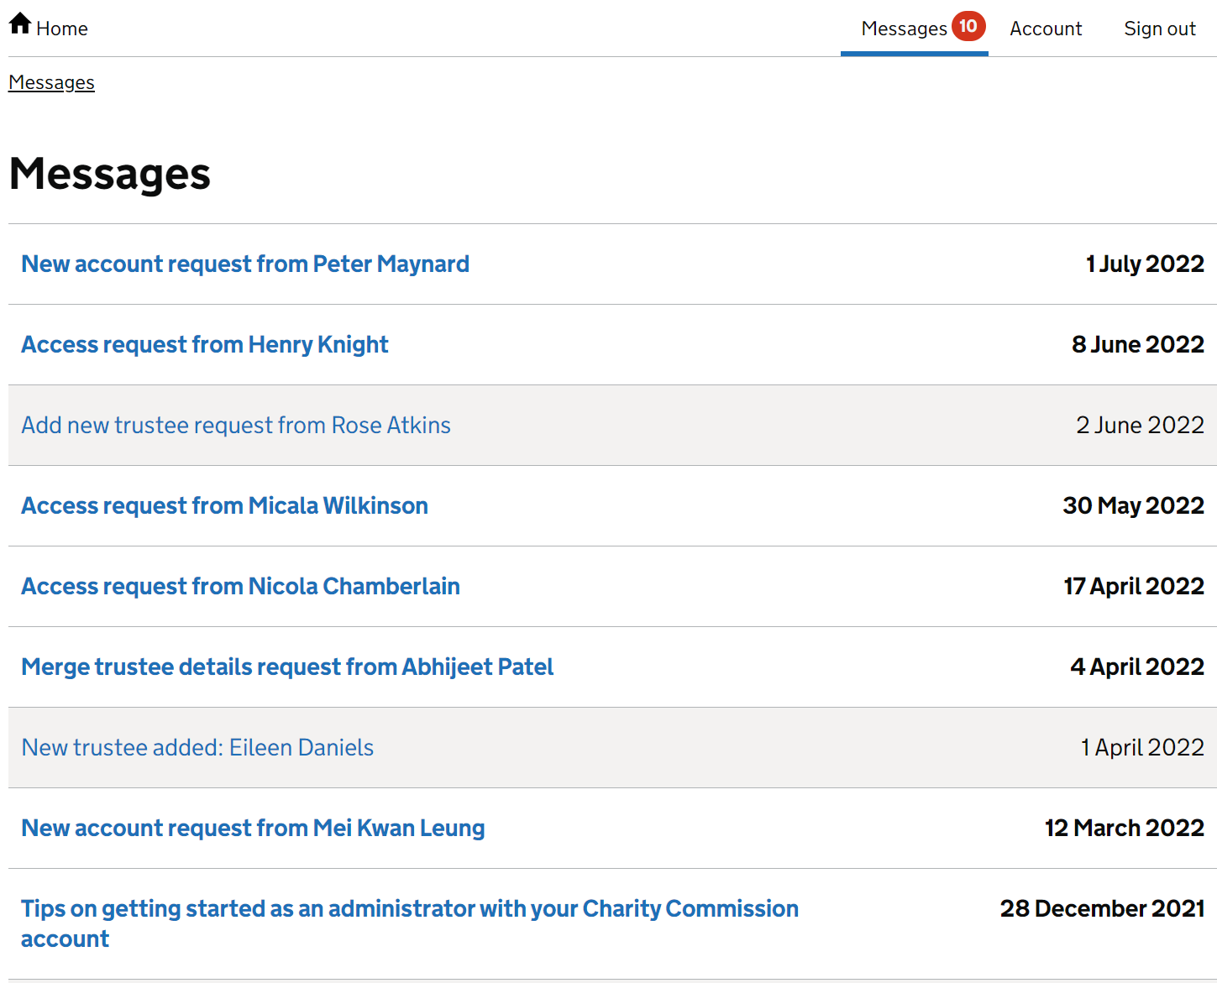
Your own personal inbox
Notes:
Trustees will also have a personal inbox, allowing them to see messages about our digital services in one place.

Slide 10
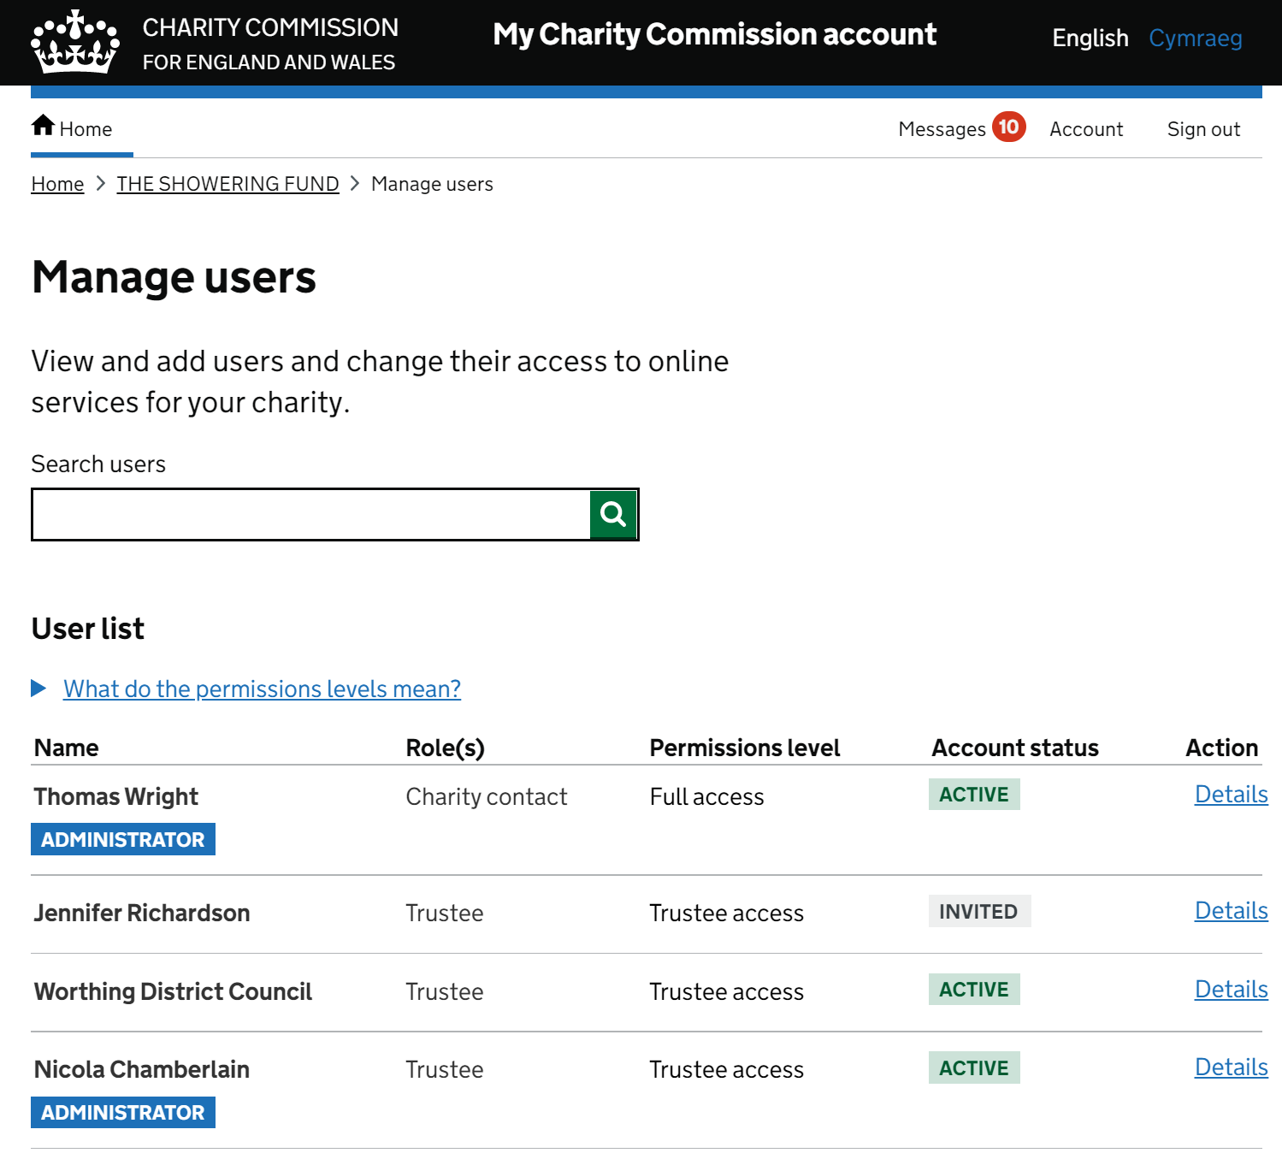
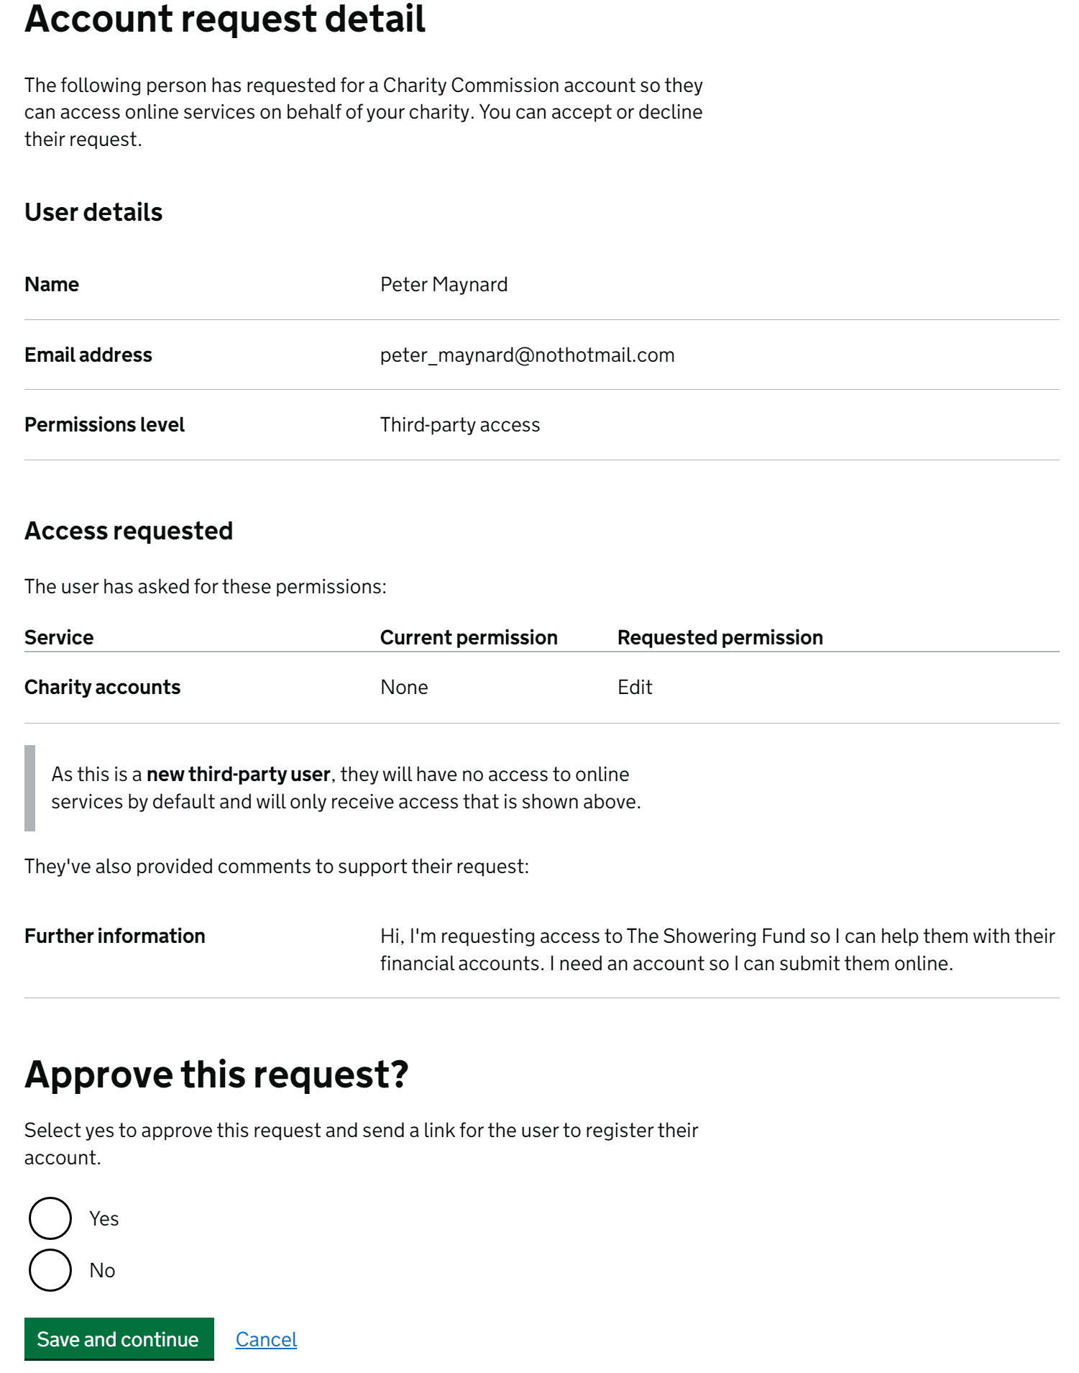
Ensure the right people have access
Notes:
Finally, the new system will give trustees a better sense of agency ensuring that all the right people – but only the right authorised people – have access to the ‘behind the scenes’ information about their charities.
From next month, we’ll begin the process of onboarding charities.

Slide 11
Charity contacts: sign up to My Commission Account
Notes:
We will begin by inviting registered contacts at charities to set up their accounts in readiness.
This will happen in stages.
Over the months ahead, we’ll be writing to all registered charity contacts.
If you are the main contact for a charity - please look out for that email, and set up your My Charity Commission Account when you receive it.
Once charities’ main contacts are onboarded and our new system is live, the process of inviting individual trustees will begin.

Slide 12
Is the right person registered as
your charity’s contact?
Notes:
In the meantime, a request to charities: please check the right person is listed with us as your main contact as charity contacts will play a key role in helping manage accounts for your charity – if not, please ensure your details are updated in the weeks ahead.
We are conscious that we’re asking charities to adjust to quite a significant shift in the long run.
This will be a gradual process. And while the My Charity Commission Account is in some ways a simple concept, but over time, and as we build functionality, it should transform our ability to reach individual trustees with helpful messaging, and make it more straightforward for trustees to interact with us.
For example, in ensuring their annual return and where appropriate their accounts are filed on time.

Slide 13
Annual return 2023
Becoming a data-driven regulator
Helping the public make informed choices
A richer understanding of the sector
Notes:
Which brings me on to a further change, namely to the annual return…
As many of you will know, we recently consulted on the annual return for 2023 onwards. I’ll come on to speak about the responses we have received in a moment.
A few words on why we are proposing changes. We have committed to becoming a more data-driven regulator, and that, of course requires us to capture the right data in a form that allows us to interrogate it. And there are wider purposes for the data we want to gather through the annual return too.
Including ensuring we hold and display information that encourages the public to use our register, and make good decisions about which charities to support.
Finally, the Commission is an authoritative source of information about charities.
We have the potential help policy-makers, researchers, the sector, and the public to gain a richer understanding of the sector in England and Wales…informing better policy making about charities that ultimately benefits the people charities serve.
We know charities are often concerned about a new Annual Return, and about potential increases in the regulatory burden.
We have aimed to ensure the time burden on charities in completing the return remains reasonable and proportionate while also being focused on our goal of becoming a more data-led regulator…

Slide 14
Annual return consultation
Thank you for taking part
460 responses received
Analysis now underway
Overall sentiment positive
Much for us to reflect on
Notes:
As I mentioned, the consultation on the Annual return for 2023 concluded in early September.
I’d like to again thank all those who made time to have their say…
We received over 460 responses to the consultation.
Overall, the sentiment was positive, but there is much for us to reflect on.
As expected, the way we proposed gathering additional data and its relevance to charities are prominent points in the feedback we received…
Separately, we’re grateful to the charities – over 270 – that helped us user test the proposed questions. This is an important part of ‘road testing’ the annual return, and is about getting a sense of how easy it is for trustees to understand the questions as drafted, and how comfortable they felt about being able to answer the questions. We’re now carefully assessing all of this feedback, and will publish a full response towards the end of the year.

Slide 15
Notes:
I’ve mentioned the importance of data in our work for the years ahead. This is why.
There are nearly 170,000 charities on our register, and it continues to grow. Over 8,000 organisations applied to register as a charity in 2021-22
The sector’s income last year reached 84 billion pounds. Charity spending also exceeded 80 billion pounds.
The value of charity cannot be measured in pounds and pennies alone.
But these figures nonetheless tell a story of the scale and reach of charities in our society and our communities

Slide 16
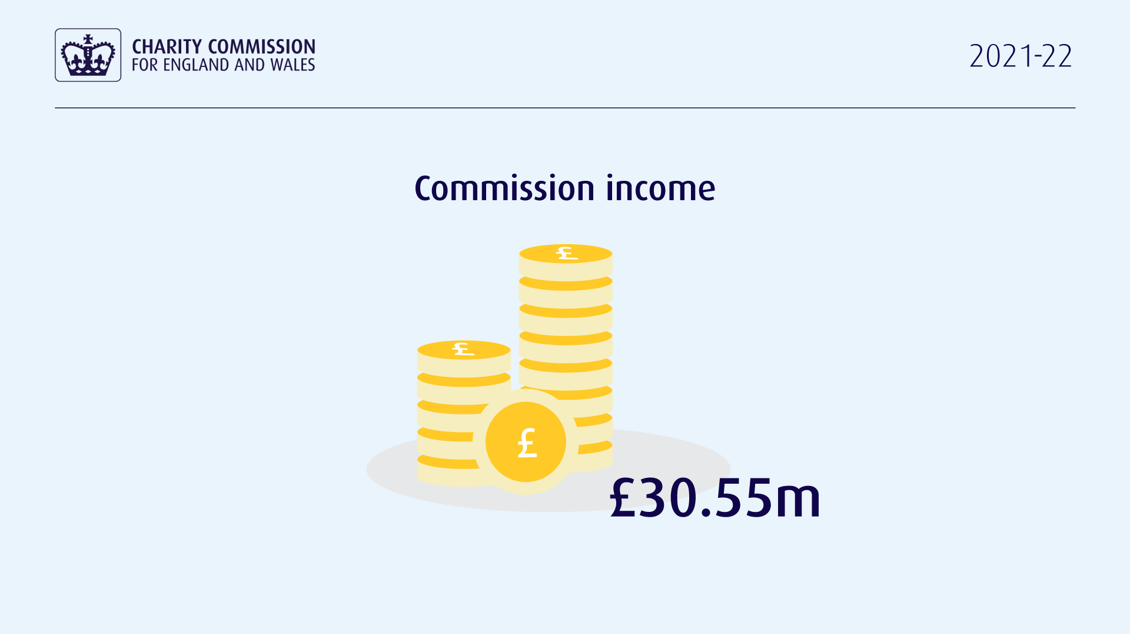
Notes:
But compared to the income and expenditure of the charities we regulate, the Commission’s own funding is small – we operate on around 30 million pounds.
We therefore have to punch well above our weight.
Just as Orlando pointed to the importance of prudence and efficiency in charities, we too need to ensure every pound we spend goes a long way in promoting compliance, and enhancing public trust.
Which is part of the reason we place such emphasis on better data, and is why we focus too on improved technology, and on helping trustees get it right, avoiding the need for us to intervene where there are concerns about mismanagement in the first place.

Slide 17
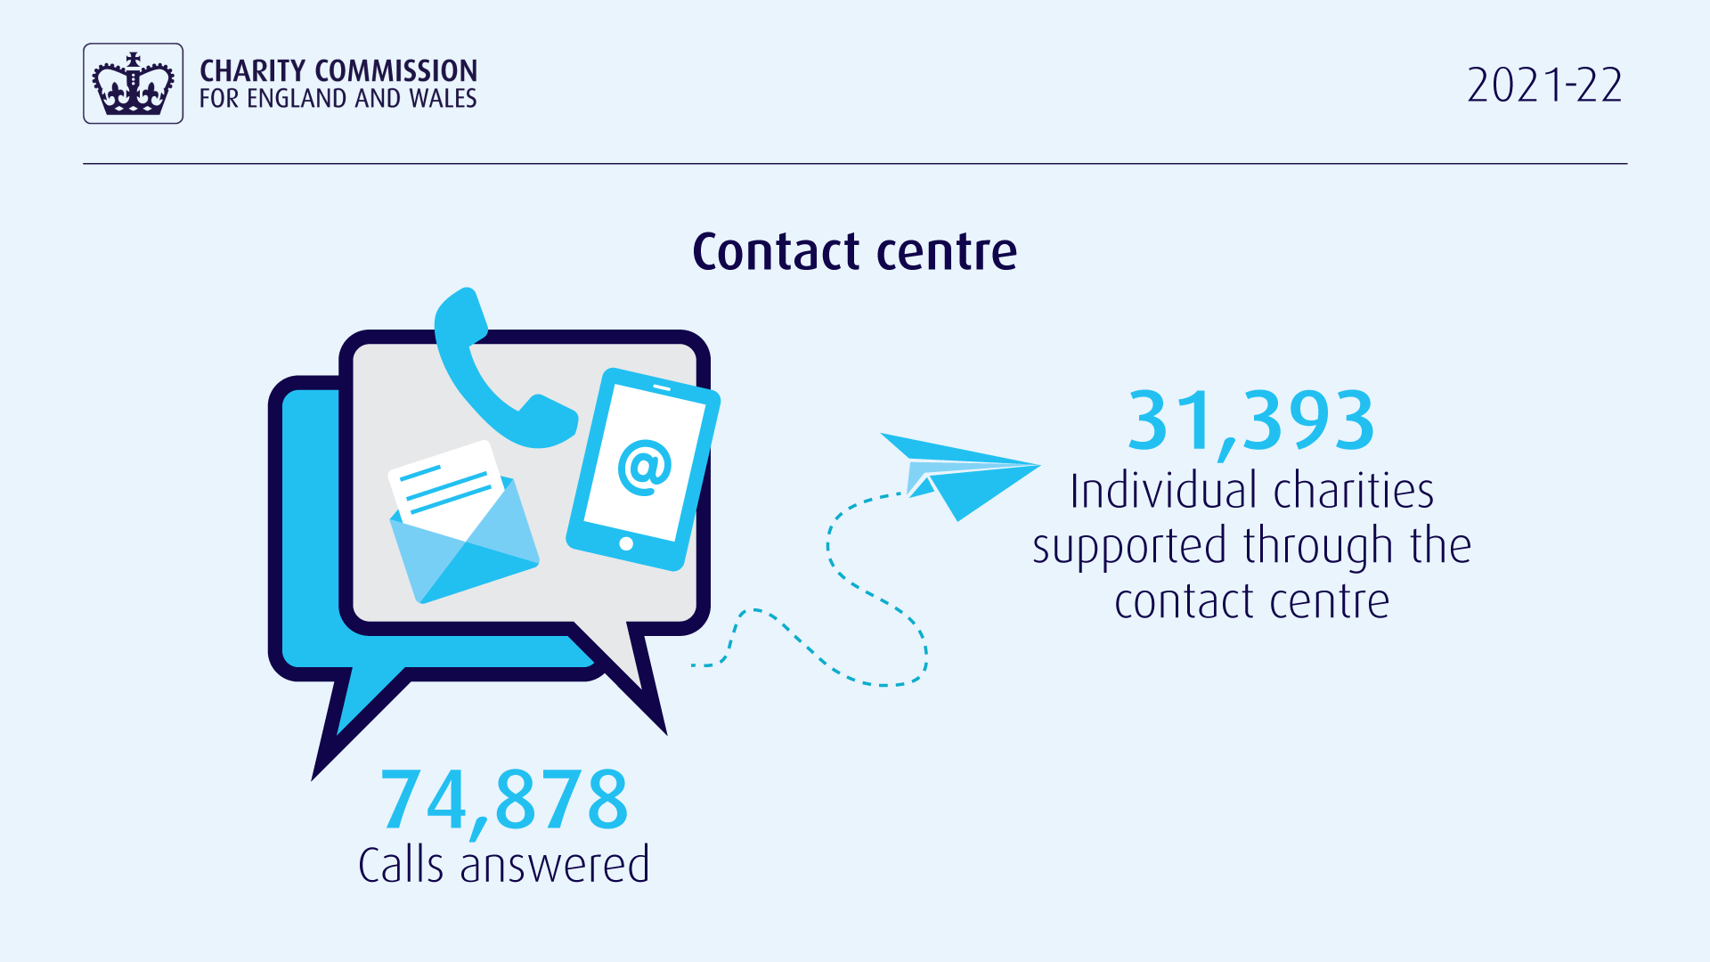
Notes:
This is also why our contact centre is so important.
Our contact centre is open on every working day of the year, and last year the team answered nearly 75,000 calls – 14,000 more than the year before – an incredible achievement by the team up in Bootle. Just the other month I sat in on calls to our contact centre and heard some of the issues worrying trustees…
Our contact centre team do a fantastic job, and I’d like to encourage trustees who need support or guidance to make use of the service they offer.

Slide 18
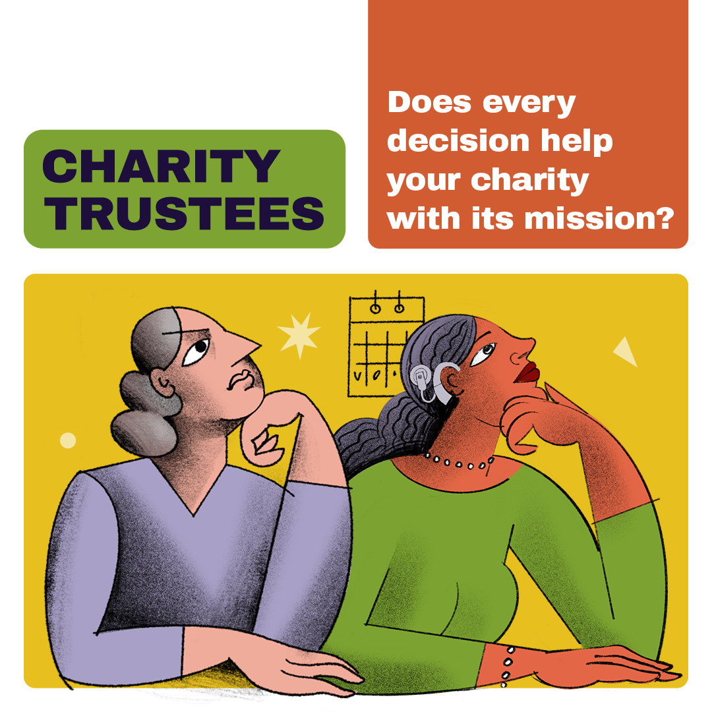
Notes:
The Contact Centre is a very important resource. Our online guidance equally so.
Orlando has mentioned our suite of 5-minute guides, which we have added to today, with the new guide on campaigning and political activity.
There are now 7 in the series, covering a range of core issues, from delivering on your charity’s purpose, to safeguarding.

Slide 19
5 minute guides
Trustees should all watch this.
That’s brilliant! @ChtyCommission 5 minute guides for charity #trustees have been enriched by a series of animated videos! Looking for more resources on #trusteeship? @CommFirstYorks @atrd_uk @TrusteeshipM @TrusteesUnltd @QueerTrustees @TrusteeWeek
These 5 minute reads from @ChtyCommission are really excellent. Share widely!
The Charity Commission has released some helpful guides aimed at supporting trustees. #Charities | #UKCharity | @ChtyCommission
This is excellent advice for trustees from @ChtyCommission
Notes:
The guides are designed as introductions to the core principles – they are not exhaustive and our longer form guidance remains important.
But they have been very well received by charities and trustees, indicating I think that there was a real gap in the market for concise, bite sized introduction to key aspects of trusteeship.
Here are just a few comments we’ve received from trustees.

Slide 20
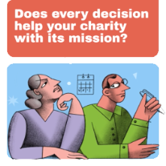
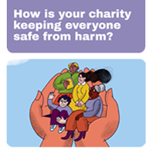
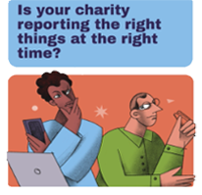
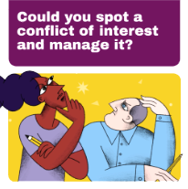
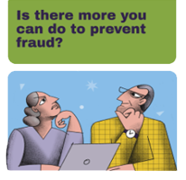
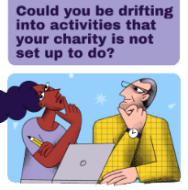
Trustee campaign
Notes:
Publishing guidance alone is not enough, however. We needed to help ensure trustees see the guidance, feel that it meets their needs, and go on to access it.
In future, we hope the My Commission Account will help ensure trustees have access to the right information, at the right time.
In the meantime, we have been running a campaign to reach trustees with thoughtful prompts designed to lead them to our guidance.
This is an example of a more proactive mindset, using advances in technology to bring our guidance and our messages to trustees, given that we know many trustees don’t automatically think of us when looking for help.
The campaign has been v successful – it reached over 2 million unique individuals with a connection to charities, between them seeing our content a total of more than 9 million times.
And among those who engaged with the 5 minute guides, 39% said they had taken some form of action as a result, for example raising the issue or guidance at a Board meeting.
Over all we’ve seen a significant increase in awareness of our five minute guides among trustees, and increases in the number of trustees accessing the guides.
This is all about supporting trustees to understand their duties, and get it right, reducing the risk of problems in charities, by proactive prevention.

Slide 21
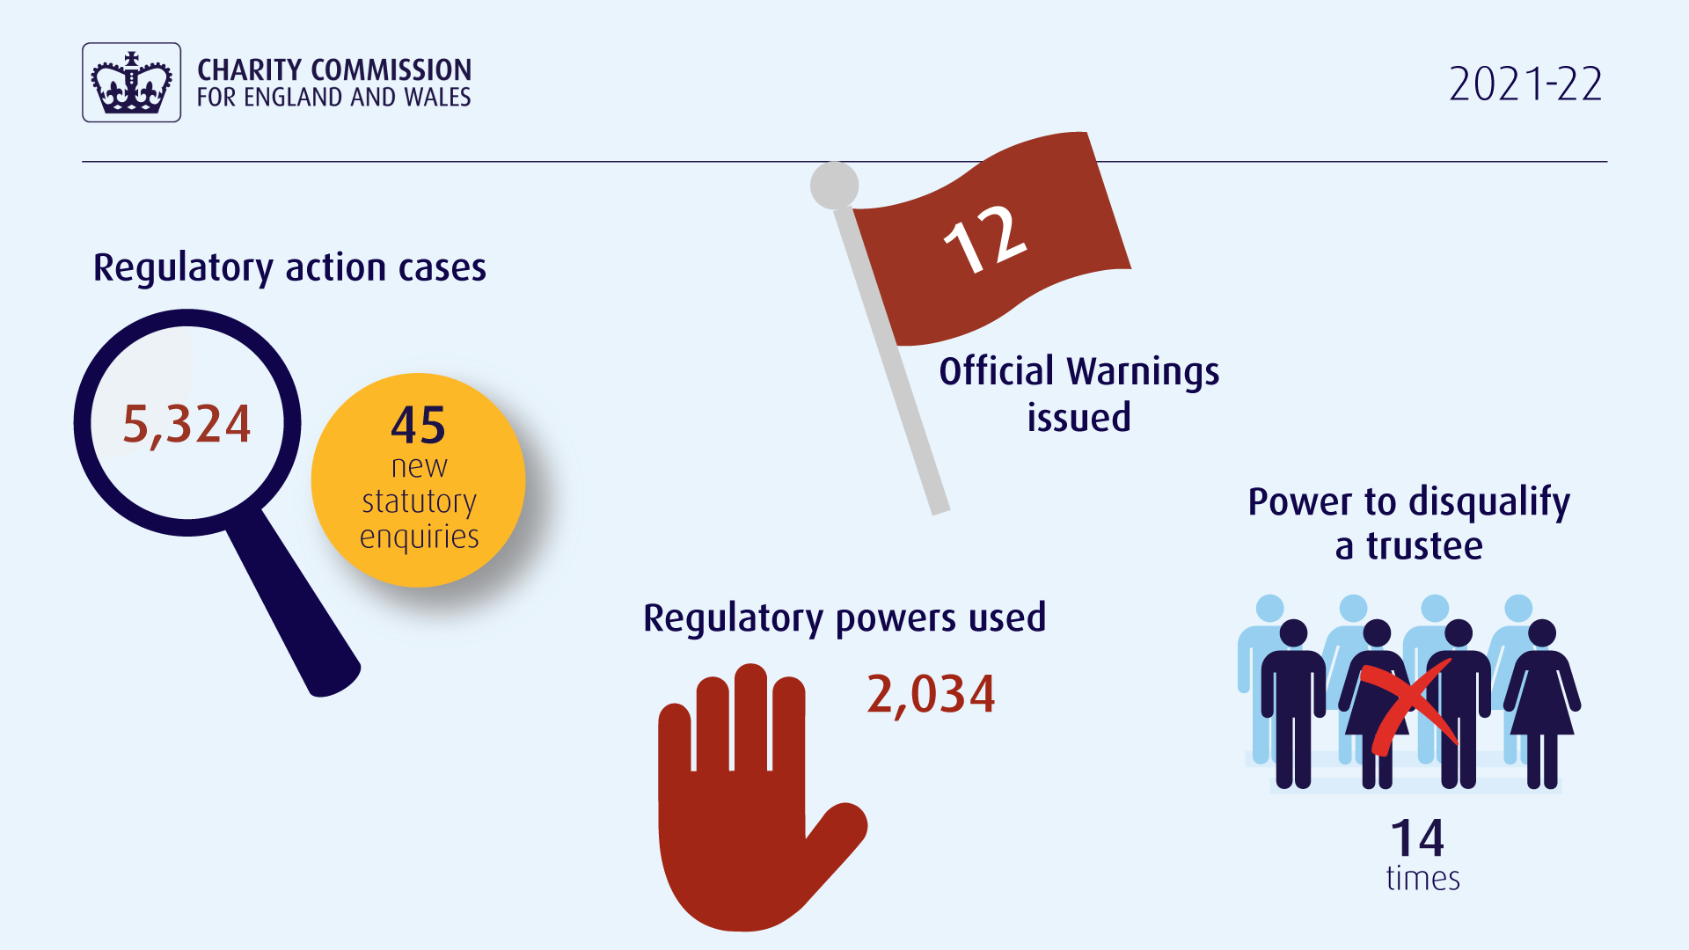
Notes:
But there are times when our role as regulator is to be robust, to take action in response to concerns about wrongdoing in individual charities.
Sometimes we need to use our powers to ensure wrongdoing ends, and to prevent further problems in a charity.
Occasionally, we disqualify trustees, ensuring that those who have harmed one charity, are prevented from senior involvement in another.
We also know that the use of our powers helps promote public trust in charities.
Here is just an overview of our regulatory interventions this past year: You’ll see that we opened over 5,000 regulatory action cases last year, of which 45 were formal statutory inquiries.
Overall we used our regulatory powers on over 2,000 occasions. Including by issuing 12 official warnings against charities or charity trustees, and using our power to disqualify trustees 14 times.

Slide 22
Notes:
Over the course of the year, we also received over 3,400 serious incident reports from charities.
While this is a reduction on reports received in 2020-21, which of course was the year of the pandemic, longer term, we have seen a considerable increase in serious incident reporting by charities.
This is a good sign.
We do not want things to go wrong in charities, but increased reporting is in fact an indication that trustees have systems in place to spot incidents, and often indicates that they are responding appropriately and managing risks.

Slide 23
Impact of our work
Impact of our work
Frank Wingett Cancer Relief
Funds raised by community to support those with cancer
Monies misused
Commission finds misconduct and mismanagement and disqualifies sole trustee
Judge orders former trustee ordered to repay £117k
Funds to be distributed to support cancer patients in / around Wrexham
Notes:
This is one example of our compliance case work in Wales, involving a former charity - Frank Wingett Cancer Relief. You may have read about this case in the news, as its outcome was widely reported a few weeks ago.
The charity was set up to support those with cancer in and around Wrexham, and people locally gave generously.
Unfortunately, the charity’s former trustee betrayed that trust, and instead of applying funds as he should have, spent monies supposedly in aid of building a giant – 200ft sculpture of a dragon.
We took firm action – we disqualified the sole trustee, and pursued the restitution of funds through the courts. A few weeks ago, the courts ordered the sole trustee to repay over one hundred thousand pounds, which once recovered, we will distribute in furtherance of this charity’s original cause.
My message to that very small proportion of people who may wish to misuse charity for their own ends, or their own gain: we will take action, including to retrieve funds that you do not rightly hold, and this case shows that the courts are prepared to make firm judgements too.

Slide 24
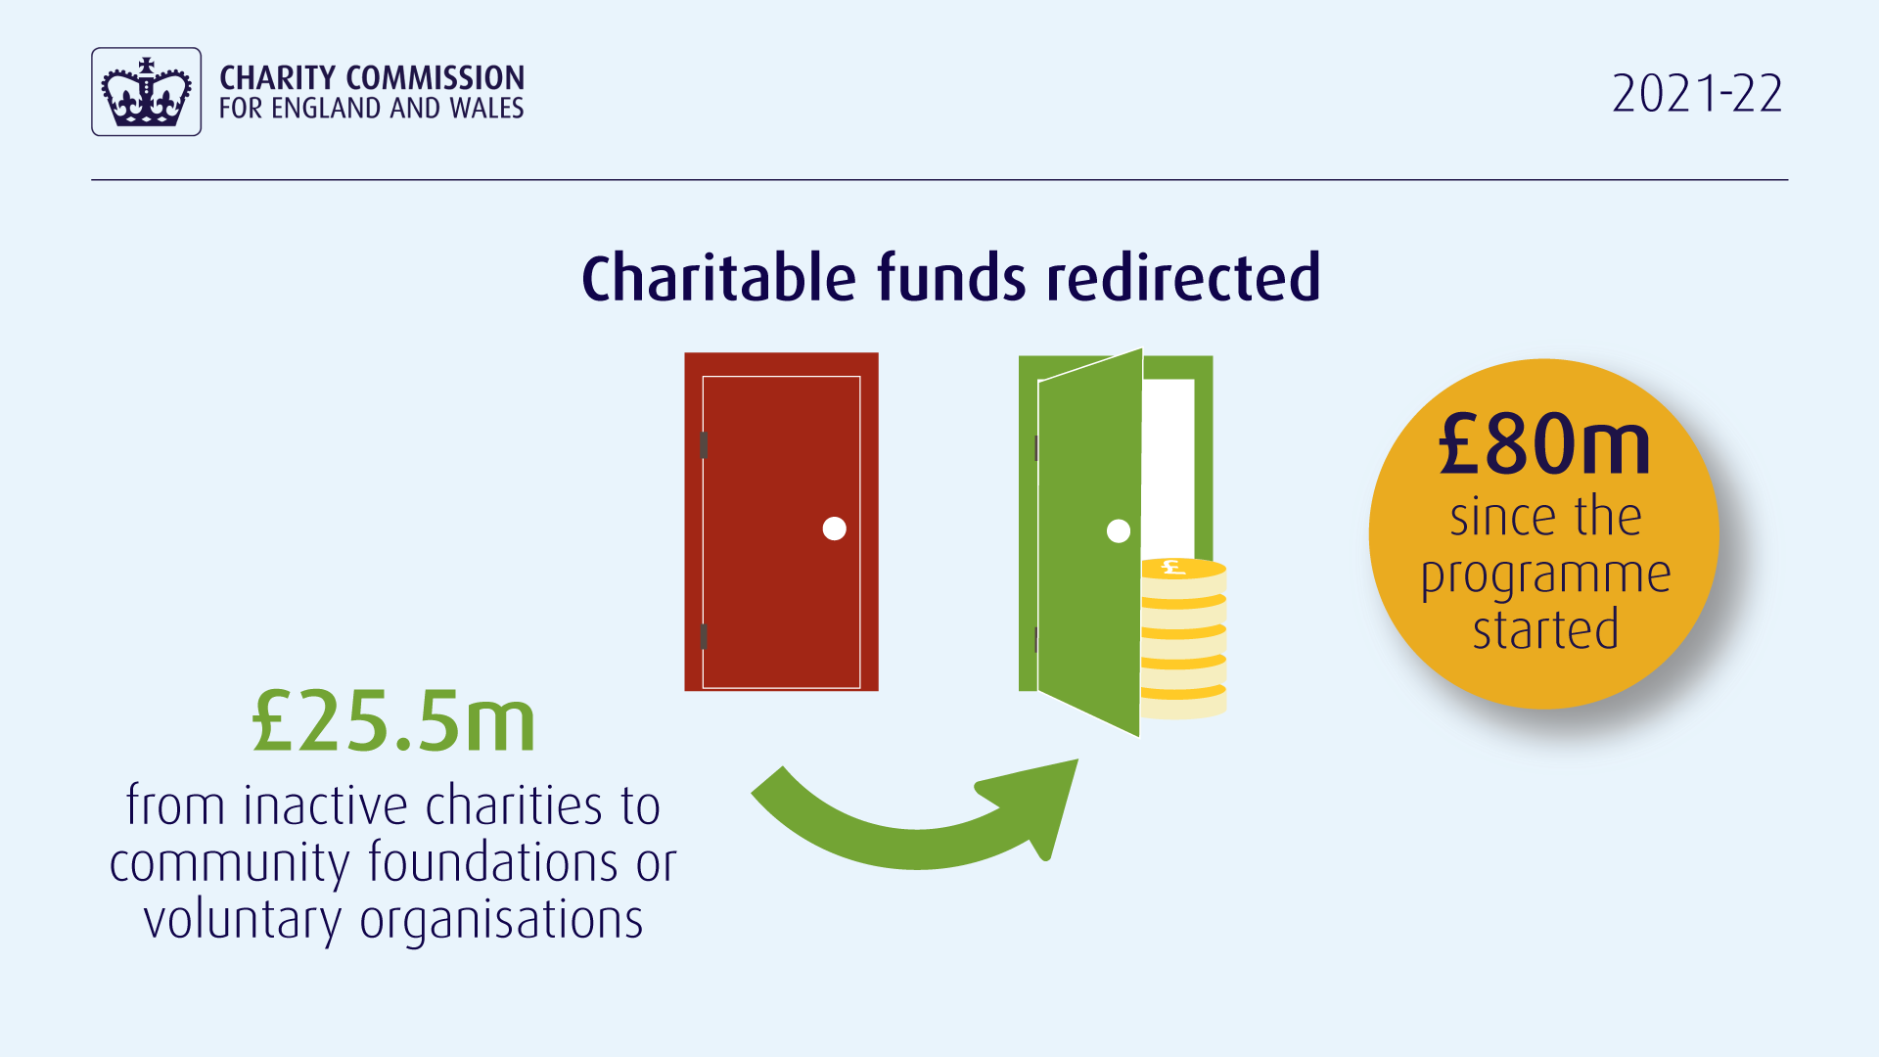
Notes:
I would like to end on a more uplifting note, namely on our work to help revitalise dormant charities and charitable assets.
This is one of the most inspiring areas of our work, which involves a collaboration between ourselves government, and the family of community foundations in Wales and England.
The programme is about encouraging trustees of inactive charities to come forward for support to put their charitable funds to good use.
It’s been really successful in England – in total since the programme began we have helped revitalise an extraordinary eighty million pounds in charitable assets – last year alone we released more than 25 million pounds. And in total, over the lifespan of the programme so far, we have helped release and repurpose 80 million pounds.

Slide 25
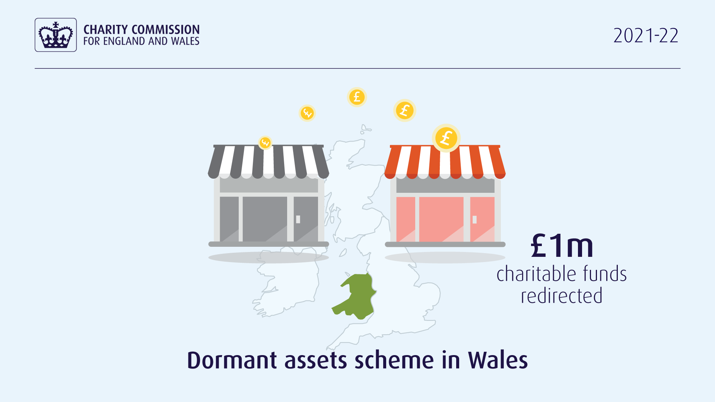
Notes:
I’m really pleased to announce today that the programme in Wales has now released one million pounds in dormant funds.
While I’m delighted about this milestone, we still have a long way to go.
We want to free up many more millions of dormant charitable assets in Wales. I want communities in Wales to receive the same benefits from this project as those in England have.
This work would be worthwhile during more certain times. But in the current economic climate, during a cost-of-living crisis, it’s absolutely vital. Charitable funds must be used to their full potential, to help improve lives and strengthen communities.
So please contact us, or Community Foundations Wales, if you’re struggling to make use of your assets, or to recruit trustees, or if you’re stuck for any other reason.
We want to help you make the greatest possible difference – and if that’s not possible, we want to help ensure any funds you hold benefit the people and causes you serve and care about.

Slide 26
Any questions?
Online delegates: Submit your question via Slido
In-person attendees: raise your hand
Notes:
That brings me to the end of my presentation today.
Thank you for listening. Diolch am wrando [Dee-olch am rando].

