Slide 1
Covid-19 Communications Toolkit
For Further Education Providers in England
September 2021

Slide 2
Contents
    Introduction……………………….............Slide 3
    Tips to Communicate Strategically........Slide 4
    Communications Assets.........................Slide 5
    Student Covid-19 vaccination………… .Slide 6
    Student Covid-19 testing………………...Slide 11
    Contact Information…….........................Slide 14
    Annex A – List of Resources..................Slide 15

Slide 3
Covid-19 Communications Toolkit
Introduction
The purpose of this toolkit is to help and support Further Education (FE) providers across England, with the latest information, key messages and links to communication material and resources. Ensuring that your students are fully aware of the latest Covid-19 guidance on testing and vaccination and to help amplify these messages to a wide student audience.
Education settings like yours have a vital role to play in supporting young people and harder-to-reach audiences understand the value of testing and vaccination in managing coronavirus.
We appreciate any work you can do to increase take up of the vaccine and testing. This will ensure that, your work will complement the national vaccination and testing campaigns by the Department for Health and Social Care. Find out more on the NHS England website and use the national campaign assets to speak to young people about the vaccine.

Slide 4
Student Covid-19 Comms
Tips to communicate strategically:
Make it timely and frequent – early comms intervention so students understand testing and covid measures and communicate regularly so expectations become embedded across the student and staff body.
Engage students via trusted sources - utilise staff with health and wellbeing roles to reinforce messaging and try to avoid generic admin emails; instead, send messages via tutors, course leaders with the emphasis on the benefits, using positive language, signposting to trusted information sources etc.
Repeat communications across multiple channels - for example, emails, text message reminders, and social media platforms using positive language.
Locally driven communications and peer to peer messaging – encourage use of student voices and blogs, use of the influence of parents/carers.
Make communications inclusive – consider translation of key messages and segmentation for different cohorts, awareness of beliefs, specific to activities sport, social, etc to avoid messaging fatigue.
Focus on positive narratives – include thanks within messaging or in materials on display.

Slide 5


Communications Assets
A range of communications assets have been produced to help education providers communicate these important Covid-19 messages to their students.
These include:
  Posters
  Social media animations
  Postcards
These assets are available to download for free here and cover a range of topics including vaccination and testing.
Please make use of these and share these through your own student-facing channels.
We continue to update these resources as new assets become available to reflect any changes to messaging or guidance.
Other ways you can support students to make an informed choice: Consider having a staff ambassador – someone that can be available to students who need support or have questions, share student stories, link with your local health team for help and support.

Slide 6
Vaccination – Who is eligible?
The following groups are eligible for 2 doses of the COVID-19 vaccination;
Those aged 18 and over
those aged 12 and above with specific underlying health conditions which put them at higher risk of serious COVID-19 complications
those aged 12 and above who are healthy but are household contacts of individuals who are immunosuppressed
students aged 16 to 17 years who are employed in, studying or in training for health and social care work
All those aged 12 to 17 are eligible for 1 dose of the COVID-19 vaccination.
There are several ways individuals can access a Covid-19 vaccine:
students aged 16+ can now use the National Booking Site to book their vaccinations.
those registered with a GP should also have received an invitation to be vaccinated from their GP practice.
at walk-in centres or pop up clinics (many are accepting 16 and 17 yr olds with more being added, check the NHS Find a walk in vaccination site finder tool)
at local sites run by GPs or community pharmacies
at larger vaccination centres and in some hospitals
For 12-15 yr olds the local school age immunisation service (SAIS) provider will have plans in place to offer vaccination to these children.

Slide 7
Vaccination- Key messages
Why vaccination is important
  Protect yourself and others. Many people have conditions that make them highly vulnerable to Covid-19. By getting the vaccine, not only are you protecting yourself, but are helping to protect your family and friends
  Reduce your risk of getting Covid. Research shows that as well as reducing the risk of catching or spreading Covid-19, the vaccine also reduces the risk of getting seriously ill if you catch it.
  Help your learning. By reducing your risk of catching or spreading Covid, you are helping to keep colleges open so that your education is less likely to be affected by colleges being closed or activities restricted.
  Continue to do the things you enjoy. Once you are vaccinated, you can feel confident that you've protected yourself and those around you in the best way possible.
  And remember
  Even if you have tested positive for Covid-19, it is still important to get vaccinated. While some people may develop natural immunity to the virus, we don't know how long this lasts or how well you are protected. The vaccine offers much more reliable protection.
  If you are aged 16 or 17 and doing a health or social care course you are eligible for two doses of the vaccine. By being fully vaccinated, you can do your work placements and complete your course.

Slide 8



Student Covid-19 Vaccination
The key vaccination messages that we recommend using with your students are:
It's easy to 'grab a jab' and get back to enjoying the activities you've missed, confident that you are protected
Protect those you love from Coronavirus by getting the jab today
Keep yourself and your friends and family safe by getting vaccinated
Grab a jab and make the most of your time at College
Vaccines have saved tens of thousands of lives and prevented millions of infections, so join the millions who have already received their vaccine.
Resources
There are various resources to support you to encourage vaccine uptake. Please make use of Public Health England’s vaccine communications assets when considering vaccine messaging. These include posters that can be displayed in your physical and virtual spaces, voice clips that can be included on student radio channels and short video clips you can include in your start of term and enrolment packs.
The Q&A for students in higher education institutions produced by NHS England may also be useful.
Key Messages

Slide 9
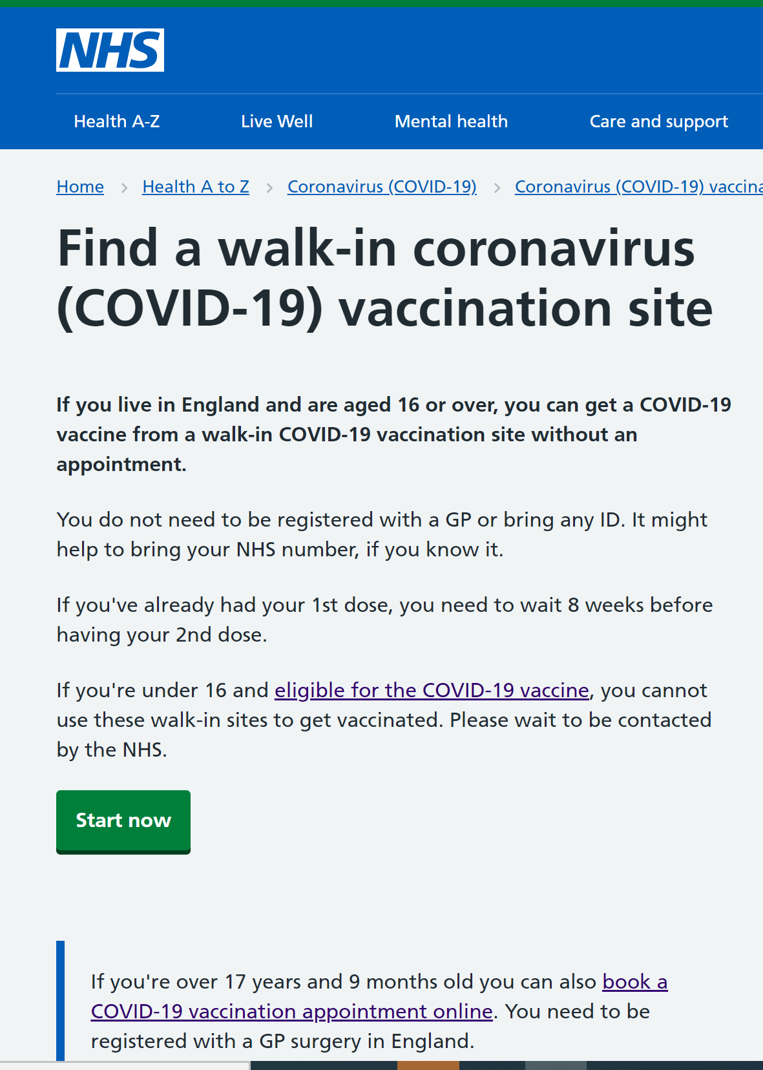
Local Temporary Vaccination Clinics
NHS England via their local Health Protection Teams (lHPT) are setting up local walk in and pop up clinics which your students and staff may be able to access. Details of these can be found on the NHS Find a walk in vaccination site finder tool. Encourage your students and staff to check the site regularly as new clinics are being added all the time.
Alternatively, local areas may also work with partners to set up ‘pop up’ temporary clinics at locations convenient for students to access. Your local Health Protection Team make decisions on vaccination and will advise if fits local need.

Slide 10
Vaccination - Health and Social Care Students
16 and 17 year olds working or studying in health and social care settings are still eligible for two doses of the vaccination.
It is essential that students are made aware that for many placements there will be a requirement from the employer that they are double vaccinated. See ACAS Getting the coronavirus (COVID-19) vaccination for work advice.
In some cases this will be mandatory following legislation coming into effect 11 November – see Guidance: Vaccination of people working or deployed in care homes.
It is advised that providers discuss with employers what their expectations are for students and vaccination status.
Consider including information on employer vaccination expectations in course details so students can make informed choices

Slide 11
Student Covid-19 Testing
On arrival at college, students should take two lateral flow antigen (LFD) tests at an on-site testing facility.
They should then continue to test and report twice a week, either using home test kits or at an on-site facility.
This is to reduce the risk of transmission to support the return to education following the summer where students will potentially mix with lots of other people.
Students at independent training providers and adult community learning providers should continue to use their home test kits when they are attending their provider onsite, twice every week, 3-5 days apart. There is no need for FE providers to test staff/students that already have access to rapid testing, for example through their workplace.
It is very important that, when testing at home, test results are reported online to NHS Test and Trace whether positive, negative or void. Reporting results helps the NHS monitor the spread of the virus, combat the virus and save lives.
If a student has had a confirmed polymerase chain reaction (PCR) test for COVID-19 in the last 90 days, they do not need to take a test within that time period if they are asymptomatic. They are still required to follow the national guidance for adults who have been identified as a close contact of a positive COVID-19 case, even if this is within the 90-day window.

Slide 12
Student Covid-19 Testing
After students have completed their initial two on-site tests, FE providers are encouraged to maintain facilities for supervised on-site testing so that students who are unable or do not wish to test at home may participate in regular testing.
If students know they are going to be tested using an LFD on-site, they should consider how they will travel back home in a way that protects others in case they should test positive.
While awaiting their result (typically it takes 30 minutes), the student or staff member should not interact with other students to avoid virus transmission.
Test results
For an assisted LFD test taken on-site: Upon notification of a positive LFD test result, individuals are legally required to self-isolate immediately on the day of the test and for at least the following ten full days and contact tracing will be initiated. Following a positive LFD test result, students and staff should take a follow-up polymerase chain reaction (PCR) test as soon as possible. If a student or staff member takes a PCR test within 2 days of the LFD test and receives a negative result, they and their household can stop self-isolating. However, self-isolation must continue if:
  the PCR test result is positive
  no follow-up PCR test is taken
  the PCR test result is negative but the test was taken more than 2 days after the LFD test
For an LFD test conducted at home: Upon notification of a positive LFD test result from a test taken at home, students and staff should self-isolate immediately and take a follow-up polymerase chain reaction (PCR) test as soon as possible. If the PCR test result is positive students and staff are then legally required to self-isolate and continue to do so for at least the following ten full days. Contact tracing will also be initiated at this point.

Slide 13
Student Covid-19 Testing
Why testing is important
  About 1 in 3 people with Covid-19 do not have any symptoms. LFD tests can detect the virus in people without symptoms and prevent them unknowingly passing it on to others.
  By identifying more people with the virus we can better mitigate the transmission of Covid-19 which will help protect your friends and family - and will allow your education to continue uninterrupted.
  Lots of people taking LFD tests allows us to detect positive cases, take quick action to prevent the spread of coronavirus and break chains of transmission.
  LFDs have been through a rigorous validation programme. Evaluations from Public Health England and the University of Oxford show these tests are accurate and sensitive enough to be used in FE.
  Antigen LFD tests are highly specific, meaning that only a small proportion of people who do not have coronavirus will receive a positive result.
  More information about understanding lateral flow antigen testing for people without symptoms is available on www.gov.uk/coronavirus.
  You can access a useful video explainer to help with communications around home testing/LFD collect here.

Slide 14
How FE Providers are encouraging Testing Participation
We have collected and shared examples of initiatives and strategies that have worked well for FE providers in delivering testing and driving up participation.
We understand that the way FE providers operate vary significantly. Here are some principles that have been successfully applied across a wide variety of education settings:
Be Creative
  Creating videos of the head or student representatives about why testing is important can be more engaging and accessible for some audiences.
  Share and encourage your students to post photos and videos of them self-testing on social media.
  Digital systems to allow students and staff to raise any issues or concerns relating to Covid and testing.
  Regular blogs to reinforce why testing and reporting negative, void and positive results is important.
  Collaborate with local media, including newspapers and radio, to encourage testing in the local area.
Leadership
  Senior leadership teams clearly conveying the importance of testing and reporting helps ensure it remains a high priority.
  Some leadership teams have established a cross organisation group that meets regularly to identify how to maintain and engage students in home testing and reporting.
  Others have worked closely with strategic partners, such as their local authority and Director of Public Health, to regularly discuss covid related issues, including testing.

Slide 15
How FE Providers are encouraging Testing Participation
Regular and ongoing monitoring and support
  Some FE providers have offered pastoral support to those who are reluctant to test through several strategies, including:
  Creating a peer-to-peer network for students and staff who are nervous about testing.
  Setting up a dedicated college Covid helpline for students to offer ongoing support.
  Identifying student testing champions to engage students and promote the value and benefit of testing.
  Some providers have developed bespoke reporting methods (e.g. creating college Apps for reporting) to make it as convenient as possible for learners and record their test results. This has been supported by proactive communications with those students who are not reporting any results.
  Some FE providers have developed targeted comms to students and parents to address misinformation relating to testing.

Slide 16
For more information
If you have any questions regarding this toolkit,
or require any more information,
please email:
COMMSPOST16&SKILLS@education.gov.uk

Slide 17
Annex A - List of Resources
NHS England website
Schools and College Toolkits – Coronavirus Resource Centre (phe.gov.uk)
national campaign assets/ vaccine communications assets
Vaccination
National Booking Site
NHS Find a walk in vaccination site finder tool
Find your local health protection team
Q&A for students (This is a Higher Education Q&A which with relevant info for all students)
Vaccination of people working or deployed in care homes
ACAS Getting the coronavirus (COVID-19) vaccination for work
https://www.youtube.com/watch?v=whbTdkj39sA
Testing
Step by step guide to Covid-19 testing (YouTube)
Twice-weekly Testing Poster
Further Education and Schools Testing FAQs
ACLPs and ITP Testing FAQs
Volunteer Workforce Support for Schools and Colleges
Further Education and Schools Testing Guidance Manuals
Report a COVID-19 rapid lateral flow test result
Get a free PCR test to check if you have coronavirus (COVID-19)
Evaluations from Public Health England and the University of Oxford
More information about understanding lateral flow antigen testing for people without symptoms is available on www.gov.uk/coronavirus.

